Slide 1


Apache Cassandra 3.x

Slide 2


Table of Contents
Quick Start: 3
Cassandra Architecture: 39
Effective CQL: 86
Configuring a Cluster: 215
Performance Tuning: 273
Managing a Cluster: 310
Monitoring: 358
Application Development:
Integration with Apache Spark:

Slide 3
1. Quick Start

Slide 4
Quick Start
In this lesson, we will cover the following topics:
Introduction to Cassandra
Installation and configuration
Starting up and shutting down Cassandra
Cassandra Cluster Manager (CCM)
Notes:
Welcome to the world of Apache Cassandra! In this first lesson, we will briefly introduce Cassandra, along with a quick, step-by-step process to get your own single-node cluster up and running. Even if you already have experience working with Cassandra, this lesson will help to provide assurance that you are building everything properly. If this is your first foray into Cassandra, then get ready to take your first steps into a larger world.
By the end of this lesson, you will have built a single-node cluster of Apache Cassandra. This will be a good exercise to help you start to see some of the configuration and thought that goes into building a larger cluster. As this lesson progresses and the material gets more complex, you will start to connect the dots and understand exactly what is happening between installation, operation, and development.

Slide 5

Introduction to Cassandra
Apache Cassandra is a highly available, distributed, partitioned row store.
It is one of the more popular NoSQL databases used by both small and large companies all over the world to store and efficiently retrieve large amounts of data.
Notes:
While there are licensed, proprietary versions available (which include enterprise support), Cassandra is also a top-level project of the Apache Software Foundation, and has deep roots in the open source community. This makes Cassandra a proven and battle-tested approach to scaling high-throughput applications.

Slide 6
High availability
Depending on the Replication Factor (RF) and required consistency level, a Cassandra cluster is capable of sustaining operations with one or two nodes in a failure state.
For example, let's assume that a cluster with a single data center has a keyspace configured for a RF of three.
This means that the cluster contains three copies of each row of data.
If an application queries with a consistency level of one, then it can still function properly with one or two nodes in a down state.
Notes:
Cassandra's design is premised on the points outlined in the Dynamo: Amazon's Highly Available Key-value Store paper (https://www.allthingsdistributed.com/files/amazon-dynamo-sosp2007.pdf). Specifically, when you have large networks of interconnected hardware, something is always in a state of failure. In reality, every piece of hardware being in a healthy state is the exception, rather than the rule. Therefore, it is important that a data storage system is able to deal with (and account for) issues such as network or disk failure.

Slide 7
Distributed
Cassandra is known as a distributed database.
A Cassandra cluster is a collection of nodes (individual instances running Cassandra) all working together to serve the same dataset.
Nodes can also be grouped together into logical data centers.
Notes:
This is useful for providing data locality for an application or service layer, as well as for working with Cassandra instances that have been deployed in different regions of a public cloud.
Cassandra clusters can scale to suit both expanding disk footprint and higher operational throughput. Essentially, this means that each cluster becomes responsible for a smaller percentage of the total data size.

Slide 8
Distributed
Assuming that the 500 GB disks of a six node cluster (RF of three) start to reach their maximum capacity, then adding three more nodes (for a total of nine) accomplishes the following:
Brings the total disk available to the cluster up from 3 TB to 4.5 TB
The percentage of data that each node is responsible for drops from 50% down to 33%
Notes:
Additionally, let's assume that before the expansion of the cluster (from the prior example), the cluster was capable of supporting 5,000 operations per second. Cassandra scales linearly to support operational throughput. After increasing the cluster from six nodes to nine, the cluster should then be expected to support 7,500 operations per second.

Slide 9
Partitioned row store
In Cassandra, rows of data are stored in tables based on the hashed value of the partition key, called a token.
Each node in the cluster is assigned multiple token ranges, and rows are stored on nodes that are responsible for their tokens.
Notes:
Each keyspace (collection of tables) can be assigned a RF. The RF designates how many copies of each row should be stored in each data center. If a keyspace has a RF of three, then each node is assigned primary, secondary, and tertiary token ranges. As data is written, it is written to all of the nodes that are responsible for its token.

Slide 10
Installation
The following are the requirements to run Cassandra locally:
A flavor of Linux or macOS
A system with between 4 GB and 16 GB of random access memory (RAM)
A local installation of the Java Development Kit (JDK) version 8, latest patch
A local installation of Python 2.7 (for cqlsh)
Your user must have sudo rights to your local system
Notes:
To get started with Cassandra quickly, we'll step through a single-node, local installation.
Note
While you don't need to have sudo rights to run Apache Cassandra, it is required for some of the operating system configurations.
Note
Apache Cassandra 3.11.2 breaks with JDK 1.8.0_161. Make sure to use either an older or newer version of the JDK.

Slide 11
Installation
Head to the Apache download site for the Cassandra project (http://cassandra.apache.org/download/), choose 3.11.2, and select a mirror to download the latest version of Cassandra.
When complete, copy the .tar or .gzip file to a location that your user has read and write permissions for.
This example will assume that this is going to be the ~/local/ directory:
mkdir ~/local
cd ~/local
cp ~/Downloads/apache-cassandra-3.11.2-bin.tar.gz .

Slide 12
Installation
Untar the file to create your cassandra directory:
tar -zxvf apache-cassandra-3.11.2-bin.tar.gz
Some people prefer to rename this directory, like so:
mv apache-cassandra-3.11.2/ cassandra/

Slide 13
Configuration
cassandra.yaml
It is usually a good idea to rename your cluster. Inside the conf/cassandra.yaml file, specify a new cluster_name property, overwriting the default Test Cluster:
cluster_name: 'PermanentWaves’
The num_tokens property default of 256 has proven to be too high for the newer, 3.x versions of Cassandra.
Go ahead and set that to 24:
num_tokens: 24
Notes:
At this point, you could start your node with no further configuration. However, it is good to get into the habit of checking and adjusting the properties that are indicated as follows.

Slide 14

Configuration
To enable user security, change the authenticator and authorizer properties (from their defaults) to the following values:
authenticator: PasswordAuthenticator
authorizer: CassandraAuthorizer
Notes:
Note
Cassandra installs with all security disabled by default. Even if you are not concerned with security on your local system, it makes sense to enable it to get used to working with authentication and authorization from a development perspective.
By default, Cassandra will come up bound to localhost or 127.0.0.1. For your own local development machine, this is probably fine. However, if you want to build a multi-node cluster, you will want to bind to your machine's IP address. For this example, I will use 192.168.0.101.

Slide 15
Configuration
To configure the node to bind to this IP, adjust the listen_address and rpc_address properties:
listen_address: 192.168.0.101
rpc_address: 192.168.0.101
If you set listen_address and rpc_address, you'll also need to adjust your seed list (defaults to 127.0.0.1) as well:
seeds: 192.168.0.101
I will also adjust my endpoint_snitch property to use GossipingPropertyFileSnitch:
endpoint_snitch: GossipingPropertyFileSnitch

Slide 16
Configuration
cassandra-rackdc.properties
To configure this, each node must use GossipingPropertyFileSnitch (as previously mentioned in the preceding cassandra.yaml configuration process) and must have its local data center (and rack) settings defined.
Therefore, I will set the dc and rack properties in the conf/cassandra-rackdc.properties file:
dc=ClockworkAngels
rack=R40
Notes:
In terms of NoSQL databases, Apache Cassandra handles multi-data center awareness better than any other.

Slide 17

Starting Cassandra
To start Cassandra locally, execute the Cassandra script.
If no arguments are passed, it will run in the foreground.
To have it run in the background, send the -p flag with a destination file for the Process ID (PID):
cd cassandra
bin/cassandra -p cassandra.pid

Slide 18

Starting Cassandra
This will store the PID of the Cassandra process in a file named cassandra.pid in the local/cassandra directory.
Several messages will be dumped to the screen.
The node is successfully running when you see this message:
Starting listening for CQL clients on localhost/192.168.0.101:9042 (unencrypted).

Slide 19
Starting Cassandra
This can also be verified with the nodetool status command:
bin/nodetool status
Datacenter: ClockworkAngels
===========================
Status=Up/Down
|/ State=Normal/Leaving/Joining/Moving
-- Address Load Tokens Owns (effective) Host ID Rack
UN 192.168.0.101 71.26 KiB 24 100.0% 0edb5efa... R40

Slide 20
Cassandra Cluster Manager
First, let's clone the CCM repository from GitHub, and cd into the directory:
git clone https://github.com/riptano/ccm.git
cd ccm
Next, we'll run the setup program to install CCM:
sudo ./setup.py install
Notes:
If you want an even faster way to install Cassandra, you can use an open source tool called CCM. CCM installs Cassandra for you, with very minimal configuration. In addition to ease of installation, CCM also allows you to run multiple Cassandra nodes locally.

Slide 21
Cassandra Cluster Manager
To verify that my local cluster is working, I'll invoke nodetool status via node1:
ccm node1 status
Datacenter: datacenter1
=======================
Status=Up/Down
|/ State=Normal/Leaving/Joining/Moving
-- Address Load Tokens Owns (effective) Host ID Rack
UN 127.0.0.1 100.56 KiB 1 66.7% 49ecc8dd... rack1
UN 127.0.0.2 34.81 KiB 1 66.7% 404a8f97... rack1
UN 127.0.0.3 34.85 KiB 1 66.7% eed33fc5... rack1

Slide 22

Cassandra Cluster Manager
To shut down your cluster, go back and send the stop command to each node:
ccm stop node1
ccm stop node2
ccm stop node3
Notes:
Note that CCM requires a working installation of Python 2.7 or later, as well as a few additional libraries (pyYAML, six, ant, and psutil), and local IPs 127.0.0.1 through 127.0.0.3 to be available. Visit https://github.com/riptano/ccm for more information.
Note
Using CCM actually changes many of the commands that we will follow in this course. While it is a great tool for quickly spinning up a small cluster for demonstration purposes, it can complicate the process of learning how to use Cassandra.

Slide 23
Using Cassandra with cqlsh
To start working with Cassandra, let's start the Cassandra Query Language (CQL) shell .
The shell interface will allow us to execute CQL commands to define, query, and modify our data.
As this is a new cluster and we have turned on authentication and authorization, we will use the default cassandra and cassandra username and password, as follows:
bin/cqlsh 192.168.0.101 -u cassandra -p cassandra
Connected to PermanentWaves at 192.168.0.101:9042.
[cqlsh 5.0.1 | Cassandra 3.11.2 | CQL spec 3.4.4 | Native protocol v4]
Use HELP for help.
cassandra@cqlsh>
Notes:
A quick introduction to the data model
Now that we have a Cassandra cluster running on our local machine, we will demonstrate its use with some quick examples. We will start with cqlsh, and use that as our primary means of working with the Cassandra data model.

Slide 24
Using Cassandra with cqlsh
New users can only be created if authentication and authorization are properly set in the cassandra.yaml file:
cassandra@cqlsh> CREATE ROLE cassdba WITH PASSWORD='flynnLives' AND LOGIN=true and SUPERUSER=true;
Now, set the default cassandra user to something long and indecipherable.
You shouldn't need to use it ever again:
cassandra@cqlsh> ALTER ROLE cassandra WITH PASSWORD='dsfawesomethingdfhdfshdlongandindecipherabledfhdfh';
Notes:
First, let's tighten up security. Let's start by creating a new superuser to work with.

Slide 25
Using Cassandra with cqlsh
Then, exit cqlsh using the exit command and log back in as the new cassdba user:
cassandra@cqlsh> exit
bin/cqlsh 192.168.0.101 -u cassdba -p flynnLives
Connected to PermanentWaves at 192.168.0.101:9042.
[cqlsh 5.0.1 | Cassandra 3.11.2 | CQL spec 3.4.4 | Native protocol v4]
Use HELP for help.
cassdba@cqlsh>

Slide 26
Using Cassandra with cqlsh
Now, let's create a new keyspace where we can put our tables, as follows:
cassdba@cqlsh> CREATE KEYSPACE packt WITH replication =
{'class': 'NetworkTopologyStrategy', 'ClockworkAngels': '1'}
AND durable_writes = true;
Notes:
Note
For those of you who have used Cassandra before, you might be tempted to build your local keyspaces with SimpleStrategy. SimpleStrategy has no benefits over NetworkTopologyStrategy, and is limited in that it cannot be used in a plural data center environment. Therefore, it is a good idea to get used to using it on your local instance as well.

Slide 27
Using Cassandra with cqlsh
With the newly created keyspace, let's go ahead and use it:
cassdba@cqlsh> use packt;
cassdba@cqlsh:packt>
Notes:
Note
The cqlsh prompt changes depending on the user and keyspace currently being used.

Slide 28
Using Cassandra with cqlsh
Now, let's assume that we have a requirement to build a table for video game scores.
We will want to keep track of the player by their name, as well as their score and game on which they achieved it.
A table to store this data would look something like this:
CREATE TABLE hi_scores (name TEXT, game TEXT, score BIGINT,
PRIMARY KEY (name,game));

Slide 29
Using Cassandra with cqlsh
Next, we will INSERT data into the table, which will help us understand some of Cassandra's behaviors:
INSERT INTO hi_scores (name, game, score) VALUES ('Dad','Pacman',182330);
INSERT INTO hi_scores (name, game, score) VALUES ('Dad','Burgertime',222000);
INSERT INTO hi_scores (name, game, score) VALUES ('Dad','Frogger',15690);
INSERT INTO hi_scores (name, game, score) VALUES ('Dad','Joust',48150);
INSERT INTO hi_scores (name, game, score) VALUES ('Connor','Pacman',182330);
INSERT INTO hi_scores (name, game, score) VALUES ('Connor','Monkey Kong',15800);
INSERT INTO hi_scores (name, game, score) VALUES ('Connor','Frogger',4220);
INSERT INTO hi_scores (name, game, score) VALUES('Connor','Joust',48850);
INSERT INTO hi_scores (name, game, score) VALUES ('Avery','Galaga',28880);
INSERT INTO hi_scores (name, game, score) VALUES ('Avery','Burgertime',1200);
INSERT INTO hi_scores (name, game, score) VALUES ('Avery','Frogger',1100);
INSERT INTO hi_scores (name, game, score) VALUES ('Avery','Joust',19520);

Slide 30

Using Cassandra with cqlsh
Now, let's execute a CQL query to retrieve the scores of the player named Connor:
cassdba@cqlsh:packt> SELECT * FROM hi_scores WHERE name='Connor';
name | game | score
--------+-------------+--------
Connor | Frogger | 4220
Connor | Joust | 48850
Connor | Monkey Kong | 15800
Connor | Pacman | 182330
(4 rows)

Slide 31
Using Cassandra with cqlsh
That works pretty well.
But what if we want to see how all of the players did while playing the Joust game, as follows:
cassdba@cqlsh:packt> SELECT * FROM hi_scores WHERE game='Joust';
InvalidRequest: Error from server: code=2200 [Invalid query] message="Cannot execute this query as it might involve data filtering and thus may have unpredictable performance. If you want to execute this query despite the performance unpredictability, use ALLOW FILTERING"
Notes:
Note
As stated in the preceding error message, this query could be solved by adding the ALLOW FILTERING directive. Queries using ALLOW FILTERING are notorious for performing poorly, so it is a good idea to build your data model so that you do not use it.

Slide 32
Using Cassandra with cqlsh
Evidently, Cassandra has some problems with that query.
We'll discuss more about why that is the case later on.
But, for now, let's build a table that specifically supports querying high scores by game:
CREATE TABLE hi_scores_by_game (name TEXT, game TEXT, score BIGINT,
PRIMARY KEY (game,score)) WITH CLUSTERING ORDER BY (score DESC);

Slide 33
Using Cassandra with cqlsh
Now, we will duplicate our data into our new query table:
INSERT INTO hi_scores_by_game (name, game, score) VALUES ('Dad','Pacman',182330);
INSERT INTO hi_scores_by_game (name, game, score) VALUES ('Dad','Burgertime',222000);
INSERT INTO hi_scores_by_game (name, game, score) VALUES ('Dad','Frogger',15690);
INSERT INTO hi_scores_by_game (name, game, score) VALUES ('Dad','Joust',48150);
INSERT INTO hi_scores_by_game (name, game, score) VALUES ('Connor','Pacman',182330);
INSERT INTO hi_scores_by_game (name, game, score) VALUES ('Connor','Monkey Kong',15800);
INSERT INTO hi_scores_by_game (name, game, score) VALUES ('Connor','Frogger',4220);
INSERT INTO hi_scores_by_game (name, game, score) VALUES ('Connor','Joust',48850);
INSERT INTO hi_scores_by_game (name, game, score) VALUES ('Avery','Galaga',28880);
INSERT INTO hi_scores_by_game (name, game, score) VALUES ('Avery','Burgertime',1200);
INSERT INTO hi_scores_by_game (name, game, score) VALUES ('Avery','Frogger',1100);
INSERT INTO hi_scores_by_game (name, game, score) VALUES ('Avery','Joust',19520);

Slide 34
Using Cassandra with cqlsh
Now, let's try to query while filtering on game with our new table:
cassdba@cqlsh:packt> SELECT * FROM hi_scores_by_game
WHERE game='Joust';
game | score | name
-------+-------+--------
Joust | 48850 | Connor
Joust | 48150 | Dad
Joust | 19520 | Avery
(3 rows)
Notes:
As mentioned previously, the following lessons will discuss why and when Cassandra only allows certain PRIMARY KEY components to be used in the WHERE clause. The important thing to remember at this point is that in Cassandra, tables and data structures should be modeled according to the queries that they are intended to serve.

Slide 35

Shutting down Cassandra
First, we will disable gossip.
This keeps other nodes from communicating with the node while we are trying to bring it down:
bin/nodetool disablegossip
Next, we will disable the native binary protocol to keep this node from serving client requests:
bin/nodetool disablebinary
Notes:
Before shutting down your cluster instances, there are some additional commands that should be run. Again, with your own, local node(s), these are not terribly necessary. But it is a good idea to get used to running these, should you ever need to properly shut down a production node that may contain data that people actually care about.

Slide 36
Shutting down Cassandra
Then, we will drain the node.
This will prevent it from accepting writes, and force all in-memory data to be written to disk:
bin/nodetool drain
With the node drained, we can kill the PID:
kill 'cat cassandra.pid'

Slide 37
Shutting down Cassandra
We can verify that the node has stopped by tailing the log:
Refer to file 1_1.txt

Slide 38
Summary
In this lesson, we introduced Apache Cassandra and some of its design considerations and components.
These aspects were discussed and a high level description of each was given, as well as how each affects things like cluster layout and data storage.
Additionally, we built our own local, single-node cluster.
Notes:
CCM was also introduced, with minimal discussion. Some basic commands with Cassandra's nodetool were introduced and put to use.
With a single-node cluster running, the cqlsh tool was introduced. We created a keyspace that will work in a plural data center configuration. The concept of query tables was also introduced, as well as running some simple read and write operations.
In the next lesson, we will take an in-depth look at Cassandra's underlying architecture, and understand what is key to making good decisions about cluster deployment and data modeling. From there, we'll discuss various aspects to help fine-tune a production cluster and its deployment process. That will bring us to monitoring and application development, and put you well on your way to mastering Cassandra!

Slide 39
2. Cassandra Architecture

Slide 40
Cassandra Architecture
Specifically, this lesson will cover:
Problems that Cassandra was designed to solve
Cassandra's read and write paths
The role that horizontal scaling plays
How data is stored on-disk
How Cassandra handles failure scenarios
Notes:
In this lesson, we will discuss the architecture behind Apache Cassandra in detail. We will discuss how Cassandra was designed and how it adheres to the Brewer's CAP theorem, which will give us insight into the reasons for its behavior.
This lesson will help you to build a good foundation of understanding that will prove very helpful later on. Knowing how Apache Cassandra works under the hood helps for later tasks around operations. Building high-performing, scalable data models is also something that requires an understanding of the architecture, and your architecture can be the difference between an unsuccessful or a successful cluster.

Slide 41
Why was Cassandra created?
What types of problems was Cassandra designed to solve?
Why does a relational database management system (RDBMS) have difficulty handling those problems?
If Cassandra works this way, how should I design my data model to achieve the best performance?
Notes:
Understanding how Apache Cassandra works under the hood can greatly improve your chances of running a successful cluster or application. We will reach that understanding by asking some simple, fundamental questions.

Slide 42
RDBMS and problems at scale
As the internet grew in popularity around the turn of the century, the systems behind internet architecture began to change.
When good ideas were built into popular websites, user traffic increased exponentially.
It was not uncommon in 2001 for too much web traffic being the reason for a popular site being slow or a web server going down.
Notes:
Web architects quickly figured out that they could build out multiple instances of their website or application, and distribute traffic with load balancers.
While this helped, some parts of web architectures were difficult to scale out, and remained bottlenecks for performance. Key among them was the database. This problem was further illustrated by Dr. Eric Brewer and Dr. Armando Fox, in their 1999 paper Harvest, Yield, and Scalable Tolerant Systems (http://lab.mscs.mu.edu/Dist2012/lectures/HarvestYield.pdf). This paper was key in describing how large-scale systems would have to be built in the future, in that achieving only two of consistency, availability, and [network]partition tolerance were possible at any one time. The points discussed in Brewer and Fox's paper would go on to be commonly referred to as Brewer's CAP theorem.
This is significant, because when a relational database receives so much traffic that it cannot serve requests, there is little that can be done. Relational databases are both highly-available and consistent, at the expense of not being tolerant to network interruptions (partitions). This is ultimately due to their single-instance, monolithic design.
Perhaps the only way to give relational databases more resources to work with was to scale vertically. This meant adding things such as RAM, CPU cores, and disks to the existing machine instance. While vertical scaling helped to alleviate some of the problems presented by the web scale, it was limited by how many resources the single server architecture could support. It wouldn't be long before vertical scaling was revealed as a band-aid, and the problem would soon present itself again.
NoSQL databases largely came about as new and innovative ways to solve this problem. The key idea was that data could be distributed across multiple instances—providing more resources to a distributed dataset, simply by adding more instances. This practice became known as horizontal scaling. This design required selecting network partition tolerance as an early design choice. Whether more importance was to be placed on data consistency or high availability was largely driven by whichever problem the system architects were trying to solve.

Slide 43
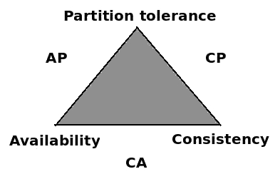
Cassandra and the CAP theorem
A graphical representation of Brewer's CAP theorem, using sides of a triangle to represent the combination of the different properties of consistency, availability, and partition tolerance
Notes:
Many of the design ideas behind Apache Cassandra were largely influenced by Amazon Dynamo. It embraced partition-tolerance to be able to scale horizontally when needed, as well as to reduce the likelihood of an outage due to having a single point of failure. Cassandra also prefers to serve its data in a highly-available fashion, and embraces the concept of eventual consistency:
When data is written, it is replicated to multiple instances. During this process, it is possible that one (or more) of the replica writes could fail. Reads for this data would then return stale or dirty results. However, one of the design choices for Cassandra was that the possibility of serving stale data outweighed the risk of a request failing. This clearly gives Cassandra a CAP designation as an AP database.

Slide 44
Cassandra's ring architecture
An aspect of Cassandra's architecture that demonstrates its AP CAP designation is in how each instance works together.
A single-instance running in Cassandra is known as a node.
A group of nodes serving the same dataset is known as a cluster or ring.
Data written is distributed around the nodes in the cluster.
Notes:
The partition key of the data is hashed to determine it's token. The data is sent to the nodes responsible for the token ranges that contain the hashed token value.
Note
The consistent hashing algorithm is used in many distributed systems, because it has intrinsic ways of dealing with changing range assignments.You can refer to Cassandra High Availability by Strickland R. (2014), published by Packt.
The partition key (formerly known as a row key) is the first part of PRIMARY KEY, and the key that determines the row’s token or placement in the cluster. PRIMARY KEY components will be further discussed in the lesson 3, Effective CQL .
Each node is also assigned additional, ancillary token ranges, depending on the replication factor specified. Therefore, data written at an RF of three will be written to one primary node, as well as a secondary and tertiary node.

Slide 45
Cassandra's ring architecture
Partitioners
The component that helps to determine the nodes responsible for specific partitions of data is known as the partitioner.
Apache Cassandra installs with three partitioners. You can refer to Apache Cassandra 3.0 for DSE 5.0, Understanding the Architecture.
Notes:
Retrieved on 20180404 from: https://docs.datastax.com/en/cassandra/3.0/cassandra/architecture/archTOC.html. Partitioners differ from each other in both efficiency and data-distribution strategy.

Slide 46
Cassandra's ring architecture
ByteOrderedPartitioner
ByteOrderedPartitioner sorts rows in the cluster lexically by partition key.
Queried results are then returned ordered by that key.
Tokens are calculated by the hexadecimal value of the beginning of the partition key.
Notes:
When we discuss data modeling and CQL later on, the ability to order a result set by a partition key may seem like a good idea. But there are several problems with this partitioner. Foremost among them is that data distribution typically suffers.

Slide 47
Cassandra's ring architecture
RandomPartitioner
RandomPartitioner was the default partitioner prior to Apache Cassandra 1.2.
Tokens are calculated using a MD5 hash of the complete partition key.
Possible token values range from zero to (2127) - 1.
For additional information you can refer to Saha S. (2017).
The Gossip Protocol - Inside Apache Cassandra.
Notes:
Retrieved on 20180422 from: https://www.linkedin.com/pulse/gossip-protocol-inside-apache-cassandra-soham-saha/

Slide 48
Cassandra's ring architecture
Murmur3Partitioner
Important points about Apache Cassandra's partitioners:
A partitioner is configured at the cluster level. You cannot implement a partitioner at the keyspace or table level.
Partitioners are not compatible. Once you select a partitioner, it cannot be changed without completely reloading the data.
Use of ByteOrderedPartitioner is considered to be an anti-pattern.
Murmur3Partitioner is an improvement on the efficiency of RandomPartitioner.
Notes:
Murmur3Partitioner is an improvement in efficiency over RandomPartitioner, and is currently the default partitioner. The murmur3 hashing algorithm is more efficient, because Cassandra does not really need the extra benefits provided by a cryptographic hash (MD5). Possible token values range from -(263) to (263)-1
Murmur3Partitioner is the default partitioner, and should be used in new cluster builds.
Note
ByteOrderedPartitioner and RandomPartitioner are still delivered with Apache Cassandra for backward compatibility, providing older implementations with the ability to upgrade.

Slide 49
Single token range per node
Node # | Start token | End token
0 | 5534023222112865485 | -9223372036854775808
1 | -9223372036854775807 | -5534023222112865485
2 | -5534023222112865484 | -1844674407370955162
3 | -1844674407370955161 | 1844674407370955161
4 | 1844674407370955162 | 5534023222112865484
Notes:
Prior to Apache Cassandra 1.2, nodes were assigned contiguous ranges of token values. With this approach, token ranges had to be computed and configured manually, by setting the initial_tokenproperty in cassandra.yaml. A possible token distribution (usingMurmur3Partitioner) with single token ranges assigned per node is as follows:
Table: An example of the token range assignments for a five-node cluster, where each node is assigned responsibility for a single, contiguous token range

Slide 50
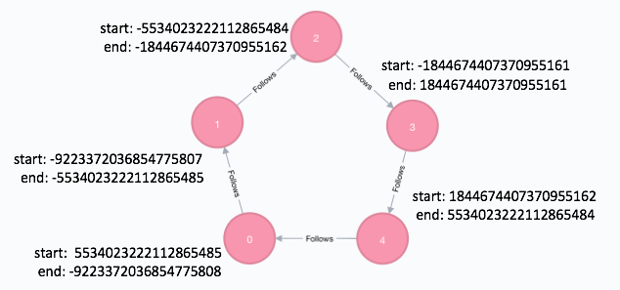
Cassandra's ring architecture
Notes:
With one node responsible for a single, contiguous token range, nodes would follow each other in the ring. When rows are written to the node determined by the hashed token value of their partition key, their remaining replicas are written to ancillary ranges on additional nodes. The additional nodes designated to hold secondary ranges of data are determined by walking the ring (or data center, depending on replication strategy) in a clockwise direction:
Figure : A five-node cluster (non-vnodes) illustrating how one node follows another based on their start and end token ranges

Slide 51

Cassandra's ring architecture
If we were to store data for the Pacman game, its hashed token value would look like this:
cassdba@cqlsh:packt&gt; SELECT game, token(game)
FROM hi_scores_by_game WHERE game=Pacman;
game | system.token(game)
-------------+----------------------
Pacman | 4538621633640690522
Notes:
For example, consider the hi_scores_by_game table from the previous lesson. As that table uses game as its partition key, data stored in that table will be written to a node based on the hash of the value it has for game.
The partition key value of Pacman hashes to a token of 4538621633640690522. Based on the figures depicting the preceding five-node cluster, node four is primarily responsible for this data, as the token falls between 1844674407370955162 and 5534023222112865484.

Slide 52
Cassandra's ring architecture
Now let's assume that the packt keyspace has the following definition:
CREATE KEYSPACE packt WITH replication =
{'class': 'NetworkTopologyStrategy', 'ClockworkAngels': '3'}
AND durable_writes = true;
Notes:
If all five of the nodes are in the ClockworkAngels data center, then the nodes responsible for the two additional replicas can be found by traversing the ring in a clockwise manner. In this case, node zero is responsible for the second replica of the Pacman high score data, and node one is responsible for the third replica.
Note
NetworkTopologyStrategy also takes logical rack definition into account. When determining additional replica placement, this strategy will attempt to place replicas on different racks, to help maintain availability in the event of a rack failure scenario.

Slide 53
Cassandra's ring architecture
Vnodes
Node # | Token ranges
0 | 79935 to -92233, -30743 to -18446, 55341 to 67638
1 | -92232 to -79935, -61488 to 61489, 43043 to 55340
2 | -79934 to -67638, -43041 to -30744, 67639 to 79935
3 | -67637 to -55340, 61490 to 18446,18447 to 30744
4 | -55339 to -43042, -18445 to -61489, 30745 to 43042
Notes:
Newer versions of Apache Cassandra have an option to use virtual nodes, better known as vnodes. Using vnodes, each node is assigned several non-contiguous token ranges. This helps the cluster to better balance its data load:
Table : An example of the token range distribution for a five-node cluster using vnodes. Each node is assigned responsibility for three, non-contiguous token ranges. Smaller numbers were used in this example for brevity.
While the application of virtual nodes may seem more chaotic, it has several benefits over single, manually-specified token ranges per node:
Provides better data distribution over manually-assigned tokens.
More numerous, multiple token ranges per node allows multiple nodes to participate in bootstrapping and streaming data to a new node.
Allows for automatic token range recalculation. This is useful when new nodes are added to the cluster, to prevent the existing nodes from needing to be reconfigured and bounced (restarted).
Note
Cassandra 3.0 uses a new token-allocation algorithm that allows the distribution of data to be optimized for a specific keyspace. Invoking this algorithm is only possible when using vnodes and Murmur3Partitioner. It requires that a keyspace be specified for the allocate_tokens_for_keyspace property in the cassandra.yaml file. You can refer to Apache Software Foundation (2016). Documentation: Adding, replacing, moving and removing nodes, retrieved on 20180418 from: http://cassandra.apache.org/doc/latest/operating/topo_changes.html.

Slide 54
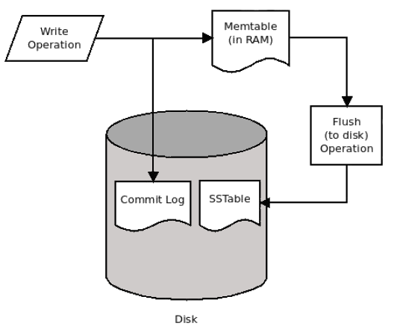
Cassandra's write path
Notes:
Understanding how Cassandra handles writes is key to knowing how to build applications on top of it. The following is a high-level diagram of how the Cassandra write path works:
Figure : An illustration of the Cassandra write path, showing how writes are applied both to in-memory and on-disk structures

Slide 55
Cassandra's write path
Some quick notes about the write path:
Data is sorted inside SSTables by token value, and then by clustering keys.
SSTables are immutable.
They are written once, and not modified afterward.
Data written to the same partition key and column values does not update.
The existing row is made obsolete (not deleted or overwritten) in favor of the timestamp of the new data.
Notes:
Once a flush of the memtable is triggered, the data stored in memory is written to the sorted string table files (SSTables) on-disk. The data is sorted by token value in memory, and then written to disk in sequential order. This is why Cassandra is known for its log-based, append-only storage engine.
Data cannot be deleted. Deletes are considered to be writes, and are written as structures called tombstones.

Slide 56
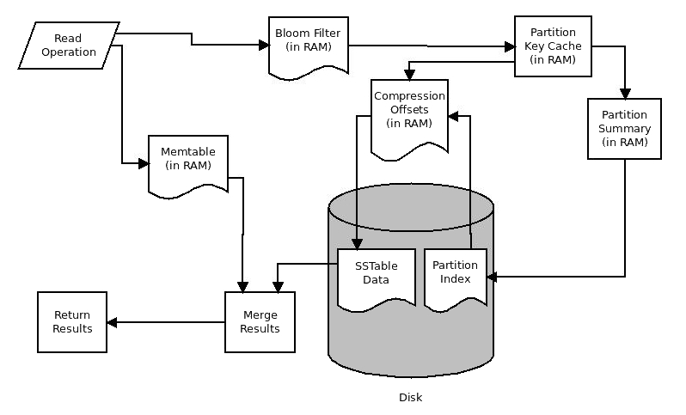
Cassandra's read path
Notes:
The Cassandra read path is somewhat more complex. Similar to the write path, structures in-memory and on-disk structures are examined, and then reconciled:
Figure: An illustration of the Cassandra read path, illustrating how the different in-memory and on-disk structures work together to satisfy query operations
As shown in the figure, a node handling a read operation will send that request on two different paths. One path checks the memtables (in RAM) for the requested data.
If row-caching is enabled (it is disabled by default), it is checked for the requested row, followed by the bloom filter. The bloom filter (Ploetz, et-al 2018) is a probability-based structure in RAM, which speeds up reads from disk by determining which SSTables are likely to contain the requested data.
If the response from the bloom filter is negative, the partition key cache is examined. Unlike the row cache, the partition key cache is enabled by default, and its size is configurable (it defaults to the smaller value of either 5% of available heap or 100 MB). If the requested partition key is located within the partition key cache, its result is then sent to the compression offset. The compression offset is a dictionary/map that contains the on-disk locations for all partition data (SSTables).
If the partition key cache does not contain the requested key, the request is routed to the partition summary instead. There the requested key is examined to obtain a range of partitions for the key, which is then sent to the partition index. The partition index contains all of the partition keys which the node is responsible for. This, in conjunction with the resultant compression offset, will lead to the appropriate SSTable(s) on-disk. The appropriate values are then read, merged with any results obtained from the memtables, and the resultant dataset is returned.
Note
Some structures in the read path are predicated on a negative search result from a prior step. Requesting data that does not exist still consumes compute resources, and may even exhibit higher read latencies than queries for data that does exist.

Slide 57
Cassandra's read path
Some quick notes about the read path:
Data is read sequentially from disk, and will be returned in that order.
This can be controlled by the table's definition.
Rows can persist across multiple SSTable files.
This can slow reads down, so eventually SSTable data is reconciled and the files are condensed during a process called compaction.
Notes:
When data is read, its obsoleted or deleted values are read as well, and disregarded. Therefore data models allowing for multiple in-place writes and/or deletes will not perform well.

Slide 58
On-disk storage
SSTables
Listing out the files reveals the following:
cd data/data/packt/hi_scores-d74bfc40634311e8a387e3d147c7be0f
ls -al
total 72
drwxr-xr-x 11 aploetz aploetz 374 May 29 08:28 .
drwxr-xr-x 6 aploetz aploetz 204 May 29 08:26 ..
-rw-r--r-- 1 aploetz aploetz 43 May 29 08:28 mc-1-big-CompressionInfo.db
-rw-r--r-- 1 aploetz aploetz 252 May 29 08:28 mc-1-big-Data.db
-rw-r--r-- 1 aploetz aploetz 10 May 29 08:28 mc-1-big-Digest.crc32
-rw-r--r-- 1 aploetz aploetz 16 May 29 08:28 mc-1-big-Filter.db
-rw-r--r-- 1 aploetz aploetz 27 May 29 08:28 mc-1-big-Index.db
-rw-r--r-- 1 aploetz aploetz 4675 May 29 08:28 mc-1-big-Statistics.db
-rw-r--r-- 1 aploetz aploetz 61 May 29 08:28 mc-1-big-Summary.db
-rw-r--r-- 1 aploetz aploetz 92 May 29 08:28 mc-1-big-TOC.txt
Notes:
When rows are written to disk, they are stored in different types of file. Let's take a quick look at these files, which should be present after what we did in lesson 1, Quick Start.
Note
If you have not followed the examples from lesson 1, Quick Start, that's okay. But some of the data to follow may be different for you.
First of all, let's cd over to where our table data is stored. By default, keyspace and table data is stored in the data/ directory, off of the $CASSANDRA_HOME directory.
The mc-1-big-TOC.txt file is the table of contents file for the directory. Listing its contents essentially shows the same list of files as we have previously. Some of the other files match up with parts of the Cassandra read path:
mc-1-big-Index.db: Primary key index (matches partition keys to their data file positions)
mc-1-big-Summary.db: Partition summary
mc-1-big-CompressionInfo.db: Compression offsets
mc-1-big-Filter.db: Bloom filter
mc-1-big-Digest.crc32: Contains a Cyclic Redundancy Check (CRC) or checksum value for the uncompressed file chunks
The last file is mc-1-big-Data.db, which contains the data for the table. Listing out the contents of the file with a system tool, such as cat, will be cumbersome to read. So we will examine this file using some of the tools that come with Apache Cassandra.

Slide 59
On-disk storage
How data was structured in prior versions
As an example, consider the following CQL query from the previous lesson.
Recall that it retrieves video game high-score data for a player named Connor:
cassdba@cqlsh:packt&gt; SELECT * FROM hi_scores WHERE name='Connor';
name | game | score
--------+-------------+--------
Connor | Frogger | 4220
Connor | Joust | 48850
Connor | Monkey Kong | 15800
Connor | Pacman | 182330
(4 rows)
Notes:
In Apache Cassandra versions 0.4 to 2.2, SSTable data was structured by row key. A row key kept a map of columns underneath it with their values. These columns were sorted by their column key. If you consider the key/value map structure from Java, it's easy to think of it as a map of a map.
This CQL query and result set make sense in the way it is shown, mainly for those of us who have a background in relational databases. But this is not how the data is stored on-disk.

Slide 60
On-disk storage
In Apache Cassandra versions 1.2 to 2.2, CQL is simply a layer that abstracts the SSTable structure.
If you were using Apache Cassandra 2.1 or earlier, this data could be viewed with the command-line interface tool, also known as cassandra-cli:
Refer to the file 2_1.txt
Notes:
A few things to note here:
We defined the partition key as the name column, which does not seem to be present here. But the get query works by simply retrieving data for RowKey of Connor.
The game column was defined as our clustering key. Again, game itself is not present here, but we can see that the score recorded for each game seems to be keyed by the game's title (such as name=Frogger:score, value=000000000000107c, timestamp=1527640087988234).
The CLI informs us that one row has been returned. As far as the storage layer is concerned, all cells (column keys and their values) constitute a single row.
The most important thing to remember from this example is that all data underneath a particular partition key is stored together. This is an important lesson that we will draw upon heavily in the next lesson.

Slide 61
On-disk storage
How data is structured in newer versions
Consider the CQL query used as the basis for the prior example, where we queried our the hi_scores table for the player named Connor.
If we were to look at the underlying data using the sstabledump tool, it would look something like this:
Refer to the file 2_2.txt
Notes:
In versions of Apache Cassandra from 3.0 on, the underlying data is structured slightly differently. The Cassandra storage engine was rewritten as a part of this release, providing several benefits.
It's important to note from this JSON output that the data for Connor is divided into a hierarchy of three distinct sections: partitions, rows, and cells. Whereas before there were simply partitions containing cells of data, rows are now a first-class citizen in the Cassandra world. In this way, CQL is no longer an abstraction, but rather a fairly accurate representation of how the data is stored. This will be discussed in more detail in the next lesson.
Note
Even with the new storage engine, it is still important to note that all data underneath a particular partition key is stored together.

Slide 62
Additional components of Cassandra
Gossiper
Gossiper is a peer-to-peer communication protocol that a node uses to communicate with the other nodes in the cluster.
When the nodes gossip with each other, they share information about themselves and retrieve information on a subset of other nodes in the cluster.
Notes:
Now that we have discussed the read and write paths of an individual Apache Cassandra node, let's move up a level and consider how all of the nodes work together. Keeping data consistent and serving requests in a way that treats multiple machines as a single data source requires some extra engineering. Here we'll explore the additional components which make that possible.
Eventually, this allows a node to store and understand state information about every other node in the cluster.
Each node's gossiper runs once per second (Saha 2017) and initiates communication with up to three other nodes. The gossip protocol first runs when the node is attempting to join the cluster. As a new node contains no information on the current network topology, it must be preconfigured with a list of current live nodes or seeds to help it start the communication process.
Note
We will discuss the concept of seed nodes in lesson 4, Configuring a Cluster. The most important thing to remember about them, is that they help new nodes discover the rest of the cluster's network topology when joining. All nodes are considered to be peers in Cassandra, and the seed-node designation does not change that.

Slide 63
Additional components of Cassandra
You can view the currently perceived gossip state of any node using the nodetool utility on any node.
The following command demonstrates what this looks like with a three-node cluster:
Refer to the file 2_3.txt
Notes:
As you can see, the gossip state of each node contains a wealth of information about it. Things such as status, data load, host ID, and schema version are readily visible. This is a good way to quickly gain an understanding of one node's view of the cluster.
Note
Remember, each node maintains its own view of the cluster's gossip state. While it should be the same on all nodes, it sometimes is not. It is entirely possible that some nodes can see certain nodes as down when other nodes do not. The nodetool gossipinfo command can be a valuable tool when troubleshooting firewall or network issues.

Slide 64

Additional components of Cassandra
Snitch
Cassandra uses a component known as the snitch to direct read and write operations to the appropriate nodes.
When an operation is sent to the cluster, it is the snitch's job (Williams 2012) to determine which nodes in specific data centers or racks can serve the request.
Notes:
Most snitches that ship with Apache Cassandra are both data center- and rack-aware. That is, they are capable of viewing (predetermined) groups of nodes in the cluster as logical data centers. Additionally, the data centers can be further divided into logical racks.
Note
The term logical is used here because the data centers may or may not be physically separate from each other. That is, nodes in a single physical data center can be split into smaller data centers, and the snitch will enforce data-replication for each separately.

Slide 65
Additional components of Cassandra
The replication of data per keyspace is defined in the keyspace definition using the configuration properties of NetworkTopologyStrategy.
This can be seen in the following example keyspace definition:
CREATE KEYSPACE packt WITH replication = {
'class': 'NetworkTopologyStrategy',
'ClockworkAngels': '3',
'PermanentWaves': '2'
};
Notes:
In the example, we'll assume the use of GossipingPropertyFileSnitch, and that we have a number of nodes in our cluster assigned to our ClockworkAngels data center and some assigned to our PermanentWaves data center. When a write operation occurs on any of the tables stored in the packt keyspace, the snitch will ensure that three replicas of that data are written to the ClockworkAngels data center. Likewise, two replicas of the data will be written to the PermanentWaves data center.
As previously mentioned, the nodes in a data center can be further divided into racks

Slide 66
Additional components of Cassandra
Let's assume that our ClockworkAngels data center has six nodes.
To maintain the maximum amount of availability possible, we could divide them up like this:
Data center: ClockworkAngels
Node Rack
========================
192.168.255.1 East_1
192.168.255.2 West_1
192.168.255.3 West_1
192.168.255.4 East_1
192.168.255.5 West_1
192.168.255.6 East_1
Notes:
Note
Nodes in a data center are ordered by primary token range, not necessarily by IP address. This example was ordered by IP for simplicity.
Let's assume that our write has a partition key that hashes out to a primary range owned by 192.168.255.2, which is in the West_1 rack. The snitch will ensure that the first replica is written to 192.168.255.2. Since our keyspace has an RF of three, the snitch will then walk the ring (clockwise by token ranges) to place the remaining replicas. As there are multiple racks, it will try to spread the replicas evenly across them. Therefore, it will place the second replica on 192.168.255.3, which is in a different rack. As both racks are now covered from an availability perspective, the third replica will be placed on the next node, regardless of rack designation.
Note
When working with physical data centers, entire racks have been known to fail. Likewise, entire availability zones have been known to fail in the cloud. Therefore, it makes sense to define logical racks with physical racks or Availability Zones (AZs) whenever possible. This configuration strategy provides the cluster with its best chance for remaining available in the event of a rack/AZ outage. When defining your cluster, data center, and rack topology, it makes sense to build a number of nodes that evenly compliment your RF. For instance, with an RF of three, the snitch will spread the data evenly over a total of three, six, or nine nodes, split into three racks.

Slide 67
Additional components of Cassandra
Phi failure-detector
Apache Cassandra uses an implementation of the Phi Failure-Accrual algorithm.
The basic idea is that gossip between nodes is measured on a scale that adjusts to current network conditions.
Notes:
The results are compared to a preconfigured, static value (phi_convict_threshold) that helps a node decide whether another node should be marked as down. phi_convict_threshold will be discussed in later lessons.

Slide 68
Additional components of Cassandra
Tombstones
Deletes in the world of distributed databases are hard to do.
After all, how do you replicate nothing? Especially a key for nothing which once held a value.
Tombstones are Cassandra's way of solving that problem.
As Cassandra uses a log-based storage engine, deletes are essentially writes.
Notes:
When data is deleted, a structure known as a tombstone is written. This tombstone exists so that it can be replicated to the other nodes that contained the deleted replica.
Discussion about tombstones tends to be more prevalent in Cassandra application-developer circles. This is primarily because their accumulation in large numbers can be problematic. Let's say that data is written for a specific key, then deleted, and then written and deleted three more times, before being written again. With the writes for that key being stored sequentially, SSTable data files that back that key will contain five possible values and four tombstones. Depending on how often that write pattern continues, there could be thousands of tombstoned and obsoleted stored across multiple files for that key. When that key is queried, there is essentially an accumulation of garbage that must be overlooked to find the actual, current value.
Accumulation of tombstones will result in slower queries over time. For this reason, use cases that require a high amount of delete activity are considered an anti-pattern with Apache Cassandra.
Note
The Apache Cassandra configuration has settings for warnings and failure thresholds regarding the number of tombstones that can be returned in a query.

Slide 69
Additional components of Cassandra
Tombstones are eventually removed, but only after two specific conditions are met:
The tombstone has existed longer than the table's defined gc_grace_seconds period
Compaction runs on that table
Notes:
The gc_grace_seconds stipulation exists to give the tombstone ample time to either replicate, or be fixed by a repair operation. After all, if tombstones are not adequately replicated, a read to a node that is missing a tombstone can result in data ghosting its way back into a result set.

Slide 70
Additional components of Cassandra
Hinted handoff
When a node reports another as down, the node that is still up will store structures, known as hints, for the down node.
Hints are essentially writes meant for one node that are temporarily stored on another.
When the down node returns to a healthy status, the hints are then streamed to that node in an attempt to re-sync its data.
Notes:
Note
As storage is finite, hints will be stored for up to three hours, by default. This means that a down node must be brought back within that time frame, or data loss will occur.
With Apache Cassandra versions older than 3.0, hints were stored in the hints table of the system keyspace. The problem with this approach is that once the stored hints were replayed, they were then deleted. This frequently led to warnings and failures due to tombstone accumulation. Apache Cassandra version 3.0 and up moved to a file-based system of hint storage, thus avoiding this problem so long as the hints directory has disk space available.

Slide 71
Additional components of Cassandra
Compaction
Apache Cassandra's answer to this problem is to periodically execute a process called compaction. When compaction runs, it performs the following functions:
Multiple data files for a table are merged into a single data file
Obsoleted data is removed
Tombstones that have outlived the table's gc_grace_seconds period are removed
Notes:
As previously mentioned, once SSTable files are written to disk, they are immutable (cannot be written to again). Additional writes for that table would eventually result in additional SSTable files. As this process continues, it is possible for long-standing rows of data to be spread across multiple files. Reading multiple files to satisfy a query eventually becomes slow, especially when considering how obsolete data and tombstones must be reconciled (so as not to end up in the result set).
There are two different compaction strategies available with Apache Cassandra: SizeTieredCompactionStrategy and LeveledCompactionStrategy. These will be detailed in a later lesson. Compaction is configured on a per-table basis, and its configuration includes thresholds for determining how often compaction is run.
Note
Cassandra does a good job of figuring out when compaction needs to be run. The best approach is to let it do what it needs to do. If it should be run sooner, then the configuration should be altered on the table in question. Forcing compaction (via the command line) to run outside of its configured thresholds has been known to drastically delay future compaction times.

Slide 72
Additional components of Cassandra
Repair
Sometimes data replicas on one or more Cassandra nodes can get out of sync.
There are a variety of reasons for this, including prior network instability, hardware failure, and nodes crashing and staying down past the three-hour hint window.
When this happens, Apache Cassandra comes with a repair process that can be run to rectify these inconsistencies.
Notes:
Note
The repair process does not run on its own, and must be executed manually. Tools such as Reaper for Apache Cassandra allow for some automation, including scheduling cluster repairs.
Conditions that can cause data inconsistencies essentially do so by introducing factors that increase the entropy of the stored replicas. Therefore, Apache Cassandra employs an anti-entropy repair mechanism, which uses a binary Merkle tree to locate inconsistent replicas across different nodes. Discrepancies are then rectified by streaming the correct data from another node.

Slide 73

Additional components of Cassandra
Merkle tree calculation
Merkle trees are created from the bottom up, starting with hashes of the base or leaf data.
The leaf data is grouped together by partition ranges, and then it is hashed with the hash of its neighboring leaf to create a singular hash for their parent.
Notes:
Parents are hashed together with neighboring parents (to create their parents), until (Kozliner 2017) all have been combined into a single hash, known as the root. Based on the hash value of the root for a token range, the Merkle trees of different nodes can be quickly compared.
Note
A Merkle tree calculation can consume high amounts of resources (CPU, disk I/O) on a node, which can result in temporary query timeouts as the node continues to try to serve requests. For this reason, it is best to run repairs during times when client requests are low. The Merkle tree calculation part of the repair processes can be monitored with nodetool compactionstats, where it will display as a validation compaction.

Slide 74
Additional components of Cassandra
We'll query our the hi_scores table for our users whose token value for name (our partition key) falls within that range:
cassdba@cqlsh&gt; SELECT DISTINCT name,token(name) FROM packt.hi_scores
WHERE token(name) &gt;= -9223372036854775807
AND token(name) &lt;= -7686143364045646507;
name | system.token(name)
--------+----------------------
Connor | -8880179871968770066
Rob | -8366205352999279036
Dad | -8339008252759389761
Ryan | -8246129210631849419
(4 rows)
Notes:
Let’s walk through a quick example. Assume that we've added high scores for more users, we're running a repair on the hi_scores table, and we're only concerned about the token range of -9223372036854775807 to -7686143364045646507.
Note
Executing a range query on a partition key is only possible when also using the token function, as shown previously.

Slide 75
Additional components of Cassandra
Now let's compute a hash (MD5 is used for this example) for all data within each partition:
Connor: h(dCo) =c13eb9350eb2e72eeb172c489faa3d7f
Rob: h(dRo) = 97ab517e5418ad2fe700ae45b0ffc5f3
Dad: h(dDa) = c9df57b434ad9a674a242e5c70587d8b
Ryan: h(dRy) = 9b961a89e744c86f5bffc1864b166514

Slide 76
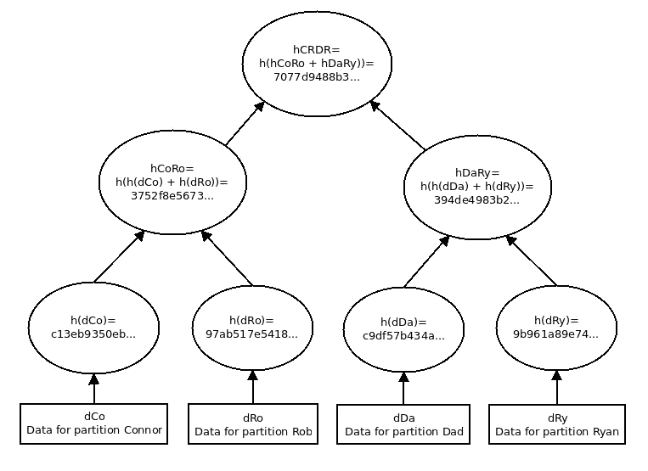
Notes:
To build a Merkle tree for this data, we start by listing each partition of hashed data separately, as leaf nodes. Then we will backtrack toward our root node by applying the hash function, h(), while combining our data recursively:
Figure: An example Merkle tree calculation for a node's token range containing four partitions of data. This illustrates how they are hashed and combined to compute the hash of the root (hCRDR).

Slide 77
Additional components of Cassandra
Once the data for the partitions is hashed, it is then combined with its neighbor nodes to generate their parent node:
hCoRo = h(h(dCo) + h(dRo)) = 3752f8e5673ce8d4f53513aa2cabad40
hDaRy = h(h(dDa) + h(dRy)) = 394de4983b242dcd1603eecc35545a6d
Likewise, the final hash for the root node can be calculated as Root node = hCRDR = h(hCoRo + hDaRy) = 7077d9488b37f4d39c908eb7560f2323.
Notes:
Likewise, the final hash for the root node can be calculated as Root node = hCRDR = h(hCoRo + hDaRy) = 7077d9488b37f4d39c908eb7560f2323.
We can then perform this same Merkle tree calculation on another node (which is also responsible for the token range of -9223372036854775807 to -7686143364045646507). If all of the underlying data is consistent (and affirms our state of anti-entropy), they should all respond with a root node hash of 7077d9488b37f4d39c908eb7560f2323. If one or more of them does not, the up-to-date node then prepares to stream a subset of the affected range of data to fix the inconsistency.
Streaming data
Once discrepancies are identified via Merkle trees, data files are streamed to the node containing the inconsistent data. Once this streaming completes, the data should be consistent across all replicas.
Note
Repair streams consume network resources that can also interfere with a node's ability to serve requests. Repair progress can be monitored using the nodetool netstats command.

Slide 78
Additional components of Cassandra
Read repair
Read repair is a feature that allows for inconsistent data to be fixed at query time. read_repair_chance (and dclocal_read_repair_chance) is configured for each table, defaulting to 0.1 (10% chance).
When it occurs (only with read consistency levels higher than ONE), Apache Cassandra will verify the consistency of the replica with all other nodes not involved in the read request.
If the requested data is found to be inconsistent, it is fixed immediately.
Notes:
Do note that read repairs do not occur when read consistency is set to ONE or LOCAL_ONE. Also, reads at a consistency level of all will force a read repair to happen 100% of the time. However, these read repairs do incur latency, which is why they are typically set to low percentages.
Note
Sometimes a single partition or key will be all that is inconsistent. If you find yourself in this situation, forcing a read repair is a simple task via cqlsh. If the number of inconsistent rows is a manageable number, you can fix them by setting your consistency level to all, and querying each of them.

Slide 79
Additional components of Cassandra
Security
One criticism of NoSQL data stores is that security is often an afterthought. Cassandra is no exception to this view.
In fact, Apache Cassandra will install with all security features initially disabled.
While clusters should be built on secured networks behind enterprise-grade firewalls, by itself this is simply not enough.
Notes:
There are several features that Cassandra provides that can help to tighten up security on a cluster.

Slide 80
Additional components of Cassandra
Authentication
Client connections are required to provide valid username/password combinations before being allowed access to the cluster.
To enable this functionality, simply change the authenticator property in the cassandra.yaml file from its default (AllowAllAuthenticator) to PasswordAuthenticator:
authenticator: PasswordAuthenticator
Notes:
Apache Cassandra allows for user authentication to be set up. Similar to other Cassandra components, users and their (encrypted) credentials are stored in a table inside the cluster.
Note
Once you have created your own DBA-level superuser account for administrative purposes, you should never use the default cassandra user again. This is because the Cassandra user is the only user that has special provisions in the code to query the system_auth tables at a consistency level higher than ONE (it uses QUORUM). This means that the default Cassandra user may not be able to log in if multiple nodes are down.
When user authentication is enabled, Cassandra will create the system_auth keyspace. When using PasswordAuthenticator, CassandraRoleManager must also be used.

Slide 81
Additional components of Cassandra
Authorization
With authentication set up, additionally enabling user authorization allows each user to be assigned specific permissions to different Cassandra objects. In Apache Cassandra versions 2.2 and up, users are referred to as roles.
The following are some examples:
GRANT SELECT ON KEYSPACE item TO item_app_readonly;
GRANT MODIFY ON KEYSPACE store TO store_app_user;
GRANT ALL PERMISSIONS ON KEYSPACE mobile TO mobile_admin;
Notes:
In Apache Cassandra versions 2.2 and up, users are referred to as roles. With authorization enabled, roles can be assigned the following permissions via CQL:
ALTER: Change table or keyspace definitions
AUTHORIZE: Grant or revoke specific permissions to other users
CREATE:: Create new tables or keyspaces
DESCRIBE: Retrieve definitions of a table or keyspace
DROP: Delete specific tables or keyspaces
EXECUTE: Run functions in a specific keyspace
MODIFY: Run DELETE, INSERT, UPDATE, or TRUNCATE commands on a specific table
SELECT: Query a specific table
ALL PERMISSIONS: No restricted access on specific tables or keyspaces

Slide 82
Additional components of Cassandra
Managing roles
As role-management is part of the user security backend, it requires PasswordAuthenticator to be enabled before its functionality is activated.
Here is an example:
CREATE ROLE cassdba WITH SUPERUSER=true AND LOGIN=true AND PASSWORD='bacon123';
CREATE ROLE supply_chain_rw WITH LOGIN=true AND PASSWORD='avbiuo2t48';
Notes:
The role system allows you to assign permissions to a role, and then GRANT access to that role for another user/role. As mentioned in the previous section, role management is new as of Apache Cassandra 2.2, and can greatly simplify user-management and permission-assignment.

Slide 83
Additional components of Cassandra
Client-to-node SSL
Enabling client-to-node Secure Socket Layer (SSL) security has two main benefits.
First, each client connecting to the cluster must present a valid certificate that matches a certificate or Certificate Authority (CA) in the node's Java KeyStore.
Notes:
Second, upon successful connection (and cert validation), all traffic between the client and node will be encrypted.

Slide 84
Additional components of Cassandra
Node-to-node SSL
Enabling node-to-node SSL security is designed to prevent a specific avenue of attack.
A node will not be allowed to join the cluster, unless it presents a valid SSL certificate in its Java KeyStore and the Java TrustStore matches with the other nodes in the cluster.
Notes:
When this level of security is active, it will encrypt communication between the nodes over port 7001.
Note
Node-to-node SSL may seem unnecessary, but without it, an internal attacker could join a rogue node to your cluster. Then once it has bootstrapped, it will shut the node down and its data directories will contain at least some of your data. If you don't enable node-to-node SSL, this can be done without having to know any of the admin passwords to authenticate to the cluster.

Slide 85
Summary
In this lesson, we discussed many aspects of Apache Cassandra.
Some concepts may not have been directly about the Cassandra database, but concepts that influenced its design and use.
These topics included Brewer's CAP theorem data-distribution and- partitioning; Cassandra's read and write paths; how data is stored on-disk; inner workings of components such as the snitch, tombstones, and failure-detection; and an overview of the delivered security features.
Notes:
This lesson was designed to give you the necessary background to understand the remaining lessons. Apache Cassandra was architected to work the way it does for certain reasons. Understanding why will help you to provide effective configuration, build high-performing data models, and design applications that run without bottlenecks. In the next lesson, we will discuss and explore CQL, and explain why it has certain limitations, and how to unleash its power.

Slide 86
3. Effective CQL

Slide 87
Effective CQL
Specifically, we will cover and discuss the following topics:
The evolution of CQL and the role it plays in the Apache Cassandra universe
How data is structured and modeled effectively for Apache Cassandra
How to build primary keys that facilitate high-performing data models at scale
How CQL differs from SQL
CQL syntax and how to solve different types of problems using it
Notes:
In this lesson, we will examine common approaches to data modeling and interacting with data stored in Apache Cassandra. This will involve us taking a close look at the Cassandra Query Language, otherwise known as CQL.
Once you have completed this lesson, you should have an understanding of why data models need to be built in a certain way. You should also begin to understand known Cassandra anti-patterns and be able to spot certain types of bad queries. This should help you to build scalable, query-based tables and write successful CQL to interact with them.
In the parts of this lesson that cover data modeling, be sure to pay extra attention. The data model is the most important part of a successful, high-performing Apache Cassandra cluster. It is also extremely difficult to change your data model later on, so test early, often, and with a significant amount of data. You do not want to realize that you need to change your model after you have already stored millions of rows. No amount of performance-tuning on the cluster side can make up for a poorly-designed data model!

Slide 88
An overview of Cassandra data modeling
Before we get started, let's create a keyspace for this lesson's work:
CREATE KEYSPACE packt_ch3 WITH replication =
{'class': 'NetworkTopologyStrategy', 'ClockworkAngels':'1'};
Notes:
Understanding how Apache Cassandra organizes data under the hood is essential to knowing how to use it properly. When examining Cassandra's data organization, it is important to determine which version of Apache Cassandra you are working with. Apache Cassandra 3.0 represents a significant shift in the way data is both stored and accessed, which warrants a discussion on the evolution of CQL.

Slide 89

An overview of Cassandra data modeling
The CQL for creating that table could look like this:
CREATE TABLE playlist (
band TEXT,
album TEXT,
song TEXT,
running_time TEXT,
year INT,
PRIMARY KEY (band,album,song));
Notes:
To preface this discussion, let's create an example table. Let's assume that we want to store data about a music playlist, including the band's name, albums, song titles, and some additional data about the songs.

Slide 90
An overview of Cassandra data modeling
Now we'll add some data into that table:
INSERT INTO playlist (band,album,song,running_time,year)
VALUES ('Rush','Moving Pictures','Limelight','4:20',1981);
INSERT INTO playlist (band,album,song,running_time,year)
VALUES ('Rush','Moving Pictures','Tom Sawyer','4:34',1981);
INSERT INTO playlist (band,album,song,running_time,year)
VALUES ('Rush','Moving Pictures','Red Barchetta','6:10',1981);
INSERT INTO playlist (band,album,song,running_time,year)
VALUES ('Rush','2112','2112','20:34',1976);
INSERT INTO playlist (band,album,song,running_time,year)
VALUES ('Rush','Clockwork Angels','Seven Cities of Gold','6:32',2012);
INSERT INTO playlist (band,album,song,running_time,year)
VALUES ('Coheed and Cambria','Burning Star IV','Welcome Home','6:15',2006);

Slide 91
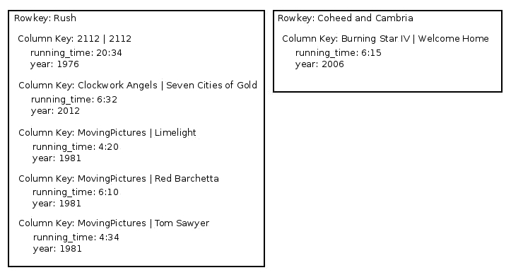
An overview of Cassandra data modeling
Cassandra storage model for early versions up to 2.2
Notes:
The original underlying storage for Apache Cassandra was based on its use of the Thrift interface layer. If we were to look at how the underlying data was stored in older (pre-3.0) versions of Cassandra, we would see something similar to the following:
Figure : Demonstration of how data was stored in the older storage engine of Apache Cassandra. Notice that the data is partitioned (co-located) by its row key, and then each column is ordered by the column keys.
As you can see in the screenshot, data is simply stored by its row key (also known as the partitioning key). Within each partition, data is stored ordered by its column keys, and finally by its (non-key) column names. This structure was sometimes referred to as a map of a map. The innermost section of the map, where the column values were stored, was called a cell. Dealing with data like this proved to be problematic and required some understanding of the Thrift API to complete basic operations.
When CQL was introduced with Cassandra 1.2, it essentially abstracted the Thrift model in favor of a SQL-like interface, which was more familiar to the database development community. This abstraction brought about the concept known as the CQL row. While the storage layer still viewed from the simple perspective of partitions and column values, CQL introduced the row construct to Cassandra, if only at a logical level. This difference between the physical and logical models of the Apache Cassandra storage engine was prevalent in major versions: 1.2, 2.0, 2.1, and 2.2.

Slide 92
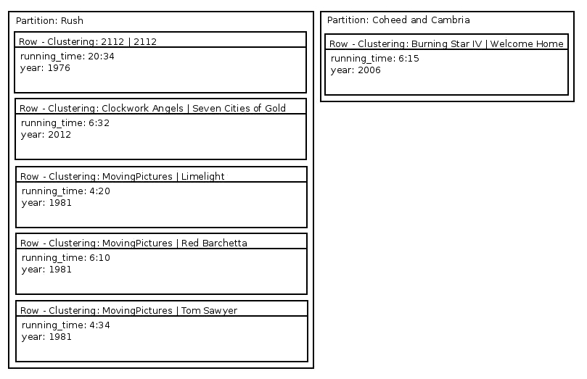
Cassandra storage model for versions 3.0 and beyond
Notes:
On the other hand, the new storage engine changes in Apache Cassandra 3.0 offer several improvements. With version 3.0 and up, stored data is now organized like this:
Figure 3.2: Demonstration of how data is stored in the new storage engine used by Apache Cassandra 3.0 and up. While data is still partitioned in a similar manner, rows are now first-class citizens.
The figure shows that, while data is still partitioned similarly to how it always was, there is a new structure present. The row is now part of the storage engine. This allows for the data model and the Cassandra language drivers to deal with the underlying data similar to how the storage engine does.
Note
An important aspect not pictured in the preceding screenshot is the fact that each row and column value has its own timestamp.
In addition to rows becoming first-class citizens of the physical data model, another change to the storage engine brought about a drastic improvement. As Apache Cassandra's original data model comes from more of a key/value approach, every row is not required to have a value for every column in a table.
The original storage engine allowed for this by repeating the column names and clustering keys with each column value. One way around repeating the column data was to use the WITH COMPACT STORAGE directive at the time of table creation. However, this presented limitations around schema flexibility, in that columns could no longer be added or removed.
Note
Do not use the WITH COMPACT STORAGE directive with Apache Cassandra version 3.0 or newer. It no longer provides any benefits, and exists so that legacy users have an upgrade path.
With Apache Cassandra 3.0, column names and clustering keys are no longer repeated with each column value. Depending on the data model, this can lead to a drastic difference in the disk footprint between Cassandra 3.0 and its prior versions.
Note
I have seen as much as a 90% reduction in disk footprint by upgrading from Cassandra 2.x to Cassandra 3.0 and as little as 10% to 15%. Your experience may vary, depending on the number of columns in a table, size of their names, and primary key definition.

Slide 93

An overview of Cassandra data modeling
Data cells
Assume the following table definition for keeping track of weather station readings:
CREATE TABLE weather_data_by_date (
month BIGINT,
day BIGINT,
station_id UUID,
time timestamp,
temperature DOUBLE,
wind_speed DOUBLE,
PRIMARY KEY ((month,day),station_id,time));
Notes:
Sometimes structures for storing column values are referred to as cells. Queries to Cassandra essentially return collections of cells.
n this model, the month and day keys are used to make up a composite partition key. The clustering keys are station_id and time. In this way, for each partition, the number of cells will be equal to the total unique combinations of tuples:
station_id, time, temperature
station_id, time, wind_speed
Understanding a cell comes into play when building data models. Apache Cassandra can only support 2,000,000,000 cells per partition. When data modelers fail to consider this, partitions can become large and ungainly, with query times eventually getting slower. This is why data models that allow for unbound row growth are considered to be an anti-pattern.
Note
The maximum of 2,000,000,000 cells per partition is a hard limit. But, practically speaking, models that allow that many cells to be written to a single partition will become slow long before that limit is reached.

Slide 94
cqlsh
Logging into cqlsh
You will find cqlsh in the /bin directory of your Cassandra home directory.
You can start it by invoking it with a host IP address to connect to and any flags required by your cluster or session to connect:
cqlsh <host_ip> <port> [flags/options]
Notes:
The cqlsh tool, which is also known as CQL shell, installs with Cassandra and should be used to control security, keyspace, and table definitions. Not to be confused with the old Cassandra-CLI (the deprecated Cassandra command-line interface), cqlsh will be your primary interface into controlling your Cassandra data model and analyzing cluster metadata.
Note
If you do not have Apache Cassandra or cqlsh installed locally, you can use pip (Python's package manager) to accomplish this quickly: pip install cqlsh.

Slide 95
cqlsh
In the interest of getting users on the correct path, we'll show you how to log into a cluster secured with both auth and ssl via cqlsh:
bin/cqlsh 192.168.0.101 -u cassdba -p flynnLives --ssl
Connected to PermanentWaves at 192.168.0.101:9042.
[cqlsh 5.0.1 | Cassandra 3.11.2 | CQL spec 3.4.4 | Native protocol v4]
Use HELP for help.
cassdba@cqlsh>
Notes:
Note
The --ssl flag is not required if your cluster does not use client-to-node SSL. Also, versions of Apache Cassandra earlier than 2.1 did not require the --ssl flag, even to connect to a secured cluster. With these older versions, an SSL connection is completely dependent on your ability to properly set up your cqlshrc file.
Problems connecting to cqlsh
If you navigate to the well-known developer Q&A site, Stack Overflow (www.stackoverflow.com), and run a search query for connect on the cqlsh tag, you'll notice something astounding. About 25% of all cqlsh questions are about people having problems using it to connect to their cluster. Given this prevailing issue, a discussion on connecting to cqlsh is warranted.
There are three common scenarios in which you might be trying to connect to your cluster, and how cqlsh will show you a failure.

Slide 96
cqlsh
Local cluster without security enabled
This is the easiest scenario. It's also the least secure, so you shouldn't get into the habit of setting things up this way (which is what too much of running on your own machine can do):
bin/cqlsh
Notes:
This is the only scenario where executing cqlsh without any parameters may work, and only if you have not configured your local Cassandra node to bind to anything but the home IP address of 127.0.0.1. cqlsh also uses 127.0.0.1 by default, so this will not work in a remote or multiple-node scenario.
Note
cqlsh connects via the native binary protocol and uses port 9042 by default. With Cassandra versions 2.0 and earlier, cqlsh connects via Thrift and uses port 9160. In both cases, you should not have to specify the port with cqlsh.

Slide 97
cqlsh
Remote cluster with user security enabled
When connecting to a remote cluster that uses authentication and authorization, you should have to provide the IP address of the host, along with a valid username and password:
bin/cqlsh 192.168.0.101 -u cassdba -p flynnLives

Slide 98
cqlsh
If you have trouble connecting to a remote cluster via cqlsh, try to figure out what it is using as its broadcast address, like this:
grep broadcast_ conf/cassandra.yaml
# broadcast_address: 1.2.3.4
broadcast_address: 192.168.0.101
# set broadcast_rpc_address to a value other than 0.0.0.0.
# rpc_address. If rpc_address is set to 0.0.0.0, broadcast_rpc_address must
broadcast_rpc_address: 192.168.0.101
# Uses public IPs as broadcast_address to allow cross-region

Slide 99
cqlsh
Remote cluster with auth and SSL enabled
A common cqlshrc file used for connecting to a client-to-node SSL enabled cluster may look like this:
cat cqlshrc
[connection]
factory = cqlshlib.ssl.ssl_transport_factory
[ssl]
certfile = /home/aploetz/.cassandra/permanentWaves.pem
validate = false
Notes:
In this scenario, you will have to tell cqlsh where to find a SSL certificate to present at connection time. This is done in your $HOME/.cassandra/cqlshrc file.
Note
Creation of the permanentWaves.pem file is demonstrated in the next section.

Slide 100
cqlsh
With that configuration in place, execute cqlsh providing the IP address of the host, along with a valid username and password and the --ssl flag:
bin/cqlsh 192.168.0.101 -u cassdba -p flynnLives --ssl
Notes:
Note
The most important thing to understand about cqlsh is that it connects to Apache Cassandra in the same way that an application does. Therefore, many of the same principles that apply to Cassandra client applications apply to cqlsh.
Connecting with cqlsh over SSL
Both client-to-node and node-to-node SSL require creation of a certificate for use with Cassandra. These certificates must also be added into Java keyStores (a keyStore and a trustStore). However, cqlsh is written in Python, and does not use a Java keyStore. Therefore, the certificate must be converted and exported into a PKCS12 (public key certificate standards) certificate file for use with cqlsh. Creating the certificate and connecting with it via cqlsh can be accomplished with some simple steps, which we will cover here.

Slide 101

cqlsh
Converting the Java keyStore into a PKCS12 keyStore
For this step, it's a good idea to copy the node's keyStore to a location where the following is applicable:
You have full access or ownership of it
You aren't risking corrupting the original

Slide 102
cqlsh
For this example, I'll copy it to the .cassandra directory underneath my home dir (which you may need sudo access to do):
sudo cp conf/keystore ~/.cassandra/keystore
Now, converting the Java keyStore into a PKCS12 keyStore can easily be done:
cd ~/.cassandra
keytool -importkeystore -srckeystore keystore -destkeystore p12keystore -deststoretype PKCS12 -srcstorepass keystorepassword -deststorepass keystorepassword
Notes:
This will produce a PKCS12 format keyStore file named p12keystore.

Slide 103
cqlsh
Exporting the certificate from the PKCS12 keyStore
Here, you will need the OpenSSL toolkit, and use it to create a Privacy Enhanced Mail (PEM) file:
openssl pkcs12 -in p12keystore -nokeys -out permanentWaves.pem -passin pass:keystorepassword
Notes:
This will produce a PEM file containing the certificate from the original keyStore.

Slide 104
cqlsh
Modifying your cqlshrc file
Connecting over SSL via cqlsh requires the use of the cqlshrc file.
As indicated in the previous section, your cqlshrc file should be adjusted to reference the PEM file created in the prior step:
[connection]
factory = cqlshlib.ssl.ssl_transport_factory
[ssl]
certfile = /home/aploetz/.cassandra/permanentWaves.pem
validate = false
Notes:
Along with specifying the PEM file in the [ssl] section, you will also need to specify whether the certificate should be validated at connection time. This feature is used for two-way SSL. Additionally, you will need to define factory in the [connection] section. Using the delivered ssl_transport_factory will suffice.

Slide 105
cqlsh
Testing your connection via cqlsh
With the certificate converted and exported, and your cqlshrc file updated, you should now be able to connect to your client-to-node SSL enabled cluster:
bin/cqlsh 192.168.0.101 -u cassdba -p flynnLives --ssl

Slide 106
Creating a keyspace
Creating a keyspace is a simple operation and can be done like this:
CREATE KEYSPACE [IF NOT EXISTS] <keyspace_name>
WITH replication =
{'class': '<replication_strategy>',
'<data_center_name>':'<replication_factor>'}
AND durable_writes = <true/false>;
Notes:
Getting started with CQL
With some quick definitions of CQL data modeling and cqlsh completed, now we'll take a look at CQL. The basic commands for creating data structures (keyspaces, tables, and so on) will be covered right away, with command complexity increasing as we build more useful structures.
Keyspaces are analogous to the logical databases of the relational world. A keyspace contains tables, which are usually related to each other by application, use case, or development team. When defining a keyspace, you also have the ability to control its replication behavior, specifying pairs of data center names and a numeric Replication Factor (RF).
Here is the detailed explanation of the preceding query:
keyspace_name: Valid keyspace names must be composed of alphanumeric characters and underscores.
replication_strategy: Either SimpleStrategy or NetworkTopologyStrategy.
data_center_name: Valid only for NetworkTopologyStrategy, must be the name of a valid data center. If using SimpleStrategy, specify replication_factor.
replication_factor: A numeric value representing the number of replicas to write for the key with which it is paired.
durable_writes: A Boolean indicating whether writes should be written to the commit log. If not specified, this defaults to true.
Note
Names for keyspaces, tables, columns, and custom structures in Apache Cassandra must be alphanumeric. The only exception to that rule is that an underscore (_) is the only valid special character that can be used.

Slide 107
Single data center example
The following example will create the packt_ch3 keyspace.
When a write occurs, one replica will be written to the cluster. Writes will also be sent to the commit log for extra durability:
CREATE KEYSPACE IF NOT EXISTS packt_ch3
WITH replication =
{'class': 'NetworkTopologyStrategy', 'ClockworkAngels':'1'}
AND durable_writes = true;
Notes:
Note
SimpleStrategy isn't very useful, so my advice is not to use it. It's a good idea to get into the habit of using NetworkTopologyStrategy, as that's the one that should be used in production. SimpleStrategy offers no advantages over NetworkTopologyStrategy, and using SimpleStrategy can complicate converting into a multi-data center environment later.

Slide 108
Multi-data center example
When a write occurs, two replicas will be written to the ClockworkAngels data center, and three will be written to the PermanentWaves and MovingPictures data centers.
Writes will also be sent to the commit log for extra durability:
CREATE KEYSPACE packt_ch3_mdc
WITH replication = {'class': 'NetworkTopologyStrategy',
'ClockworkAngels':'2', 'MovingPictures':'3', 'PermanentWaves':'3'}
AND durable_writes = true;
Notes:
The following example will create the packt_ch3b keyspace, as long as it does not already exist.

Slide 109

Multi-data center example
Once you have created your keyspace, you can use it to avoid having to keep typing it later.
Notice that this will also change your Command Prompt:
cassdba@cqlsh> use packt_ch3 ;
cassdba@cqlsh:packt_ch3>

Slide 110
Creating a table
If someone refers to column families, it is safe to assume that they are referring to structures in older versions of Apache Cassandra:
CREATE TABLE [IF NOT EXISTS] [keyspace_name.]<table_name>
<column_name> <column_type>,
[additional <column_name> <column_type>,]
PRIMARY KEY ((<partition_key>[,additional <partition_key>])[,<clustering_keys]);
[WITH <options>];

Slide 111
Simple table example
For a small table with simple query requirements, something like this might be sufficient:
CREATE TABLE users (
username TEXT,
email TEXT,
department TEXT,
title TEXT,
ad_groups TEXT,
PRIMARY KEY (username));

Slide 112
Clustering key example
Let's say that we wanted to be able to offer up the same data, but to support a query for users by department.
The table definition would change to something like this:
Refer to the file 3_1.txt
Notes:
As the preceding table will be read more than it will be written to (users queried more often than they are added), we also designate use of LeveledCompactionStrategy.
Note
The default compaction strategy is SizeTieredCompactionStrategy, which tends to favor read and write patterns that are either even (50% read, 50% write) or more write-heavy.

Slide 113
Clustering key example
For a later example, let's write some data to that table:
Refer to the file 3_2.txt

Slide 114
Clustering key example
Let's assume that we want to query security entrance logs for employees.
If we were to use a clustering key on a new column named time to one of the preceding examples, we would be continually adding cells to each partition.
So we'll build this PRIMARY KEY to partition our data by entrance and day, as well as cluster it on checkpoint_time and username:
Refer to the file 3_3.txt
Notes:
Solving data model problems attributed to unbound row growth can sometimes be done by adding another partition key.
The preceding table will store data sorted within each partition by both checkpoint_time and username. Note that, since we care more about the most recent data, we have designated the clustering on checkpoint_time to be in descending order. Additionally, we'll assume we have a requirement to only keep security log data for the last 30 days, so we'll set default_time_to_live to 30 days (2592000 seconds).

Slide 115
Table options
Clustering order specifies the column(s) and direction by which the table data (within a partition) should be stored on disk.
As Cassandra stores data written sequentially, it's also faster when it can read sequentially, so learning how to utilize clustering keys in your models can help with performance:
CLUSTERING ORDER BY (<clustering_key_name <ASC|DESC>)
Notes:
There are several options that can be adjusted at table-creation time. Most of these options are present on all tables. If they are omitted from table creation, their default values are assumed. The following are a few of the table options:

Slide 116

Table options
This setting represents the false positive probability for the table's bloom filter.
The value can range between 0.0 and 1.0, with a recommended setting of 0.1 (10%):
bloom_filter_fp_chance = 0.1

Slide 117
Table options
The caching property dictates which caching features are used by this table.
There are two types of caching that can be used by a table: key caching and row caching.
Key caching is enabled by default.
Row caching can take up larger amounts of resources, so it defaults to disabled or NONE:
caching = {'keys': 'ALL', 'rows_per_partition': 'NONE'}

Slide 118
Table options
This property allows for the addition of comment or description for the table, assuming that it is not clear from its name:
comment = ‘’
This enables the table for Change Data Capture (CDC) logging and cdc defaults to FALSE:
cdc = FALSE
A map structure that allows for the configuration of the compaction strategy, and the properties that govern it:
compaction = {'class': 'org.apache.cassandra.db.compaction.LeveledCompactionStrategy'}

Slide 119
Table options
If you create a table without configuring compaction, it will be set to the following options:
compaction = {'class': 'org.apache.cassandra.db.compaction.SizeTieredCompactionStrategy',
'max_threshold': '32', 'min_threshold': '4'}
Notes:
Apache Cassandra 3.0 ships with three compaction strategies:
SizeTieredCompactionStrategy: This is the default strategy, and works well in most scenarios, specifically write-heavy throughput patterns. It works by finding similarly-sized SSTable files and combining them once they reach a certain size.

Slide 120
Table options
LeveledCompactionStrategy: The leveled compaction strategy builds out SSTable files as levels, where each level is 10 times the size of the previous level.
In this way, a row can be guaranteed to be contained within a single SSTable file 90% of the time.
A typical leveled compaction config looks like this:
compaction = {'class': 'org.apache.cassandra.db.compaction.LeveledCompactionStrategy',
'sstable_size_in_mb': '160'}
Notes:
Under these settings, a minor compaction will trigger for the table when at least 4 (and no more than 32) SSTables are found to be within a calculated threshold of the average SSTable file size.

Slide 121
Table options
TimeWindowCompactionStrategy: Time-window compaction builds SSTable files according to time-based buckets.
Rows are then stored according to these (configurable) buckets.
Configuration for time window compaction looks like this:
compaction = {'class': 'org.apache.cassandra.db.compaction.TimeWindowCompactionStrategy',
'compaction_window_unit': 'hours', 'compaction_window_size': '24'}
Notes:
Leveled compaction is a good idea for operational patterns where reads are twice (or more) as frequent as writes.

Slide 122
Table options
This is especially useful for time-series data, as it allows data within the same time period to be stored together.
compression = {'chunk_length_in_kb': '64', 'class': 'org.apache.cassandra.io.compress.LZ4Compressor'}
Notes:
Note
Time-window compaction can greatly improve query performance (over other strategies) for time-series data that uses time to live (TTL). This ensures that data within a bucket is tombstoned together, and therefore the TTL tombstones should not interfere with queries for newer data.
Note
TimeWindowCompactionStrategy is new as of Apache Cassandra 3.0, and replaces DateTieredCompactionStrategy, which was shipped with Apache Cassandra 2.1 and 2.2.

Slide 123
Table options
Apache Cassandra ships with three compressor classes: LZ4Compressor (default), SnappyCompressor, and DeflateCompressor.
Once the class has been specified, chunk_length can also be specified.
By default, a table will use LZ4Compressor, and will be configured as shown here:
compression = {'class': 'org.apache.cassandra.io.compress.LZ4Compressor',
'chunk_length_in_kb': '64'}
Notes:
This property is another map structure that allows the compression settings for a table to be configured.
Note
To disable compression, specify compression = {'sstable_compression': ''}.

Slide 124
Table options
It should be noted that the default chunk_length_in_kb of 64 is intended for write-heavy workloads.
Access patterns that are more evenly read and write, or read-heavy may see a performance benefit from bringing that value down to as low as four.
As always, be sure to test significant changes, like this:
crc_check_chance = 1.0

Slide 125
Table options
With compression enabled, this property defines the probability that the CRC compression checksums will be verified on a read operation.
The default value is 1.0, or 100%:
dclocal_read_repair_chance = 0.1
This property specifies the probability that a read repair will be invoked on a read.
The read repair will only be enforced within the same (local) data center:
default_time_to_live = 0
Notes:
This allows all data entered into a table to be automatically deleted after a specified number of seconds. The default value is 0, which disables TTL by default. TTLs can also be set from the application side, which will override this setting. The maximum value is 630720000, or 20 years.
Note
Don't forget that TTLs also create tombstones. So, if your table employs a TTL, be sure to account for that in your overall data modeling approach.

Slide 126

Table options
gc_grace_seconds = 864000
This property specifies the amount of time (in seconds) that tombstones in the table will persist before they are eligible for collection via compaction.
By default, this is set to 864000 seconds, or 10 days.
min_index_interval & max_index_interval
Notes:
Note
Remember that the 10 day default exists to give your cluster a chance to run a repair. This is important, as all tombstones must be successfully propagated to avoid data ghosting its way back into a result set. If you plan to lower this value, make sure that you also increase the frequency by which the repair is run.

Slide 127
Table options
The actual value used is determined by how often the table is accessed.
Default values for these properties are set as follows:
max_index_interval = 2048
min_index_interval = 128
memtable_flush_period_in_ms = 0
Notes:
These properties work together to determine how many entries end up in the table's index summary (in RAM). The more entries in the partition index, the quicker a partition can be located during an operation. The trade-off, is that more entries equal more RAM consumed.

Slide 128
Table options
The number of milliseconds before the table's memtables are flushed from RAM to disk.
The default is zero, effectively leaving the triggering of memtable flushes up to the commit log and the defined value of memtable_cleanup_threshold:
read_repair_chance = 0.0
Notes:
Similar to dclocal_read_repair_chance, this setting specifies the probability that a cross-data center read repair will be invoked.

Slide 129
Table options
This defaults to zero (0.0), to ensure that read repairs are limited to a single data center at a time (and therefore less expensive):
speculative_retry = '99PERCENTILE';
Notes:
This property configures rapid read protection, in that read requests are sent to other replicas despite their consistency requirements having been met. This property has four possible values:
ALWAYS: Every ready sends additional read requests to other replicas.
XPERCENTILE: Sends additional read requests only for requests that are determined to be in the slowest X percentile. The default value for this property is 99PERCENTILE, which will trigger additional replica reads for request latencies in the 99th percentile, based on past performance of reads for that table.
XMS: Sends additional replica reads for requests that do not complete within X milliseconds.
NONE: Disables this functionality.

Slide 130
Data types
CQL type | Java class | Description
ascii | String | US-ASCII (United States – American Standard Codes for Information Interchange) character string.
bigint | Long | 64-bit signed long.
blob | java.nio.ByteBuffer | Supports storage of BLOBs (binary large objects).
date | java.time.LocalDate | 32-bit integer denoting the number of days elapsed since January 1, 1970. Dates can also be specified in CQL queries as strings (such as July 22, 2018).
decimal | java.math.BigDecimal | Arbitrary precision floating-point numeric.
double | Double | 64-bit floating-point numeric.
float | Float | 32-bit floating-point numeric.
Notes:
Apache Cassandra comes with many common types that can help you with efficient data storage and representation. As Cassandra is written in Java, the Cassandra data types correlate directly to Java data types:

Slide 131
Data types
inet | java.net.InetAddress | String type for working with IP addresses. Supports both IPv4 and IPv4 addresses.
int | Integer | 32-bit signed Integer.
list | java.util.List | A collection of ordered items of a specified type.
map | java.util.Map | A key/value collection that stores values by a unique key. Type can be specified for both key and value.
set | java.util.Set | A collection of unique items of a specified type.
smallint | Short | 16-bit integer.
text | String | UTF-8 character string.
time | Long | The current time in milliseconds elapsed since midnight of the current day.

Slide 132
Data types
timestamp | java.util.Date | Date/time with milliseconds, can also be specified in CQL queries as strings (such as 2018-07-22 22:51:13.442).
timeuuid | java.util.UUID | Type 1 UUID (128-bit), used for storing times.
tinyint | Byte | 8-bit integer.
tuple | com.datastax.driver.core.TupleValue | A tuple type, consisting of a collection of 2 to 3 values.
uuid | java.util.UUID | Type 4 (randomly-generated) UUID.
varchar | String | UTF-8 character string.
varint | java.math.BigInteger | Arbitrary precision integer.
Notes:
List of CQL data types with their Java equivalents and descriptions

Slide 133
Type conversion
Starting type | Compatible types
ascii | text, varchar
bigint | timestamp, varint
date | timestamp
int | bigint
text | varchar
time | bigint
timestamp | bigint, varint, date
timeuuid | UUID
varchar | text
Notes:
One common point of consternation for many folks new to Cassandra is converting between types. This can be done either by altering the existing table, or coercing the results at query-time with CAST. While some of the types may seem interchangeable, issues can arise when converting between types where the target type cannot support the amount of precision required. The following type conversions can be done without issue:
Some notes about CQL data type conversion:
blob is the only ubiquitous type to convert into. You can convert any column or column value into blob.
varint successfully converts into the new date type in Apache Cassandra 2.2.0, but the table is not able to be queried after that. This was later identified as a bug (https://issues.apache.org/jira/browse/CASSANDRA-10027) and fixed in Apache Cassandra 2.2.4. If you are running on that version and have a varint column in a table, I do not recommend attempting to convert it to date.
varchar and text are interchangeable. In fact, describing a table consisting of varchar columns displays them as text columns.
timeuuid can be converted into UUID, but the opposite is not true. This is because, while all timeuuids are UUIDs, not all UUIDs are timeuuids (which is a type 1 UUID).
Type conversions do not work for collections. A column cannot be changed into a LIST or SET of its current type, and a LIST cannot be converted into a SET (of the same type) and vice versa.

Slide 134
The primary key
The most important part of designing your data model is how you define the primary key of your tables.
As mentioned previously in this lesson, primary keys are built at table-creation time, and have the following options:
PRIMARY KEY ((<partition_key>[,additional <partition_key>])[,<clustering_keys])
Notes:
Tables in Apache Cassandra may have (both) multiple partition and clustering keys. As previously mentioned, the partition keys determine which nodes are responsible for a row and its replicas. The clustering keys determine the on-disk sort order within a partition.

Slide 135
Designing a primary key
When designing a primary key, Cassandra modelers should have two main considerations:
Does this primary key allow for even distribution, at scale?
Does this primary key match the required query pattern(s), at scale?
Notes:
Note that on the end of each statement is the phrase at scale. A model that writes all of its table's data into a single partition distributes evenly when you have a 3-node cluster. But it doesn't evenly distribute when you scale up to a 30-node cluster. Plus, that type of model puts your table in danger of approaching the limit of 2,000,000,000 cells per partition. Likewise, almost any model will support high-performing unbound queries (queries without a WHERE clause) when they have 10 rows across the (aforementioned) 3-node cluster. But increase that to 10,000,000,000 rows across 30 nodes, and watch the bad queries start to time out.
Apache Cassandra is a great tool for supporting large amounts of data at large scale. But simply using Cassandra for that task is not enough. Your tables must be designed to take advantage of Cassandra’s storage and distribution model, or trouble will quickly ensue.
Selecting a good partition key
So, how do we pick a partition key that distributes well at scale? Minding your model’s potential cardinality is the key. The cardinality of a partition key represents the number of possible values of the key, ranging from one to infinity.
Note
Avoid extreme ends of cardinality. Boolean columns should not be used as a single partition key (results in only two partitions). Likewise, you may want to avoid UUIDs or any kind of unique identifier as a single partition key, as its high cardinality will limit potential query patterns.
A bad partition key is easy to spot, with proper knowledge of the business or use case. For instance, if I wanted to be able to query all products found in a particular store, store would seem like a good partition key. However, if a retailer has 1,000,000 products, all of which are sold in all 3 of their stores, that's obviously not going to distribute well.

Slide 136

Selecting a good partition key
Let's think about a time-series model. If I'm going to keep track of security logs for a company's employees (with multiple locations), I may think about building a model like this:
CREATE TABLE security_logs_by_location (
employee_id TEXT,
time_in TIMESTAMP,
location_id TEXT,
mailstop TEXT,
PRIMARY KEY (location_id, time_in, employee_id));
Notes:
This will store the times that each employee enters by location. And if I want to query by a specific location, this may work for query requirements. The problem is that, with each write, the location_id partition will get bigger and bigger. Eventually, too many employees will check in at a certain location, and the partition will get too big and become unable to be queried. This is a common Cassandra modeling anti-pattern, known as unbound row growth.
Note
Cardinality may also be an issue with location_id. If the company in question has 20-50 locations, this might not be so bad. But if it only has two, this model won’t distribute well at all. That's where knowing and understanding the business requirements comes into play.
To fix unbound row growth, we can apply a technique called bucketing. Let's assume that we know that each building location will only have 300 employees enter each day. That means if we could partition our table by day, we would never have much more than 300 rows in each partition.

Slide 137
Type conversion
We can do that by introducing a day bucket into the model, resulting in a composite partition key:
DROP TABLE security_logs_by_location;
CREATE TABLE security_logs_by_location (
employee_id TEXT,
time_in TIMESTAMP,
location_id TEXT,
day INT,
mailstop TEXT,
PRIMARY KEY ((location_id, day), time_in, employee_id));
Notes:
Note
Creating a compound partition key is as simple as specifying the comma-delimited partition keys inside parentheses.

Slide 138
Type conversion
Now when I insert into this table and query it, it looks something like this:
Refer to file 3_4.txt
Notes:
Now my application can write as many rows as it needs to, without worrying about running into too many cells per partition. The trade-off is that when I query this table, I'll need to specify the location and day. But business-reporting requirements typically (in this hypothetical use case) require querying data only for a specific day, so that will work.

Slide 139
Selecting a good clustering key
Consider the table used in the preceding examples.
This section will make more sense with more data, so let’s start by adding a few more rows:
Refer to file 3_5.txt
Notes:
As mentioned previously, clustering determine the on-disk sort order for rows within a partition.
But a good clustering key can also help to ensure uniqueness among the rows.

Slide 140

Selecting a good clustering key
Now, I'll query the table for all employees entering the MPLS2 building between 6 AM and 10 AM, on July 23, 2018:
Refer to file 3_6.txt
Notes:
Here are some things to note about the preceding result set:
As required by the table's PRIMARY KEY, I have filtered my WHERE clause on the complete partition key (location_id and day)
I did not specify the complete PRIMARY KEY, choosing to omit employee_id
The results are sorted by time_in, in ascending order; I did not specify ORDER BY
I specified a range on time_in, mentioning it twice in the WHERE clause, instructing Cassandra to return a range of data
While Cassandra is aware of my system's time zone, the time_in timestamp is shown in UTC time
As per my clustering key definition, my result set was sorted by the time_in column, with the oldest value at the top. This is because, while I did clearly specify my clustering keys, I did not specify the sort order. Therefore, it defaulted to ascending order.

Slide 141
Selecting a good clustering key
Now assume that the requirements change slightly, in that the result set needs to be in descending order.
How can we solve for that? Well, we could specify an ORDER BY clause at query time, but flipping the sort direction of a large result set can be costly for performance.
What is the best way to solve that? By creating a table designed to serve that query naturally, of course:
Refer to file 3_7.txt
Notes:
Additionally, I omitted the employee_id key. I can do that because I specified the keys that preceded it. If I opted to skip time_in and specify employee_id, this query would fail. There's more on that later.
So why make employee_id part of PRIMARY KEY? It helps to ensure uniqueness. After all, if two employees came through security at the exact same time, their writes to the table would conflict. Although unlikely, designating employee_id as the last clustering key helps to ensure that a last-write-wins scenario does not occur.
Another good question to ask would be, if Cassandra requires specific keys, how can range query be made to work. Recall that Apache Cassandra is built on a log-based storage engine (LSM tree). This means that building a table to return data in the order in which it is written actually coincides with how Cassandra was designed to work. Cassandra has problems when it is made to serve random reads but sequential reads actually work quite well.

Slide 142
Selecting a good clustering key
If I duplicate my data into this table as well, I can run that same query and get my result set in descending order:
Refer to file 3_8.txt

Slide 143
Querying data
While Apache Cassandra is known for its restrictive query model (design your tables to suit your queries), the previous content has shown that CQL can still be quite powerful.
Consider the following table:
Refer to file 3_9.txt

Slide 144
Querying data
Let's start by querying everything for pk1:
SELECT * FROM query_test WHERE pk1='a';
InvalidRequest: Error from server: code=2200 [Invalid query] message="Cannot execute this query as it might involve data filtering and thus may have unpredictable performance. If you want to execute this query despite the performance unpredictability, use ALLOW FILTERING"
Notes:
So what happened here? Cassandra is essentially informing us that it cannot ensure that this query will be served by a single node. This is because we have defined pk1 and pk2 as a composite partition key.

Slide 145
Querying data
Without both pk1 and pk2 specified, a single node containing the requested data cannot be ascertained. However, it does say the following:
If you want to execute this query despite the performance unpredictability, use ALLOW FILTERING
So let's give that a try:
Refer to file 3_10.txt
Notes:
That worked. But the bigger question is why? The ALLOW FILTERING directive tells Cassandra that it should perform an exhaustive seek of all partitions, looking for data that might match. With a total of six rows in the table, served by a single node cluster, that will still run fast. But in a multi-node cluster, with millions of other rows, that query will likely time out.

Slide 146
Querying data
So, let's try that query again, and this time we'll specify the complete partition key, as well as the first clustering key:
SELECT * FROM query_test
WHERE pk1='a' AND pk2='b' AND ck3='c2';
pk1 | pk2 | ck3 | ck4 | c5
-----+-----+-----+-----+----
a | b | c2 | d2 | e2
a | b | c2 | d3 | e3
a | b | c2 | d4 | e4
(3 rows)

Slide 147
Querying data
That works. So what if we just want to query for a specific ck4, but we don't know which ck3 it's under? Let's try skipping ck3:
SELECT * FROM query_test
WHERE pk1='a' AND pk2='b' AND ck4='d2';
InvalidRequest: Error from server: code=2200 [Invalid query] message="PRIMARY KEY column "ck4" cannot be restricted as preceding column "ck3" is not restricted"
Notes:
Remember, components of the PRIMARY KEY definition can be omitted, as long as (some of) the preceding keys are specified. But they can only be omitted in order. You can't pick and choose which ones to leave out.

Slide 148
Querying data
So how do we solve this issue? Let's use ALLOW FILTERING:
SELECT * FROM query_test
WHERE pk1='a' AND pk2='b' AND ck4='d2' ALLOW FILTERING;
pk1 | pk2 | ck3 | ck4 | c5
-----+-----+-----+-----+----
a | b | c2 | d2 | e2
(1 rows)
Notes:
That works. But given what we know about the ALLOW FILTERING directive, is this OK to do? The answer to this question lies in the fact that we have indeed specified the complete partition key. By doing that, Cassandra knows which node can serve the query. While this may not follow the advice of build your tables to support your queries, it may actually perform well (depending on the size of the result set).
Note
Avoid using ALLOW FILTERING. It might make certain ad-hoc queries work, but improper use of it may cause your nodes to work too hard, and whichever is chosen as the coordinator may crash. Definitely do not deploy any production code that regularly uses CQL queries containing the ALLOW FILTERING directive.

Slide 149
Querying data
For a quick detour, what if I wanted to know what time it was on my Apache Cassandra cluster?
I could query my table using the now() function:
Refer to file 3_11.txt
Notes:
What happened here? The now() function was invoked for each row in the table. First of all, this is an unbound query and will hit multiple nodes for data that it's not even using. Secondly, we just need one result. And third, returning the current time as TIMEUUID isn't very easy to read.

Slide 150
Querying data
Let's solve problems one and two by changing the table we're querying.
Let's try that on the system.local table:
SELECT now() FROM system.local ;
system.now()
--------------------------------------
94a88ad0-8fbb-11e8-91d4-a7c67cc60e89
(1 rows)
Notes:
The system.local table is unique to each node in a Cassandra cluster. Also, it only ever has one row in it. So, this query will be served by one node, and there will only be one row returned. But how can we make that more easier to read?

Slide 151
Querying data
We can use the dateof() function for this:
SELECT dateof(now()) FROM system.local;
system.dateof(system.now())
---------------------------------
2018-07-25 03:37:08.045000+0000
(1 rows)
Notes:
Cassandra has other built-in functions that can help to solve other problems. We will cover those later.
Note
You can execute SELECT CAST(now() as TIMESTAMP) FROM system.local; to achieve the same result.

Slide 152
The IN operator
Allowing filters in the WHERE clause to be specified on an OR basis would force Cassandra to perform random reads, which really works against how it was built.
However, queries can be made to perform similarly to OR, via the IN operator:
SELECT * FROM query_test WHERE pk1='a' AND pk2 IN ('b','c');
Notes:
So we've seen that CQL has an AND keyword for specifying multiple filters in the WHERE clause. Does it also have an OR keyword, like SQL?
No, it does not. This is because Apache Cassandra is designed to serve sequential reads, not random reads. It works best when its queries give it a clear, precise path to the requested data. Allowing filters in the WHERE clause to be specified on an OR basis would force Cassandra to perform random reads, which really works against how it was built.
While this query technically will work, its use is considered to be an anti-pattern in Cassandra. This is because it is a multi-key query, meaning the primary key filters are filtering on more than one key value. In this case, Cassandra cannot figure out which node the requested data is on

Slide 153
The IN operator
We are only giving it one part of the partition key.
This means that it will have to designate one node as a coordinator node, and then scan each node to build the result set:
SELECT * FROM query_test WHERE pk1='a' AND pk2='b' AND ck3 IN ('c1','c3');
Notes:
This query is also a multi-key query. But, this query will perform better, because we are at least specifying a complete partition key. This way, a token-aware application will not require a coordinator node, and will be able to go directly to the one node that can serve this request.
Do note that, if you use IN, the same restrictions apply as for other operators. You cannot skip primary keys, and if you use IN on a key, you must do the following:
Specify all of the keys prior to it
Use IN only on the last key specified in the query
Note
Like its ALLOW FILTERING counterpart, IN queries can still be served by one node if the complete partition key is specified. However, it’s a good idea to limit the number of values specified with the IN operator to less than 10.

Slide 154
Writing data
Assume that we need to keep track of statuses for orders from an e-commerce website.
Consider the following table:
CREATE TABLE order_status (
status TEXT,
order_id UUID,
shipping_weight_kg DECIMAL,
total DECIMAL,
PRIMARY KEY (status,order_id))
WITH CLUSTERING ORDER BY (order_id DESC);
Notes:
Given the ways in which Apache Cassandra has been shown to handle things such as INSERT, UPDATE, and DELETE, it is important to discuss what they have in common. They all result in writes to the database. Let's take a look at how each one behaves in certain scenarios.
Note
The order_status table is for example purposes only, and is intended to be used to show how writes work in Apache Cassandra. I do not recommend building an order-status-tracking system this way.

Slide 155

Inserting data
Additionally, every column that you wish to provide a value for must be specified in a parenthesis list, followed by theVALUESin their own parenthesis list:
Refer to file 3_13.txt
Notes:
Let's write some data to that table. To do this, we'll use the INSERT statement. With an INSERT statement, all PRIMARY KEY components must be specified; we will specifystatus and order_id.
Note
If you're going to need a unique identifier for things such as IDs, the UUID() and TIMEUUID() functions can be invoked in-line as a part of INSERT.

Slide 156
Inserting data
As you can see, not all columns need to be specified.
In our business case, assume that we do not know the shipping weight until the order has been PICKED.
If I query for all orders currently in a PENDING status, it shows shipping_weight_kg as null:
Refer to file 3_13.txt
Notes:
Remember, Apache Cassandra does not use null in the same way that other databases may. In the case of Cassandra, null simply means that the currently-requested column does not contain a value.
Note
Do not literally INSERT a null value into a table. Cassandra treats this as a DELETE, and writes a tombstone. It's also important to make sure that your application code is also not writing nulls for column values that are not set.

Slide 157
Updating data
Updates and inserts are treated the same in Cassandra, so we could actually update our row with the INSERT statement:
INSERT INTO order_status (status,order_id,shipping_weight_kg)
VALUES ('PENDING',fcb15fc2-feaa-4ba9-a3c6-899d1107cce9,1.4);
Notes:
So now let's update one of our PENDING orders to a status of PICKED, and give it a value for shipping weight. We can start by updating our shipping_weight_kg for order fcb15fc2-feaa-4ba9-a3c6-899d1107cce9, and we'll assume that it is 1.4 kilograms. This can be done in two different ways.

Slide 158
Updating data
Or, we can also use the UPDATE statement that we know from SQL:
UPDATE order_status SET shipping_weight_kg=1.4
WHERE status='PENDING'
AND order_id=fcb15fc2-feaa-4ba9-a3c6-899d1107cce9;

Slide 159
Updating data
Either way, we can then query our row and see this result:
SELECT * FROM order_status
WHERE status='PENDING'
AND order_id=fcb15fc2-feaa-4ba9-a3c6-899d1107cce9;
status | order_id | shipping_weight_kg | total
---------+--------------------------------------+--------------------+--------
PENDING | fcb15fc2-feaa-4ba9-a3c6-899d1107cce9 | 1.4 | 114.22
(1 rows)

Slide 160
Updating data
Ok, so now how do we set the PENDING status to PICKED?
Let's start by trying to UPDATE it, as we would in SQL:
UPDATE order_status SET status='PICKED'
WHERE order_id='fcb15fc2-feaa-4ba9-a3c6-899d1107cce9';
InvalidRequest: Error from server: code=2200 [Invalid query] message="PRIMARY KEY part status found in SET part"

Slide 161
Updating data
With the UPDATE statement in CQL, all the PRIMARY KEY components are required to be specified in the WHERE clause.
So how about we try specifying both PRIMARY KEY components in WHERE, and both columns with values in SET:
UPDATE order_status SET shipping_weight_kg=1.4,total=114.22
WHERE status='PICKED'
AND order_id=fcb15fc2-feaa-4ba9-a3c6-899d1107cce9;

Slide 162

Updating data
So that doesn't error out, but did it work? To figure that out, let's run a (bad) query using ALLOW FILTERING:
Refer to file 3_14.txt
Notes:
So for this order ID, there are now two rows present in our table; not at all what we really wanted to do. Sure, we now have our order in a PICKED state, but our PENDING row is still out there. Why did this happen?
First of all, with both INSERT and UPDATE you must specify all of the PRIMARY KEY components or the operation will fail. Secondly, primary keys are unique in Cassandra. When used together, they essentially point to the column values we want. But that also means they cannot be updated. The only way to update a PRIMARY KEY component is to delete and then rewrite it.
Note
To Cassandra, INSERT and UPDATE are synonymous. They behave the same, and can mostly be used interchangeably. They both write column values to a specific set of unique keys in the table. You can insert new rows with UPDATE and you can update existing rows with INSERT.

Slide 163
Deleting data
In our case, we have an extra row for our order that we need to delete:
DELETE FROM order_status
WHERE status='PENDING'
AND order_id=fcb15fc2-feaa-4ba9-a3c6-899d1107cce9;
Notes:
While deleting data and its associated implications have been discussed, there are times when rows or individual column values may need to be deleted. In our use case, we discussed the difficulties of trying to work with the primary key on something that needs to be dynamic, such as status

Slide 164
Deleting data
As mentioned previously, DELETE can also enforce the removal of individual column values:
DELETE shipping_weight_kg FROM order_status
WHERE status='PICKED'
AND order_id=99886f63-f271-459d-b0b1-218c09cd05a2;
Notes:
Note
Again, take care when using DELETE. Deleting creates tombstones, which can be problematic to both data consistency and query performance.
Similar to the previous write operations, DELETE requires a complete primary key. But unlike the other write operations, you do not need to provide all of the clustering keys. In this way, multiple rows in a partition can be deleted with a single command.

Slide 165
Lightweight transactions
In any case, an INSERT statement can only check whether a row does not already exist for the specified the PRIMARY KEY components.
If we consider our attempts to insert a new row to set our order status to PENDING, this could have been used:
INSERT INTO order_status (status,order_id,shipping_weight_kg
VALUES ('PENDING',fcb15fc2-feaa-4ba9-a3c6-899d1107cce9,1.4)
IF NOT EXISTS;
Notes:
One difference between the CQL INSERT and UPDATE statements is in how they handle lightweight transactions. Lightweight transactions are essentially a way for Apache Cassandra to enforce a sequence of read-and-then-write operations to apply conditional writes.
Lightweight transactions are invokable at query time. Apache Cassandra implements the paxos (consensus algorithm) to enforce concurrent lightweight transactions on the same sets of data.
Note
A lightweight transaction in flight will block other lightweight transactions, but will not stop normal reads and writes from querying or mutating the same data.

Slide 166
Lightweight transactions
In our previous example, we could make our update to shipping_weight_kg and order total based on a threshold for shipping_weight_kg:
UPDATE order_status SET shipping_weight_kg=1.4,total=114.22
WHERE status='PICKED' AND order_id=fcb15fc2-feaa-4ba9-a3c6-899d1107cce9
IF shipping_weight_kg > 1.0;
Notes:
Essentially what is happening here is that Cassandra is performing a read to verify the existence of a row with the specified keys. If that row exists, the operation does not proceed, and a response consisting of applied with a value of false (along with the column values which failed to write) is returned. If it succeeds, an applied value of true is returned.
On the other hand, UPDATE allows for more granular control in terms of lightweight transactions. It allows for the use of both IF EXISTS and IF NOT EXISTS. Additionally, it can determine whether a write should occur based on arbitrary column values.

Slide 167
Lightweight transactions
Deletes can also make use of lightweight transactions, much in the same way that updates do:
DELETE FROM order_status
WHERE status='PENDING'
AND order_id=fcb15fc2-feaa-4ba9-a3c6-899d1107cce9
IF EXISTS;
Notes:
Note
Lightweight transactions do incur a performance penalty, so use them sparingly. However using them with DELETE is probably the best use case, as the performance hit is preferable to generating many needless tombstones.

Slide 168
Executing a BATCH statement
BATCH statements in CQL can be applied as such:
BEGIN BATCH
INSERT INTO security_logs_by_location (location_id,day,time_in,employee_id,mailstop)
VALUES ('MPLS2',20180726,'2018-07-26 11:45:22.004','robp','M266');
INSERT INTO security_logs_by_location_desc (location_id,day,time_in,employee_id,mailstop)
VALUES ('MPLS2',20180726,'2018-07-26 11:45:22.004','robp','M266');
APPLY BATCH;
Notes:
One of the more controversial features of CQL is the BATCH statement. Essentially, this allows for write operations to be grouped together and applied at once, automatically. Therefore, if one of the statements should fail, they are all rolled back. A common application of this is for developers to write the same data to multiple query tables, keeping them in sync.
Note that statements in BATCH are not guaranteed to be executed in any particular order. All statements within a batch are assumed to have been applied at the same time, and so will bear the same write timestamps.
What makes this functionality controversial is that it bears a resemblance to a keyword in the RDBMS world, which behaves very differently. RDBMS developers are encouraged to apply several (sometimes thousands) of writes in a batch, to apply them all in one network trip, and gain some performance. With Cassandra, this approach is dangerous, because batching too many writes together can exacerbate a coordinator node and potentially cause it to crash.
Note
BATCH was just not designed to apply several updates to the same table. It was designed to apply one update to several (such as five or six) tables. This fundamental misunderstanding of the purpose of BATCH can potentially affect cluster availability.

Slide 169
The expiring cell
Apache Cassandra allows for data in cells to be expired. This is called setting a TTL.
TTLs can be applied at write-time, or they can be enforced at the table level with a default value.
To set a TTL on a row at write time, utilize the USING TTL clause:
INSERT INTO query_test (pk1,pk2,ck3,ck4,c5)
VALUES ('f','g','c4','d6','e7')
USING TTL 86400;

Slide 170
The expiring cell
Likewise, TTLs can also be applied with the UPDATE statement:
UPDATE query_test
USING TTL 86400
SET c5='e7'
WHERE pk1='f' AND pk2='g' AND ck3='c4' AND ck4='d6';
Notes:
TTLs represent the number of seconds elapsed since write-time.
Note
One day is 86,400 seconds.

Slide 171
Altering a keyspace
Changing a keyspace to use a different RF or strategy is a simple matter of using the ALTER KEYSPACE command.
Let's assume that we have created a keyspace called packt_test:
CREATE KEYSPACE packt_test WITH replication = {
'class': 'SimpleStrategy', 'replication_factor': '1'}
AND durable_writes = true;

Slide 172
Altering a keyspace
As it is preferable to use NetworkTopologyStrategy, we can alter that easily:
ALTER KEYSPACE packt_test WITH replication = { 'class':'NetworkTopologyStrategy',
'datacenter1': '1’};
If, at some point, we want to add our second data center, that command would look like this:
ALTER KEYSPACE packt_test WITH replication = { 'class': 'NetworkTopologyStrategy',
'datacenter1': '1', 'datacenter2': '1'};

Slide 173
Altering a keyspace
If we added more nodes to both data centers, and needed to increase the RF in each, we can simply run this:
ALTER KEYSPACE packt_test WITH replication = {'class': 'NetworkTopologyStrategy',
'datacenter1': '3', 'datacenter2': '3'};
Notes:
Note
Updating an RF on a keyspace does not automatically move data around. The data will need to be streamed via repair, rebuild, or bootstrap.

Slide 174
Dropping a keyspace
Removing a keyspace is a simple matter of using the DROP KEYSPACE command:
DROP KEYSPACE packt_test;
Notes:
Note
Dropping a keyspace does not actually remove the data from disk.

Slide 175
Altering a table
Tables can be changed with the ALTER statement, using it to add a column:
ALTER TABLE query_test ADD c6 TEXT;
Or to remove a column:
ALTER TABLE query_test DROP c5;
Notes:
Note
Primary key definitions cannot be changed on a table. To accomplish this, the table must be recreated.

Slide 176
Altering a table
Table options can also be set or changed with the ALTER statement.
For example, this statement updates the default TTL on a table to one day (in seconds):
ALTER TABLE query_test WITH default_time_to_live = 86400;

Slide 177
Truncating a table
To remove all data from a table, you can use the TRUNCATE TABLE command:
TRUNCATE TABLE query_test;

Slide 178
Dropping a table
Removing a table is a simple matter of using the DROP TABLE command:
DROP TABLE query_test;
Notes:
Note
Try to avoid frequent drops or creates of a table with the same name. This process has proven to be problematic with Apache Cassandra in the past. If you need to recreate a table, it’s always a good idea to TRUNCATE it before dropping it. It may be helpful to create a table with a version number on the end of it (query_test_v2) to prevent this problem from occurring.
Truncate versus drop
It's important to note that dropping a table is different from truncating it. A drop will remove the table from the schema definition, but the data will remain on-disk. With truncate, the data is removed, but the schema remains. Truncate is also the only way to clear all data from a table in a single command, as a CQL delete requires key parameters.

Slide 179
Creating an index
Next, we'll store the total as a BIGINT representing the number of cents (instead of DECIMAL for dollars), to ensure that we maintain our precision accuracy.
But the biggest difference is that, in talking with our business resources, we will discover that bucketing by week will give us a partition of manageable size:
Refer to file 3_15.txt
Notes:
Cassandra comes with the ability to apply distributed, secondary indexes on arbitrary columns in a table. For an application of this, let's look at a different solution for our order_status table. For starters, we'll add the date/time of the order as a clustering column.

Slide 180
Creating an index
Next, we will add similar rows into this table:
Refer to file 3_16.txt
Now I can query for orders placed during the fourth week of July, 2018:
Refer to file 3_17.txt

Slide 181
Creating an index
This works, but without status as a part of the primary key definition, how can we query for PENDING orders?
Here is where we will add a secondary index to handle this scenario:
CREATE INDEX [index_name] ON [keyspace_name.]<table_name>(<column_name>);
Notes:
Note
You can create an index without a name. Its name will then default to [table_name]_[column_name]_idx.

Slide 182
Creating an index
In the following code block, we will create an index, and then show how it is used:
Refer to file 3_18.txt
Notes:
In this way, we can query on a column that has a more dynamic value. The status of the order can effectively be updated, without having to delete the entire prior row.
Caution with implementing secondary indexes
While secondary indexes seem like a simple solution to add a dynamic querying capability to a Cassandra model, caution needs to be given when addressing their use. Effective, high-performing, distributed database-indexing is a computing problem that has yet to be solved. Proper, well-defined queries based on primary key definitions are high-performing within Apache Cassandra, because they take the underlying storage model into consideration. Secondary indexing actually works against this principle.
Secondary indexes in Apache Cassandra store data in a hidden table (behind the scenes) that only contains lookups for data contained on the current node. Essentially, a secondary index query (which is not also filtered by a partition key) will need to confer with every node in the cluster. This can be problematic with large clusters and potentially lead to query timeouts.
Note
Our preceding example using a secondary index gets around this problem, because our query is also filtering by its partition key. This forces the query to limit itself to a single node.
Cardinality is another problem to consider when building a secondary index in Apache Cassandra. Let's say we created a secondary index on order_id, so that we can pull up an individual order if we had to. In that scenario, the high cardinality of order_id would essentially mean that we would query every node in the cluster, just to end up reading one partition from one node.
Author (and DataStax Cassandra MVP) Richard Low accurately explains this in his article The Sweet Spot for Cassandra Secondary Indexing, when he describes creating an index on a high-cardinality column such as an email address:
This means only one node (plus replicas) store data for a given email address but all nodes are queried for each lookup. This is wasteful—every node has potentially done a disk seek but we've only got back one partition.
On the flip-side of that coin, consider a secondary index on a low-cardinality column, such as a Boolean. Now consider that the table in question has 20,000,000 rows. With an even distribution, both index entries will each point to 10,000,000 rows. That is far too many to be querying at once.
We have established that querying with a secondary index in conjunction with a partition key can perform well. But is there a time when querying only by a secondary index could be efficient? Once again, Low's article concludes the following:
...the best use case for Cassandra's secondary indexes is when p is approximately n; i.e. the number of partitions is about equal to the number of nodes. Any fewer partitions and your n index lookups are wasted; many more partitions and each node is doing many seeks. In practice, this means indexing is most useful for returning tens, maybe hundreds of results.
In conclusion, secondary indexing can help with large solutions at scale under certain conditions. But when used alone, the trade-off is usually one of giving up performance in exchange for convenience. The number of nodes in the cluster, total partition keys, and cardinality of the column in question must all be taken into consideration.

Slide 183
Dropping an index
Dropping a secondary index on a table is a simple task:
DROP INDEX [index_name]
If you do not know the name of the index (or created it without a name), you can describe the table to find it.
Indexes on a table will appear at the bottom of the definition.
Then you can DROP it:
Refer to file 3_19.txt

Slide 184
Creating a custom data type
UDTs allow for further denormalization of data within a row.
A good example of this is a mailing address for customers. Assume a simple table:
CREATE TABLE customer (
last_name TEXT,
first_name TEXT,
company TEXT,
PRIMARY KEY (last_name,first_name));
Notes:
Apache Cassandra allows for the creation of custom user-defined types (UDTs).

Slide 185
Creating a custom data type
One way to accomplish this would be to create a collection of a UDT:
CREATE TYPE customer_address (
type TEXT,
street TEXT,
city TEXT,
state TEXT,
postal_code TEXT,
country TEXT);
Notes:
Now, our customers have mailing addresses. Corporate customers usually have addresses for multiple things, including billing, shipping, headquarters, distribution centers, store locations, and data centers. So how do we track multiple addresses for a single customer?

Slide 186
Creating a custom data type
Now, let's add the customer_address UDT to the table as a list.
This way, a customer can have multiple addresses:
ALTER TABLE customer ADD addresses LIST<FROZEN <customer_address>>;
With that in place, let's add a few rows to the table:
Refer to file 3_20.txt
Notes:
Note
The FROZEN types are those that are immutable. They are written once and cannot be changed, short of rewriting all underlying properties.

Slide 187
Creating a custom data type
Querying it for Zoey Washburne shows that her company has two addresses:
Refer to file 3_21.txt

Slide 188
Altering a custom type
UDTs can have columns added to them.
For instance, some addresses have two lines, so we can add an address2 column:
ALTER TYPE customer_address ADD address2 TEXT;
UDT columns can also be renamed with the ALTER command:
ALTER TYPE customer_address RENAME address2 TO street2;
Notes:
Note
Columns within a UDT cannot be removed or dropped, only added or renamed.

Slide 189
Dropping a custom type
UDTs can be dropped very easily, just by issuing the DROP command. If we create a simple UDT:
CREATE TYPE test_type (value TEXT);
It can be dropped like this:
DROP TYPE test_type;
Notes:
User management
As of Apache Cassandra 2.2, Cassandra uses a role-based permission system. CQL can be utilized by a superuser to create and manage roles within Apache Cassandra. Roles can be general permission designations assigned to users or they can be users themselves.
Note
The syntax provided will be for the role security of Apache Cassandra 2.2 and up. The syntax for managing users in prior versions is different. Thus, these commands will not work. For information on managing security in earlier versions, please consult the documentation for the appropriate version.

Slide 190
Creating a user and role
This creates a new role called cassdba (as seen in lesson 1, Quick Start) and gives it a password and the ability to log in and makes it a superuser:
CREATE ROLE cassdba WITH PASSWORD='flynnLives' AND LOGIN=true and SUPERUSER=true;
We can also create simple roles:
CREATE ROLE data_reader;
CREATE ROLE data_test;

Slide 191
Creating a user and role
Creating non-superuser roles looks something like this:
CREATE ROLE kyle WITH PASSWORD='bacon' AND LOGIN=true;
CREATE ROLE nate WITH PASSWORD='canada' AND LOGIN=true;

Slide 192
Altering a user and role
By far, the most common reason for modifying a role is to change the password.
This was also demonstrated in lesson 1, Quick Start, in showing how to change the default cassandra password:
ALTER ROLE cassandra WITH PASSWORD=dsfawesomethingdfhdfshdlongandindecipherabledfhdfh';

Slide 193
Dropping a user and role
Removing a user or role is done like this:
DROP ROLE data_test;

Slide 194
Granting permissions
Once created, permissions can be granted to roles:
GRANT SELECT ON KEYSPACE packt_test TO data_reader;
GRANT MODIFY ON KEYSPACE packt_test TO data_reader;

Slide 195
Granting permissions
Roles can also be granted to other roles:
GRANT data_reader TO kyle;
More liberal permissions can also be granted:
GRANT ALL PERMISSIONS ON KEYSPACE packt_test TO kyle;

Slide 196
Revoking permissions
Sometimes a permission granted to a role will need to be removed.
This can be done with the REVOKE command:
REVOKE MODIFY ON KEYSPACE packt_test FROM data_reader;
Notes:
Other CQL commands
CQL has some additional commands and constructs that provide additional functionality. A few of them bear a resemblance to their similarly-named SQL counterparts, but may behave differently.

Slide 197
COUNT
CQL allows you to return a count of the number of rows in the result set. Its syntax is quite similar to that of the COUNT aggregate function in SQL.
This query will return the number of rows in the customer table with the last name Washburne:
SELECT COUNT(*) FROM packt_ch3.customer WHERE last_name='Washburne';
count
-------
2
(1 rows)

Slide 198
COUNT
The most common usage of this function in SQL was to count the number of rows in a table with an unbound query.
Apache Cassandra allows you to attempt this, but it does warn you:
SELECT COUNT(*) FROM packt_ch3.customer;
count
-------
3
(1 rows)
Warnings :
Aggregation query used without partition key
Notes:
This warning is Cassandra's way of informing you that the query was not very efficient. As described earlier, unbound queries (queries without WHERE clauses) must communicate with every node in the cluster. COUNT queries are no different, and so these queries should be avoided.
Note
cqlsh has a hard limit of 10,000 rows per query, so COUNT queries run from cqlsh on large tables will max out at that number.

Slide 199
DISTINCT
CQL has a construct that intrinsically removes duplicate partition key entries from a result set, using the DISTINCT keyword.
It works in much the same way as its SQL counterpart:
SELECT DISTINCT last_name FROM customer;
last_name
-----------
Tam
Washburne
(2 rows)
Notes:
The main difference of DISTINCT in CQL is that it only operates on partition keys and static columns.
Note
The only time in which DISTINCT is useful is when running an unbound query. This can appear to run efficiently in small numbers (fewer than 100). Do remember that it still has to reach out to all the nodes in the cluster.

Slide 200
LIMIT
CQL allows the use of the LIMIT construct, which enforces a maximum number of rows for the query to return.
This is done by adding the LIMIT keyword on the end of a query, followed by an integer representing the number of rows to be returned:
SELECT * FROM security_logs_by_location LIMIT 1;
location_id | day | time_in | employee_id | mailstop
-------------+----------+---------------------+-------------+----------
MPLS2 | 20180723 | 2018-07-23 11:49:11 | samb | M266
(1 rows)

Slide 201
STATIC
A new table can be created with a STATIC column like this:
CREATE TABLE packt_ch3.fighter_jets (
type TEXT PRIMARY KEY,
nickname TEXT STATIC,
serial_number BIGINT);
Notes:
Static columns are data that is more dependent on the partition keys than on the clustering keys. Specifying a column as STATIC ensures that its values are only stored once (with its partition keys) and not needlessly repeated in storage with the row data.

Slide 202
STATIC
Likewise, an existing table can be altered to contain a STATIC column:
ALTER TABLE packt_ch3.users_by_dept ADD department_head TEXT STATIC;
Now, we can update data in that column:
Refer to file 3_22.txt
Notes:
As shown, department_head only changes as per department. This is because department_head is now stored with the partition key.

Slide 203
User-defined functions
The date column will return the complete year, month, and day:
SELECT todate(now()) FROM system.local;
system.todate(system.now())
-----------------------------
2018-08-03
(1 rows)
Notes:
As of version 3.0, Apache Cassandra allows users to create user-defined functions (UDFs). As CQL does not supply much in the way of extra tools and string utilities found in SQL, some of that function can be recreated with a UDF. Let's say that we want to query the current year from a date column.

Slide 204
User-defined functions
To just get the year back, we could handle that in the application code, or, after enabling user-defined functions in the cassandra.yaml file, we could write a small UDF using the Java language:
CREATE OR REPLACE FUNCTION year (input DATE)
RETURNS NULL ON NULL INPUT RETURNS TEXT
LANGUAGE java AS 'return input.toString().substring(0,4);';

Slide 205
User-defined functions
Now, re-running the preceding query with todate(now()) nested inside my new year() UDF returns this result:
SELECT packt_ch3.year(todate(now())) FROM system.local;
packt_ch3.year(system.todate(system.now()))
---------------------------------------------
2018
(1 rows)
Notes:
Note
To prevent injection of malicious code, UDFs are disabled by default. To enable their use, set enable_user_defined_functions: true in cassandra.yaml. Remember that changes to that file require the node to be restarted before they take effect.
cqlsh commands
It's important to note that the commands described in this section are part of cqlsh only. They are not part of CQL. Attempts to run these commands from within the application code will not succeed.

Slide 206
CONSISTENCY
By default, cqlsh is set to a consistency level of ONE.
But it also allows you to specify a custom consistency level, depending on what you are trying to do.
These different levels can be set with the CONSISTENCY command:
Refer to file 3_23.txt
Notes:
On a related note, queries at CONSISTENCY ALL force a read repair to occur. If you find yourself troubleshooting a consistency issue on a small to mid-sized table (fewer than 20,000 rows), you can quickly repair it by setting the consistency level to ALL and querying the affected rows.

Slide 207
CONSISTENCY
CONSISTENCY ALL;
Consistency level set to ALL.
SELECT COUNT(*) FROM system_auth.roles;
count
-------
4
(1 rows)
Warnings :
Aggregation query used without partition key
Notes:
Note
Querying at consistency ALL and forcing a read repair comes in handy when facing replication errors on something such as the system_auth tables.

Slide 208
COPY
The COPY command delivered with cqlsh is a powerful tool that allows you to quickly export and import data.
Let's assume that I wanted to duplicate my customer table data into another query table. I'll start by creating the new table:
CREATE TABLE customer_by_company ( last_name text,
first_name text,
addresses list<frozen<customer_address>>,
company text,
PRIMARY KEY (company,last_name,first_name));

Slide 209
COPY
Next, I will export the contents of my customer table using the COPY TO command:
Refer to file 3_24.txt
And finally, I will import that file into a new table using the COPY FROM command:
Refer to file 3_25.txt
Notes:
Sometimes exporting larger tables will require additional options to be set, in order to eliminate timeouts and errors. For instance, the COPY TO options of PAGESIZE and PAGETIMEOUT control how many rows are read for export at once and how long each read has before it times out. These options can help to effectively break up the export operation into smaller chunks, which may be necessary based on the size and topology of the cluster.
Note
COPY has a bit of a bad reputation, as early versions were subject to timeouts when exporting large tables. Remember that the COPY tool itself is also subject to the constraints applied by the Apache Cassandra storage model. This means that exporting a large table is an expensive operation. That being said, I have managed to leverage the PAGESIZE and PAGETIMEOUT options to successfully export 350,000,000 rows from a 40-node cluster without timeouts or errors.

Slide 210
DESCRIBE
DESCRIBE is a command that can be used to show the definition(s) for a particular object.
Its command structure looks like this:
DESC[RIBE] (KEYSPACE|TABLE|TYPE|INDEX) <object_name>;
In putting it to use, you can quickly see that it can be used to view things such as full table options, keyspace replication, and index definitions.
Notes:
Note
The DESCRIBE command can be shortened to DESC

Slide 211
DESCRIBE
Here, we will demonstrate using the DESC command on a table:
DESC TYPE customer_address;
CREATE TYPE packt_ch3.customer_address (
type text,
street text,
city text,
state text,
postal_code text,
country text,
street2 text
);

Slide 212
DESCRIBE
Likewise, the DESC command can be used to describe an INDEX:
DESC INDEX order_status_idx;
CREATE INDEX order_status_idx ON packt_ch3.order_status_by_week (status);

Slide 213

TRACING
The TRACING command is a toggle that allows the tracing functionality to be turned on:
TRACING ON
Now Tracing is enabled
TRACING
Tracing is currently enabled. Use TRACING OFF to disable
Notes:
Tracing is useful in that it can show why particular queries may be running slowly. A tracing report allows you to view things about a query, such as the following:
Nodes contacted
Number of SSTables read
Number of tombstones encountered
How long the query took to run
Tracing will be covered in more detail in lesson 5, Performance Tuning.

Slide 214
Summary
Our goals for this lesson included discussing the details behind CQL.
This includes its syntax and usage and evolution as a language and comparing some of its capabilities to the well-known SQL of the relational database world.
In addition, I have included tips and notes regarding the application of the functionalities covered, as well as how they can be leveraged in certain situations.
Notes:
One point that should be abundantly clear is that building a good data model is a key part of the foundation to any high-performing, scalable application. The main component of which is the primary key definition. Building your primary keys properly, while taking into account data distribution and appropriate query flexibility, is without a doubt the most important lesson in this lesson, and arguably in this COURSE.
While the next lessons will include more information about performance-tuning Apache Cassandra nodes, clusters, and networks, remember that the main point for tuning is the data model itself. There is no amount of tuning that can mediate a bad data model. Do your best to start with a data model that takes Cassandra's storage architecture and your application's query requirements into account, and the amount of further tuning required should be minimal. It is my sincere hope that the examples covered in this lesson help you to leverage the power of CQL and Apache Cassandra to build successful applications.

Slide 215
4. Configuring a Cluster

Slide 216
Configuring a Cluster
Specifically, this lesson will cover the following topics:
Sizing hardware and computer resources for Cassandra deployments
Operating system optimizations
Tips and suggestions on orchestration
Configuring the JVM
Configuring Cassandra
Notes:
This lesson will cover planning, configuring, and deploying an Apache Cassandra cluster. By the end of this lesson, you will understand the decisions behind provisioning resources, installing Cassandra, and getting nodes to behave properly while working together to serve large-scale datasets. When appropriate, considerations for cloud deployments will be interjected.
At the end of this lesson, you should be able to make good decisions about architecting an Apache Cassandra cluster. You should have an understanding of the target instances and providers to deploy on, and be able to articulate the pros/cons of deploying to different types of infrastructure.
Additionally, you will have found ways to configure Cassandra to work under various conditions and use cases.

Slide 217
Evaluating instance requirements
RAM
Cassandra runs on a JVM, and therefore needs to have a sufficient amount of RAM available.
The JVM heap size will be the primary consideration, as most of the memory that Cassandra will use will be on-heap.
The off-heap activity will be largely driven by how much is configured for off-heap memtables (see the following section on configuring Cassandra).
And of course, the operating system needs to have its share of RAM as well.
Notes:
Knowing how to appropriately size hardware for a new Cassandra cluster is a vital step to helping your application team succeed. Instances running Apache Cassandra must have sufficient resources available to be able to support the required operational workload.
One important note about the hardware/instance requirements for Cassandra is that it was designed to run on commodity-level hardware. While some enterprise RDBMS suppliers recommend copious amounts of RAM and several dozen CPU cores on a proprietary chassis, Cassandra can run on much, much less. In fact, Cassandra can be made to run on small to mid-sized cloud instances, or even something as meager as a Raspberry Pi. However, as with most databases, Cassandra will obviously perform better with more resource.
Note
The word instance was chosen here instead of hardware or machine. This is because many large-scale Cassandra deployments are now fully running in public clouds. Compare this with the situation as little as 5 years ago, when most deployments were made on dedicated, on-premises hardware.
Most Cassandra production deployments should have between 32 GB and 64 GB per instance. Cloud instances with as little as 16 GB of RAM can be effective as well. While Cassandra can be made to work on less, great care should be taken if a production cluster is built on instances with a smaller amount of RAM. Compare this to many relational databases, which typically recommend system RAM be in the 64 GB to 256 GB range.

Slide 218

Evaluating instance requirements
CPU
The CPU is still the heart of the instance, and today most have multiple CPU cores.
While CPU is not typically a bottleneck with Cassandra, having more available processing power can give a boost to heavy operational workloads.
Notes:
One way in which modern CPUs get more processing power is by provisioning a single CPU core into two virtual CPUs. This is known as Hyper-Threading. Hyper-Threading allows a single CPU core to handle multiple tasks in parallel, essentially functioning as if it were two cores. Author and engineer Amy Tobey provides some insight here in her "Amy's Cassandra 2.1 tuning guide," indicating that although many databases (Tobey, 2015) recommend disabling Hyper-Threading, Cassandra has shown to benefit from it.
A production instance running Cassandra should have between eight and 24 CPU cores at its disposal, with Hyper-Threading enabled. Instances can be built with less than that, but try not to go lower than four. Also make sure that the CPU has an adequate amount of cache at its disposal (16 MB to 32 MB).
In the multi-core CPU world, reading from RAM takes about 100 nanoseconds (Bonér, 2012). CPU cache reads happen in single-digit ns (Bonér, 2012). The more CPU cache available, the less frequently RAM needs to be read from (Tobey, 2015).

Slide 219
Evaluating instance requirements
Disk
This is the one resource that probably has the most room for variance. Several factors can help to determine the optimal disk size:
Anticipated size of a single copy of the dataset
Replication Factor (RF)
Operational throughput requirements
Cost of cloud volumes (usually per hour)
Compaction strategy used on the larger tables
Whether the size of the dataset will be static, or grow over time
Whether the application team has an archival strategy
Notes:
Note
I have built production Cassandra instances on as much as 1 TB, and as little as 40 GB. Typically, nodes with larger amounts of data also need to have more compute resource available to them.
Let's walk through a little exercise here.
Assume that we need to build a cluster for an application team that needs to store 100 GB of data. The dataset is largely static, and is not expected to grow significantly. We'll go with an RF of three, so the cluster will hold three copies of the data, or 300 GB in total.
We work with the application team, and help them come up with an efficient data model. 100 GB of data isn't too much, so we start with three-nodes. Their largest table is a mix of read and write activity, so we leave the compaction strategy at the default setting of SizeTieredCompactionStrategy.
But we also know that SizeTieredCompactionStrategy can sometimes double the size of the dataset's largest table during the compaction process. Based on the available data, we need to support 300 GB of data, plus another 300 GB just in case compaction needs it.
That's 600 GB of total disk space required. So, if you guessed that we would need to build our three-nodes with 200 GB of storage, you were correct.
As the application team begins to load their cluster with data and run performance testing, the three-node cluster seems to be topping out at a maximum of 3,000 operations per second. They are concerned that it will not be able to support the 5,000 operations per second that they are anticipating during the holiday season.
Fortunately, we also know that Apache Cassandra scales linearly. That is, if the application team is seeing 3,000 operations per second with three-nodes. We can build two more nodes (making a total of five) to put them at 5,000 operations per second. In fact, we'll build three more (making a total of six), so they should be able to support 6,000 operations per second.
But what does that do for our anticipated disk storage? Keeping our RF the same (three), but doubling the number of nodes from three to six, makes each node responsible for less data. When we started with a three-node cluster with RF=3, each node was responsible for 100% of a single copy of the data (100 GB). When we grow to a six-node cluster with RF=3, each node is now only responsible for 50% of a single copy of the data, or 50 GB.
That changes things. Assuming that we still use SizeTieredCompactionStrategy on the largest table, we should still have 50% of the disk available, just in case. While our total disk space required for the entire cluster remains the same, it reduces the amount of disk space we need for each node. In this way, we can build our nodes with as little as 100 GB and they'll probably be fine.
In the following sections, we'll quickly discuss types of storage and how they should be used with Apache Cassandra.

Slide 220

Evaluating instance requirements
Solid state drives
Disk I/O tends to be the main bottleneck with Cassandra.
Therefore, if money isn't a barrier, you should always use solid state drives (SSDs).
Cassandra has configuration properties that can help to take advantage of the increased read times that SSDs can offer.
Notes:
On the other hand, there are times when it makes economic sense to go with spinning disks instead. In this case, you'll want to employ some other optimizations, such as procuring a CPU with a larger amount of cache and defining your commitlog to be on a different mount point.
Cloud storage offerings
If you are deploying in a public cloud, you should ask your provider if they have SSD-backed storage options available. They can be pricey, but for clusters that are sensitive to read latency they are worth it.
SAN and NAS
One of the most widely-known Cassandra anti-patterns is backing your instances with storage from network attached storage (NAS) or storage area networks (SANs). While reads from disk may be slow, reads from the network are typically slower.
Furthermore, using a SAN or NAS turns all of your disk I/O into network I/O. This can be especially painful when your cluster is deployed over a large geographic region.
Network
Another possible pain point (if done incorrectly) is network I/O. Make sure your instance has a high-performance NIC, and that your network hardware is solid. A poorly configured or inconsistent network can lead to problems. After all, a distributed database depends on network uptime to be able to adequately communicate with all nodes.
Here, we will outline two networking aspects to be examined prior to a production deployment.
Public cloud networks
As deployments in public clouds have become more prevalent, the uptime of the network connections becomes more important. This can become even more problematic when a single cluster is distributed into data centers across multiple providers.
When working with your cloud providers, the best (and most expensive) option is to go with a direct connection or pipe to their data centers. If that's not possible, a virtual private network (VPN) connection can link the provider with your enterprise network. For best results, that connection should be able to support between 1 GB and 10 GB per second.
Note
I have worked through issues with problematic VPN connections with multiple major cloud providers. Many of the issues stemmed from improper VPN configuration. Be sure to consult with your cloud provider about proper configuration recommendations, and then follow through on them.

Slide 221

Evaluating instance requirements
Firewall considerations
Once the network is properly configured, it is possible that you may have to open firewall rules to allow traffic between Cassandra nodes and clients. Remember that Cassandra requires the following ports to be opened for TCP traffic:
9042 native binary client protocol
7199 JMX
7000 internode communication
7001 internode communication via SSL
Notes:
Note
If you are using Cassandra 2.0 or an earlier version, some tools like cqlsh will still connect over port 9160 (Thrift protocol). Use of the Thrift protocol was reduced with Cassandra 2.2, and disabled by default as of Cassandra 3.0. With these newer versions, port 9160 is no longer required to be opened.
Depending on your cloud provider, you may or may not have cross-region communications (such as east to west, and vice versa). To account for this, you may need to set up appropriate security groups for your cloud instances.
Specifically, they will want to allow TCP ingress traffic (for the ports specified previously) for a specified range of IPs, nodes, or tags.
See your cloud provider's documentation on inter-region communication and security.

Slide 222
Evaluating instance requirements
Strategy for many small instances versus few large instances
One aspect to consider when planning Cassandra node instances is to take the approach of many, smaller instances versus fewer, larger instances.
Each approach has its share of advantages and shortcomings.
Notes:
Larger nodes, consisting of 24+ core CPUs, 64 GB of RAM or more, and disk space consisting of more than a TB, can offer the benefit of concentrating resources onto a smaller number of nodes. Depending on the resource parameters chosen, they can also cost less in the cloud.
But larger nodes can sometimes be difficult to manage in terms of streaming operations, such as repairs or joining new nodes or data centers. Larger nodes also typically means larger JVM heaps, which (prior to the acceptance of the Garbage First Garbage Collector (G1GC)) have been pain points for Cassandra, historically.
Smaller nodes, in the neighborhood of four to eight core CPUs, 16 GB of RAM, and disk space of around 100 GB, offer the benefit of distributing data over several smaller containers. This helps for a wider distribution of data, and an increase of overall throughput. Streaming operations tend to be faster, as there is less data to stream and more places to stream it from.
But, with more nodes comes the possibility of more points of failure. In a use case requiring queries at quorum, this may be problematic if multiple nodes happen to fail.
Note
For the larger node approach, you may find that ScyllaDB better suits your needs. ScyllaDB is a drop-in replacement for Cassandra, and is designed for low latency under large node conditions. Visit https://www.scylladb.com/ for more information.

Slide 223
Operating system optimizations
Apache Cassandra has a long-standing presence on Linux-based operating systems (OS), and will run just fine on many flavors of Linux (both RHEL and Debian-based), UNIX, and BSD.
As of Apache Cassandra 2.2, Windows is now supported as a host operating system.
Notes:
For production clusters, Apache Cassandra should be deployed on the most recent, Long Term Support (LTS) release of a Debian or RHEL based Linux.
Note
Cassandra on Windows is still a very new development. If you want to ensure that your cluster is high-performing and problem-free, run it on Linux. The majority of the material in this COURSE assumes that Cassandra is being deployed on Linux.
This COURSE will describe installation variants for Ubuntu 16.04 LTS (Debian), and CentOS 7.4 (RHEL) Linux.

Slide 224
Operating system optimizations
Disable swap
Disabling swap is fairly simple, and can be done with this command:
sudo swapoff –all
Persisting this change after a reboot is done by editing /etc/fstab and removing the swap entries.
Notes:
Using swap space with Cassandra is bad for performance. Remember that swap space is essentially disk space used to extend RAM. The big difference is that reading references from RAM can be done in 100 nanoseconds, while disk seeks alone take about 20 milliseconds (Bonér, 2012). The bottom line is that it's better to have less memory than to have lots of slow memory.
XFS
Volumes serving Cassandra data should be formatted with the XFS filesystem. If you are not able to use XFS, then the EXT4 filesystem is a good alternative. ZFS also has a good following in the Cassandra community, but it is currently not supported by most enterprise Linux vendors.
BTRFS should be used with caution (Apache, 2016), and EXT3 is too slow to warrant consideration.
Limits
Here are the additional resource limits and Linux kernel parameters that should be set to ensure maximum performance.

Slide 225

Operating system optimizations
limits.conf
It is not recommended to have Cassandra running as the root user.
Part of the deployment process should be to create a cassandra user, which Cassandra should be made to run as.
These entries should be made to the file:
cassandra - memlock unlimited
cassandra - nofile 100000
cassandra - nproc 32768
cassandra - as unlimited
Notes:
Adjustments to the /etc/security/limits.conf file will need to be made for the user that Apache Cassandra will be running as.
If there is another user that Cassandra runs as, simply change the cassandra username listed in the preceding four entries, and replace it with the other username.

Slide 226
Operating system optimizations
sysctl.conf
The following adjustments to /etc/sysctl.conf are recommended.
For starters, the default kernel value on max map counts will be too low, so adjust that to the following value:
vm.max_map_count = 1048575
Notes:
If any of your firewalls or other network devices are configured to terminate long-lived, idle connections, you should adjust the TCP keepalive settings.

Slide 227
Operating system optimizations
These keep connections between nodes, data centers, and client apps from being forcibly disconnected:
net.ipv4.tcp_keepalive_time=60
net.ipv4.tcp_keepalive_probes=3
net.ipv4.tcp_keepalive_intvl=10

Slide 228
Operating system optimizations
Additionally, adjusting the following settings allows the instance to be better equipped to handle the multitude of concurrent connections required by Cassandra (DataStax, 2018):
net.core.rmem_max=16777216
net.core.wmem_max=16777216
net.core.rmem_default= 6777216
net.core.wmem_default=16777216
net.core.optmem_max=40960
net.ipv4.tcp_rmem=4096 87380 16777216
net.ipv4.tcp_wmem= 096 65536 16777216
Notes:
Note
I have dealt with issues concerning network configurations with private, internal clouds, resulting in Cassandra connections being terminated prematurely. Be sure to work with your cloud engineering team to ensure that intrinsic or default network settings are not interfering with Cassandra internode or client connections.

Slide 229
Operating system optimizations
Restart the instance to make sure these changes are active, or execute the following command:
sudo sysctl -p

Slide 230
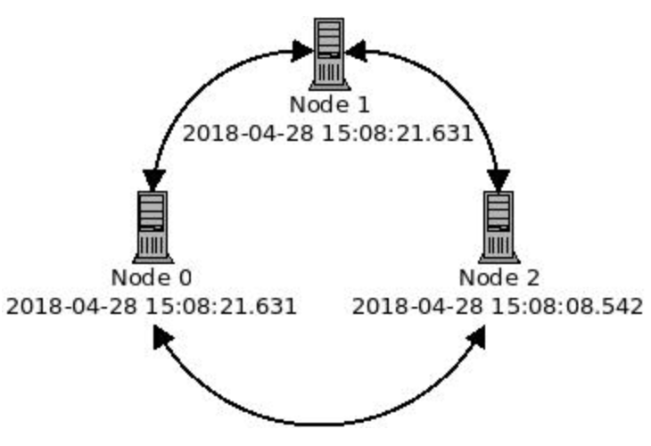
Operating system optimizations
Notes:
As Cassandra's log-based storage is timestamp-driven, it is absolutely critical that all nodes in a cluster have synchronized clocks. To this end, instances running Cassandra should be using NTPD or another time synchronization application to keep all system clocks in a cluster in sync.
Issues related to time synchronization discrepancies can manifest themselves as obsolete data or deleted data ghosting itself.
Consider the following current times from instances in a three-node cluster:

Slide 231
Operating system optimizations
Let's say I run the following CQL to create a simple table:
cassdba@cqlsh:packt> CREATE TABLE keyvalue (key TEXT PRIMARY KEY, value TEXT);
cassdba@cqlsh:packt> INSERT INTO keyvalue(key,value) VALUES('timetest','blue');

Slide 232
Operating system optimizations
These requests are handled by Node 1, and, with an RF of three, replicate out to Node 0 and Node 2. Selecting the key, value, and writetime of that value returns this result:
cassdba@cqlsh:packt> SELECT key,value,writetime(value) FROM keyvalue WHERE key='timetest';
key | value | writetime(value)
-----------+-------+------------------
timetest | blue | 1524929184866290

Slide 233
Operating system optimizations
So far, so good. Now, let's say about 5 seconds later, I run another INSERT request:
cassdba@cqlsh:packt> INSERT INTO keyvalue(key,value) VALUES('timetest','green');
Notes:
Let's say that this request is handled by Node 2, which is behind the other two by 13.009 seconds. The new value of green is persisted on Node 2, and the snitch ensures that the other two replicas get written to Node 0 and Node 1.

Slide 234
Operating system optimizations
Let's see what happens when we re-run our SELECT query:
cassdba@cqlsh:packt> SELECT key,value,writetime(value) FROM keyvalue WHERE key='timetest';
key | value | writetime(value)
-----------+-------+------------------
timetest | blue | 1524929184866290
Notes:
Wait a minute, shouldn't value be green? What happened was that, as the request was handled by Node 2, the value of green was persisted with a writetime of 1524929178272916.
As you can see, this is about 6.6 seconds before the writetime for blue of 1524929184866290.
Essentially, this means that as far as Cassandra is concerned, the most recent write to that data was already present. Hopefully, this demonstrates why it is so important to have your instance clocks synchronized with Cassandra.

Slide 235
Configuring the JVM
Apache Cassandra was written in Java, and therefore requires a JVM to run.
Make sure to download a Java Runtime Environment (JRE) or Java Development Kit (JDK) to include as a part of your Cassandra installation.
Unless otherwise noted, the latest patch of version 8 of the Oracle JDK or OpenJDK should be used.
Notes:
Note
At the time of writing, Apache Cassandra is not currently compatible with Java 9 or higher.
Adjustments to the JVM settings used by Cassandra can be made in the jvm.options configuration file. Many of those settings deal with the configuration and tuning of the garbage collector.
Garbage collection
Probably the most noticeable aspect of the JVM is how it manages garbage collection. There are two main garbage collectors used: Concurrent Mark Sweep (CMS) and the G1GC. Both have their strengths and weaknesses, and both can be made to perform well with Cassandra.
Note
There is so much information available on JVM garbage collection configuration that an entire COURSE could be written on the subject. As this is out of scope for this COURSE, JVM garbage collection settings will be discussed within the parameters of what works best with Cassandra.
CMS
The CMS garbage collector is the default garbage collector that is used with Apache Cassandra. CMS is known as a generational garbage collector. It works by dividing the Java heap into contiguous ranges of memory. Each range of memory or generation is responsible for holding objects that are created (and eventually discarded) by a Java application.

Slide 236
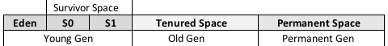
Configuring the JVM
When certain conditions arise, the garbage collector runs and reclaims heap space by collecting unused objects, and promoting the remaining objects (survivors) to a different generation:
Notes:
Figure: A representation showing the different sections of the JVM heap when using the CMS garbage collector
All objects are created in the Eden space of the Young Gen (DataStax, 2018). When the Eden space is full, unused objects are collected. Those still referenced are moved to a Survivor Space.
When these spaces are full (or other thresholds are met), the survivors are then promoted to Tenured Space. When this type of collection runs to clean up the Young Gen, it is known as a Minor GC.
When the space of the Old Gen reaches 92% full (Eichwald, 2016), the collection process runs on it as well.
Collections run on the Old Gen are not necessarily bad. But, sometimes, a collection can be triggered on both generations concurrently. This process, known as a Full GC or a stop-the-world GC, is what you want to avoid. It is single threaded (DataStax, 2018), and can be very slow (with Cassandra, stop-the-world pauses as long as 10 seconds are not unheard of).
Note
The promotion of objects between generations is very expensive, and can happen in both minor and full collections.

Slide 237
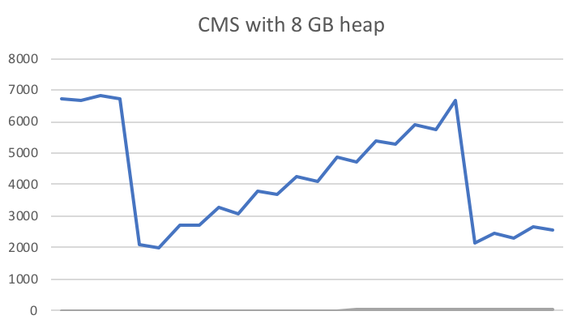
Configuring the JVM
Let's examine a graph which exhibits a common, healthy heap usage pattern with the CMS garbage collector:
Notes:
Figure : A representation of the typical sawtooth garbage collection activity using CMS
The preceding diagram provides a visual representation of the heap memory reclamation pattern typically seen with the CMS garbage collector. Sometimes known as a sawtooth pattern, the small changes in heap memory usage represent minor collections, while the big drops (from 6.9 GB down to 2.1 GB) are full collections.
Note
It is a good idea to graph-out your heap usage, so that you can map and compare it to other graphs, such as read or write latencies. This (combined with the garbage collection logs) can help you to see if you have an issue with garbage collection consuming too much resource.
Here are some helpful settings for using the CMS garbage collector with Apache Cassandra. In fact, if you look in the jvm.options file (cassandra-env.sh for version <= 2.2), you should see the following JVM properties:
-XX:+UseParNewGC: This indicates that a parallel collector should be used for the new generation, in conjunction with the CMS garbage collector.
-XX:+UseConcMarkSweepGC: This indicates that the CMS collector should be used for the Old Gen.
-XX:+CMSParallelRemarkEnabled: This indicates that the remarking cycle is done in parallel. Recommended for many-core instances.
-XX:SurvivorRatio: This defaults to eight, meaning that each Survivor Space (S0, S1) is one-eighth of the total Young Gen size.
-XX:MaxTenuringThreshold: This indicates the number of times an object can be copied between Young Gen spaces (Eden and each Survivor Space). Once an object has been copied this many times, it is promoted to the Old Gen. While it is typically defaulted to 1 in the Cassandra configs, increasing it is usually a good idea.
-XX:+CMSClassUnloadingEnabled: This tells the JVM to unload classes that are no longer needed.
-Xms: This indicates the initial size of the JVM heap.
-Xmx: This indicates the maximum size of the JVM heap.
-Xmn: This indicates the new and Young Gen size (aka the heap new size).

Slide 238
Configuring the JVM
When configuring a CMS heap for use with Apache Cassandra, the cassandra-env.sh file will compute the default size of your heap.
First, the maximum heap size is calculated, based on the following formula:

Slide 239
Configuring the JVM
Similarly, the size of the Young Gen is computed with this formula:
Notes:
The default calculations will probably be fine on a local instance, or maybe even a development environment. But for a stage/test or production environment, the initial, maximum, and new heap sizes should be overridden.
Also by default, the initial heap size and max heap size are set to the same value. This prevents possible latency due to heap sizing.
The default calculation for the maximum heap size is meant to prevent new users from setting their heap sizes too big. Typically, max heap sizes greater than 8 GB are not encouraged with CMS garbage collection. The idea is that (with the current heap new size default formula), increasing the heap simply increases the size of the Old Gen and Permanent Gen, leading to longer pauses during full garbage collections.
Note
In addition to the default calculation, some older documentation on Apache Cassandra also recommends setting the heap new size (the -Xmn parameter) to 100 MB per CPU core. For instances with fewer resources, this is often not sufficient, and can cause the JVM to have to work too hard/often to run collection and promotion on the Eden space and each Survivor Space. A better plan (Tobey, 2015) is to size the new generation to 25% of the maximum heap size (-Xmx).
Some additional recommendations come from the official Apache Cassandra Jira issues project (CASSANDRA-8150). This Jira ticket (Apache, 2016) was opened in late 2014, as an attempt to revisit and update some of the default CMS garbage collection settings. At the time of writing (2018), it remains unresolved.
Despite this, it did spark some good discussion on acceptable CMS settings, based on results observed on clusters backing large-scale social media sites.
According to Haddad, 2018, some of the suggestions are:
Increasing the max heap size to 20 GB.
Increasing the size of the new generation between 25% and 50% of max heap size.
Increasing MaxTenuringThreshold to a value of around six or eight. This allows surviving objects to remain in the Young Gen longer, thus avoiding costly promotions.
Setting parallel and concurrent garbage collections threads to the minimum value of 20 or more number of cores. The idea here is to find a happy point where the collector can use enough threads to run efficiently, without choking the system of resources.
Note
While CASSANDRA-8150 can help to provide a great deal of information as to how the CMS garbage collector works with Cassandra, do not simply mix and match settings. Please read through the ticket, and only implement settings once you understand what they do. It is also a good idea to implement GC settings in a test or stage environment first (sometimes on a single node for comparison), before trying them in production.

Slide 240
Configuring the JVM
G1GC
A newer garbage collector innovated in the last few years is the G1GC.
The G1GC organizes its heap memory differently to the contiguous memory diagram previously seen, used for parallel collectors, such as CMS.
Notes:
The G1 heap is targeted as a matrix of 2,048 small regions. Each region is between 1 MB and 32 MB, and can be either Eden space, Survivor Space, or (tenured) Old Gen space (Eichwald, 2016)

Slide 241
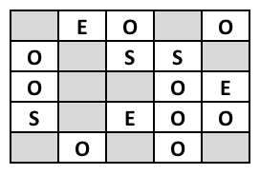
Configuring the JVM
This is demonstrated in the following diagram:
Notes:
Figure : A representation of the different sections of the G1GC heap (25 regions shown for brevity)
In the preceding diagram, the E represent the Eden space, the S represent Survivor Space, and the O represent Old Gen.
The primary setting for G1GC is MaxGCPauseMillis. This is a target time for how long a pause will be incurred by the collector. This comes into play as the collector will analyze a sampling of the regions in the heap, and determine which regions it can run on within its target time (DataStax, 2018).

Slide 242
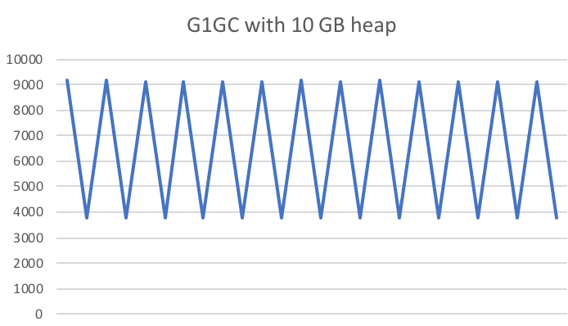
Configuring the JVM
The collection of other regions are then delayed until later:
Notes:
Figure : A representation of garbage collection activity using G1GC
One easily noticeable difference between the CMS and G1 garbage collectors is that the pattern of heap memory usage graphs quite differently. While CMS heap usage/activity typically resembles the sawtooth pattern, G1 does not.
The G1 collector sees a much larger deviation in heap usage over a short period of time. This rapid reclamation of heap is observed because G1 is designed to make intelligent decisions about which regions to collect and promote.
Another difference is that G1 almost always performs better with larger heap sizes. With heap sizing for G1, the general idea is to estimate how much data will be on-heap at a time and then double it. Ideally, G1 will run with half its space free, allowing it more freedom with region allocation and Young Gen sizing.
While a CMS heap shouldn't typically exceed 8 GB, a G1 heap can easily be sized (instance resources permitting) between 20 GB and 26 GB.
Here are some helpful settings for using the G1 garbage collector with Apache Cassandra. As with the CMS settings, the jvm.options file (cassandra-env.sh for version<=2.2) contains a list of default and optional settings:
-XX:+UseG1GC: This indicates that the JVM should use G1GC.
-XX:+G1RSetUpdatingPauseTimePercent=5: This instructs the JVM to do less remembered set work during stop-the-world pauses.
-XX:MaxGCPauseMillis=500: As mentioned earlier, this is the most impactful setting for tuning G1GC. 500 milliseconds is a good starting point. Note that this is only a target time; the JVM will try to keep collection times under/at this number, but will not always succeed. Increase this value to help with throughput issues; lower it to reduce stop-the-world pauses.
-XX:InitiatingHeapOccupancyPercent=70 (optional): This delays region scanning until the heap is 70% full.
-XX:ParallelGCThreads=16 (optional): For systems with more than eight CPU cores, the default is 5/8 of the number of logical cores.
-XX:ConcGCThreads=16 (optional): The default value is one-quarter of ParallelGCThreads. In some cases, setting both to the same value may decrease stop-the-world pauses (optional).
-XX:G1MixedGCCountTarget=8 (optional): This indicates the target number of mixed garbage collections after a marking cycle to collect old regions. The default is 8.
-XX:G1HeapRegionSize=n (optional): This controls the size of the heap regions. Note that increasing this value decreases the number of regions, and vice versa. Not setting this property lets the G1 collector compute it (recommended).
-Xms: This indicates the initial heap size.
-Xmx: This indicates the maximum heap size.
You should notice the absence of the heap new size parameter (-Xmn) for the size of the Young Gen. G1GC computes the size of the Young Gen on its own, and adjusts it adaptively to help the collector complete within the specified target time (MaxGCPauseMillis). You'll find that G1 will compute this and many other values on its own.
As with the CMS garbage collector, max heap size and initial heap size should be set to the same value.
Note
Just in case the previous paragraph was not completely clear, do not set a value for the heap new size parameter (-Xmn) when using G1GC. Simply comment-out that line in the cassandra-env.sh or jvm.options file.
Note
Newer versions of Apache Cassandra require JDK version 1.8., patch level 40. You can use G1GC with older versions of Cassandra (2.0, 2.1, and 2.2), but it is not advisable to use G1GC with JDK version 1.7. If you are stuck running on a pre-1.8 JDK, you should opt for the CMS garbage collector.
Initially, with Apache Cassandra 3.0, the G1 collector was intended to be the new default. However, this soon was discovered to be problematic. Smaller, local development instances of Cassandra became subject to garbage collection latencies. The default cassandra-env.sh calculation of heap sizes made it difficult for the G1 collector to adequately adapt to its available resources on most developers' laptops. Thus, the CMS collector remains the default garbage collector for Apache Cassandra, for now.
Despite these problems with development instances, the G1 collector should be the go-to garbage collector for production Cassandra instances. Although CMS is still relevant, and quite capable of achieving minimal interference from garbage collection, it typically requires more configuration and a thorough understanding of the JVM to utilize it properly.
Note
My team supports dozens of clusters across hundreds of production nodes, and we've used G1GC exclusively for the last 2 years.

Slide 243
Configuring the JVM
Garbage collection with Cassandra
High throughput use cases will almost always generate garbage collection.
Even clusters with access patterns that tend to be mostly read-serving can see heavy collection activity when their batch loaders run.
Notes:
For a cluster that backs something customer-facing, minimizing garbage collection pause times is imperative.
In the pre-G1GC days, stop-the-world garbage collections were a common pain point for many production clusters. Successfully tuning the CMS (and other collectors) takes a great deal of skill, time for testing, and knowledge of the JVM and its behaviors. The inherent efficiency tuning intrinsic to G1GC tends to simplify the process greatly, which is one of the reasons its use is recommended for Apache Cassandra.

Slide 244
Configuring the JVM
Installation of JVM
With the JDK downloaded, untar it, and move it to a location other than your home directory.
For the purposes of this example, we'll put it in /usr/local/:
sudo tar -zxvf jdk-8u171-linux-x64.tar.gz
sudo mv jdk1.8.0_171 /usr/local
sudo alternatives --install /usr/bin/java java /usr/local/jdk1.8.0_171/bin/java 1
sudo alternatives --set java /usr/local/jdk1.8.0_171/bin/java
Notes:
Installation of the JVM is quite simple. Download the most recent patch version of the JDK, and distribute it to the node(s) you are building via scp, wget, curl, or another method of orchestration.
Note
Remember, Cassandra 3.x should use Java 8.

Slide 245
Configuring the JVM
Alternatively, you can install the JDK via your Linux package management system.
For Debian Linux, try:
sudo apt-get install openjdk-8-jdk
Or for Red Hat Linux:
sudo yum install java-1.8.0-openjdk

Slide 246
Configuring the JVM
Now test your JDK by executing java -version:
java -version
openjdk version "1.8.0_171"
OpenJDK Runtime Environment (build 1.8.0_171-b11)
OpenJDK 64-Bit Server VM (build 25.171-b11, mixed mode)
Notes:
Note
It's recommended to install the JDK, as it has extra tools that can help you configure and troubleshoot issues with your JVM. I've never installed the JDK and wished that I had only used the JRE instead. But I have been in a position where I needed something in the JDK, only to find out that I only had a JRE at my disposal.

Slide 247
Configuring the JVM
JCE
Downloading and installing the JCE enables certain additional cipher suites to be used with Apache Cassandra.
With Ubuntu or another Debian Linux flavor, installing the JCE is as simple as this:
sudo apt-get install oracle-java8-unlimited-jce-policy
Notes:
If you plan on using node-to-node or client-to-node SSL, you may be required to download the Java Cryptography Extensions (JCE). The JCE exists as a separate download, and is not packaged with the JRE or JDK. This is due to legal issues surrounding export restrictions to certain countries from the United States.

Slide 248
Configuring the JVM
unzip jce_policy-8.zip
Archive: jce_policy-8.zip
creating: UnlimitedJCEPolicyJDK8/
inflating: UnlimitedJCEPolicyJDK8/local_policy.jar
inflating: UnlimitedJCEPolicyJDK8/README.txt
inflating: UnlimitedJCEPolicyJDK8/US_export_policy.jar
Notes:
It can also be downloaded from Oracle and installed via the command line. Visit http://www.oracle.com/technetwork/java/javase/downloads/jce8-download-2133166.html and download jce_policy-8.zip:

Slide 249
Configuring the JVM
Once the file is unzipped, move the policy files to the jre/lib/security directory of your JDK ($JAVA_HOME):
cd /usr/local/jdk1.8.0_171/jre/lib/security/
sudo cp ~/UnlimitedJCEPolicyJDK8/US_export_policy.jar .
sudo cp ~/UnlimitedJCEPolicyJDK8/local_export_policy.jar .

Slide 250
Configuring Cassandra
Configuring a single node for Apache Cassandra is done in a few files located in the conf directory of the instance's Cassandra installation.
Modification of many of these files can be optional for local instance, development deployments (the defaults should suffice).
Notes:
But for production deployments, most of these files should be adjusted.

Slide 251
Configuring Cassandra
cassandra.yaml
The cassandra.yaml file is the main configuration file for each node in a Cassandra cluster.
Many of the behaviors of a node can be controlled or influenced from this file.
While the settings in cassandra.yaml are specific to the node on which the file resides, some settings do need to be the same throughout the cluster (these will be noted).
Notes:
Failure to do this may cause the node to fail to start, join, or cause unpredictable behavior.
Note
This file is in the yet another markup language (YAML) format, so be aware that proper spacing and formatting are important. The cassandra.yaml properties are listed here in the order which they appear in the file:
cluster_name: This is the name of the cluster, and it is case sensitive. New nodes joining an existing cluster must have a matching cluster_name.
auto_bootstrap: This is a Boolean property, no longer present in the cassandra.yamlfile, that controls whether or not the node streams data when joining a cluster. It is set to true by default. If you want to disable this behavior, simply add it to the file with a value of false.
num_tokens: This is an integer, representative of the number of token ranges this node should be responsible for. Setting this property to a value greater than one invokes vnodes. This value defaults to 256, as this setting came about with the old storage engine and allocation algorithms. With Apache Cassandra 3.0 and up, most production installations should be fine running on a value between 12 and 32.
allocate_tokens_for_keyspace: This designates the name of a single keyspace to optimize token allocation for the node. This option is only valid when using the Murmur3Partitioner. The allocate_tokens_for_keyspaceparameter essentially helps Apache Cassandra figure out the optimal token distribution based on the RF of the specified keyspace.
initial_token: This allows for manual specification of token ranges. When used with vnodes, it expects a comma-separated list of token start values.
hinted_handoff_enabled: This is a Boolean value, indicating whether or not this node will participate in hinted handoffs.
hinted_handoff_disabled_datacenters: When hinted handoff is enabled, this allows the specification of data centers that will be excluded from participation.
max_hint_window_in_ms: When hinted handoff is enabled, this determines how long hints are stored for an unresponsive node. The default is 10,800,000 milliseconds (3 hours).
hinted_handoff_throttle_in_kb: This allows hinted handoff activity to be tuned, so as to not consume too much resource. Note that this throttle rating represents a per-thread value of throughput to be shared by the entire cluster. For example, with a default value of 1024 Kbps, a five-node cluster will divide that value evenly by four (256 Kbps), with one node assumed to be receiving the hint traffic.
max_hints_delivery_threads: This designates the number of threads to be used by the node to deliver hints to other nodes. It defaults to a value of two.
hints_directory: New to Apache Cassandra 3.0, this specifies a location on-disk to store any hints to be delivered to other nodes. If not set, the default is $CASSANDRA_HOME/data/hints.
hints_flush_period_in_ms: This determines how often hints should be flushed to disk. The default is 10,000 (10 seconds).
max_hints_file_size_in_mb: This controls the size of the hints files on-disk. When this limit is reached, a new file is written.

Slide 252
Configuring Cassandra
hints_compression: This indicates the compression class and options to be used for on-disk hint storage.
The default is none, which means hints will be written uncompressed.
The available compression classes are LZ4Compressor, SnappyCompressor, and DeflateCompressor.
Additional properties can also be added, as follows:
hints_compression:
- class_name: LZ4Compressor
parameters:
- chunk_length_kb: 64
- crc_check_chance: 1.0
Notes:
batchlog_replay_throttle_in_kb: This indicates the overall maximum throttle for hint replay. As with hinted_handoff_throttle_in_kb, this represents a total value of throughput to be shared by the entire cluster. The default value is 1024.
authenticator: This controls how users are authenticated when connecting to this Cassandra node. By default, it is set to a value of AllowAllAuthenticator, which does not require a valid username and password combination to connect. The other delivered authentication class is PasswordAuthenticator. This should be used for production systems, and creates the system_authkeyspace with the default cassandra/cassandra username and password combination.
authorizer: This controls which users have access to certain keyspaces or tables, as well as the permissions available to them. AllowAllAuthorizer is the default, and allows all users the ability to perform any action. When using PasswordAuthenticator, it is a good idea to also enable CassandraAuthorizer to enforce access and permission assignment.
role_manager: This allows for the implementation of role-based security, in which roles can be assigned permissions, and users can be assigned to roles. The default value is CassandraRoleManager, which is sufficient for most deployments.
role_validity_in_ms: As pulling back roles can be somewhat expensive, user roles granted are cached and reloaded asynchronously after this time period elapses. The default is 2000 (2 seconds). It has a corresponding setting known as roles_update_interval_in_msthat defaults to the same value, but can be set to update the role cache at a different interval.
permissions_validity_in_ms: Similar to role_validity_in_ms, this represents the amount of time for which the permissions cache is valid. The default is 2000 (2 seconds). It has a corresponding setting known aspermissions_update_interval_in_msthat defaults to the same value, but can be set to update the permissions cache at a different interval.
partitioner: This configures which partitioner will be used for this node/cluster. Once one is chosen, it cannot be changed without deleting and reloading all data. The default Murmur3Partitioner should not be changed for new deployments.

Slide 253
Configuring Cassandra
data_file_directories: This specifies where on-disk the data for the node's keyspaces and tables should be stored.
The default location is $CASSANDRA_HOME/data/data.
If multiple directories are specified, the data will be spread across them evenly; for example:
data_file_directories:
- /cass_ssd_data0
- /cass_ssd_data1
- /cass_ssd_data2
Notes:
commitlog_directory: This specifies the location where the commitlog files should be stored. If the instance is using spinning disk drives, this should be a different physical disk to the data drive(s). The default location is $CASSANDRA_HOME/data/commitlog.
Note
Any changes to the cassandra.yaml file must be followed by a restart of the Cassandra process in order for them to take effect.
cdc_enabled: This is a Boolean value indicating whether or not Change Data Capture (CDC) is enabled.
cdc_raw_directory: This specifies the on-disk location where the CDC data is stored. The default value is $CASSANDRA_HOME/data/cdc_raw.
disk_failure_policy: This setting determines the node behavior if a disk should fail. The default value is stop. Possible other values are as follows:
die: Stops the node for any type of filesystem errors or SSTable errors
stop_paranoid: Stops the node for single SSTable errors
stop: Stops gossip and client availability, but can still be reached via JMX
best_effort: Node remains running, but it stops trying to use the affected disk and completes incoming requests using the remaining available resources
ignore: Node remains running and allows requests to fail
commit_failure_policy: This setting determines the node behavior if a write to the commitlog should fail. The default value is stop. Possible other values are as follows:
die: Stops the node
stop: Stops gossip and client availability, but can still be reached via JMX
stop_commit: Essentially disables the commitlog, allowing the node to continue to service reads
ignore: Node remains running and allows commitlog batches to fail
prepared_statements_cache_size_mb: This setting determines how much of the JVM heap to use for caching prepared statements. The default value is either 10 MB or 1/256 of the heap, whichever is the larger.
Note
If you notice errors in the log about discarding prepared statements because the limit has been reached, resist the urge to increase this value without further investigation. You should first reach out to the application team, and make sure that they are not creating prepared statements inside a loop construct.
key_cache_size_in_mb: This sets the amount of memory on-heap to use for the key cache. It defaults to either 100 MB or 5% of the heap, whichever is the lesser. Setting it to zero will disable key caching.
key_cache_save_period: This determines how long to keep keys in the key cache. The default is 14,400 seconds (4 hours).
key_cache_keys_to_save: This determines how many keys to save in the cache. By default, there is no limit and all keys are saved for the duration specified by key_cache_save_period.
row_cache_class_name: This specifies which row caching mechanism to use. While it is disabled by default, there are two possible implementations:
SerializingCacheProvider: The original off-heap row cache implementation
OHCProvider: A newer implementation; this also stores the row cache in off-heap memory, but faster than SerializingCacheProvider
row_cache_size_in_mb: This sets the amount of memory to use for the row cache. As row caching can use a significant amount of memory, this is disabled by default (set to zero) as a precaution.
row_cache_save_period: This indicates the number of seconds that a row should be cached for. The default is zero to disable row caching.
row_cache_keys_to_save: This determines the maximum number of rows to save in the cache.
counter_cache_size_in_mb: This sets the amount of memory on-heap to use for the counter cache, which can help reduce problems with counter lock contention. By default, it is sized at either 2.5% of the heap or 50 MB, whichever is the lesser. It can be disabled by setting it to zero.
counter_cache_save_period: This determines how long to keep entries in the counter cache. The default is 7200 seconds (2 hours).
counter_cache_keys_to_save: This determines the maximum number of entries to save in the counter cache.
saved_caches_directory: This specifies the on-disk location of the saved caches. It defaults to $CASSANDRA_HOME/data/saved_caches.
commitlog_sync: This determines the behavior around how often fsync is invoked to persist the commitlog to disk. Available options are as follows:
batch: The node does not acknowledge writes until fsync has completed on the commitlog, waiting commitlog_sync_batch_window_in_ms time between fsync calls
periodic: The node acknowledges writes immediately, but fsync may not be called on the commitlog until the next commitlog_sync_period_in_ms interval
Note
Just because fsync has been called, that does not necessarily mean that the data has been fully-persisted, as it could be in the disk cache.
commitlog_segment_size_in_mb: This determines the size of the commitlog files. Note that this setting works in tandem with the settings from the commitlog_archiving.propertiesfile. You can use them together to accurately set/estimate the disk footprint of your commitlog.
max_mutation_size_in_kb: This forces an upper limit on the size of a mutation in KB. If this setting is used, commitlog_segment_size_in_mbshould be set to twice its value (times 1024).

Slide 254
Configuring Cassandra
commitlog_compression: The commitlog can be compressed by specifying the compression class and options to be used.
The default is none, which means the commitlog will be uncompressed.
Available compression classes are LZ4Compressor, SnappyCompressor, and DeflateCompressor, as follows:
commitlog_compression:
- class_name: LZ4Compressor
parameters:
- chunk_length_kb: 64
- crc_check_chance: 1.0
Notes:
seed_provider: Apache Cassandra delivers with one seed provider: the SimpleSeedProvider. Most users will never need to alter this.
Note
Like many classes in Apache Cassandra, this setting is pluggable, allowing you to use third-party or custom seed providers. You can write your own, as long as it implements the SeedProvider interface.

Slide 255
Configuring Cassandra
seeds: A parameter of SimpleSeedProvider, this is where you specify your list of seed nodes (in double quotes, comma-delimited).
The default value is 127.0.0.1, which is always wrong in a plural node configuration, for example:
seeds: "192.168.0.101,192.168.0.102,192.168.1.21,192.168.1.22"
Notes:
Note
Remember, specifying a node as a seed node does not differentiate it from its peers in any way. All seed nodes really do is provide a way for a new node to figure out the cluster topology. Any existing node can be a seed node for a new node. Nodes that specify themselves as seed nodes will not bootstrap (stream data upon joining).
concurrent_reads: This compute concurrent_readsas the number of hard drives x 16. The default value of 32 should work for most implementations. Note that Cassandra will fail to start if this value is less than 1.
concurrent_writes: As writes tend to be more dependent on CPU cores than they are on-disk I/O, concurrent_writescan be computed as CPU cores x eight. The default value of 32 should work for most implementations.
concurrent_counter_writes: The concurrent_counter_writesproperty should be computed in the same way asconcurrent_reads. This is because counter updates perform a read before they write, and will be bottlenecked more by their read time than their write time. It also defaults to 32.
concurrent_materialized_view_writes: This also performs a read, so it should be set under similar conditions to concurrent_counter_writes. It also defaults to 32.
file_cache_size_in_mb: This sets the maximum amount of off-heap RAM to be used for SSTable chunk cache and buffer pooling. The default is either 512 MB or one-quarter of the maximum heap size, whichever is the lesser.
disk_optimization_strategy: Cassandra can make small optimizations to help reads perform better. There are two possible options:
ssd: The default setting, for use if the instance is backed by SSDs
spinning: To be used if the instance is backed by platter and spindle-based storage
memtable_heap_space_in_mb: This indicates the maximum amount of RAM to use for on-heap memtables. The default value is one-quarter of the maximum heap size.
memtable_offheap_space_in_mb: This indicates the maximum amount of RAM to use for off-heap memtables. The default value is one-quarter of the maximum heap size.
memtable_allocation_type: This property is new as of Cassandra 2.1, and allows you to direct Cassandra to move some of its memtable processing off the JVM heap. On machines with smaller heaps, this can help to alleviate some of the heap pressure. The following options are available for configuration:
heap_buffers: This is the default setting, and keeps memtable objects on the JVM heap
offheap_buffers: This moves cell names and values to buffer objects off-heap (Ellis, 2014)
offheap_objects: This moves the whole cell off-heap, leaving only a reference on the heap (Ellis, 2014), pointing to the off-heap cells
commitlog_total_space_in_mb: This indicates the maximum amount of on-disk space to use for the commitlog. When the active commitlog file exceeds this value, the tables in the oldest segment are flushed to disk. The default size is either one-quarter of the max heap or 8 GB, whichever is the lesser.
memtable_flush_writers: This property indicates how many threads should be used to flush memtables to disk. The default value is calculated at two threads per data directory.
cdc_total_space_in_mb: If CDC is enabled for a table, this sets the maximum amount of disk space to use for CDC logs. The default is either 4 GB or one-eighth of the available disk, whichever is the lesser.
cdc_free_space_check_interval_ms: This property indicates how much time Cassandra waits before checking if more CDC space is available on-disk. The default value is 250 milliseconds.
index_summary_capacity_in_mb: This indicates the amount of RAM allocated for SSTable index summaries. The default value is 5% of the maximum heap size.
index_summary_resize_interval_in_minutes: This is the duration in minutes after which the index summaries are resampled. The default value is 60 minutes.
trickle_fsync: false: This enables calling fsync during sequential writes, which instructs the OS to flush the output buffers to disk. Without this setting, the OS decides when to flush the buffers, which can impact read performance. It is set to false by default, but should be enabled when Cassandra is backed by SSDs.
trickle_fsync_interval_in_kb: This sets a threshold in KB for when to force fsync call, if trickle_fsyncis enabled.
storage_port: This indicates the port that Apache Cassandra uses for internode communication, via TCP. It defaults to 7000.
ssl_storage_port: When node-to-node SSL encryption is enabled, Apache Cassandra uses this port for internode communication, via TCP. It defaults to 7001.
listen_address: This indicates the address of the instance to bind to and advertise to other Cassandra nodes. If the instance has both internal and external IP addresses, this should be set to the internal IP address. It defaults to localhost, which is always wrong in a plural node configuration.
listen_interface_prefer_ipv6: This is a Boolean property that is useful if the instance has both IPv4 and IPv6 addresses, and instructs Cassandra to prefer one over the other when binding the listen_address. The default value is false.
listen_interface_: This indicates the network interface to listen on. This can be specified instead of listen_address, but do not specify both.
broadcast_address: This indicates the address of the instance to broadcast to the other nodes in the cluster. If the instance has both internal and external IP addresses, this should be set to the external IP address. It defaults to the value specified for listen_address.
start_native_transport: This is a Boolean property that specifies whether or not Apache Cassandra should start its native transport server process. The default value is true.
Note
The native binary protocol is the new de facto standard for handling client connections to Cassandra. It should always be set to true, as the delivered cqlsh tool connects using this protocol.
native_transport_port: This property specifies the port on which to listen for native binary protocol client traffic (TCP). The default value is 9042.
start_rpc: This is a Boolean property indicating whether or not Apache Cassandra should start the Thrift RPC server process. The default value is false.
Note
Cassandra's Thrift RPC server has been deprecated since Cassandra 2.2, and will be removed with Apache Cassandra version 4.0. As the Hector project (Cassandra’s early Thrift-based client library) has been marked as inactive, and cqlsh no longer uses Thrift, there should not be any reason to enable this setting.
rpc_address: This indicates the address of the instance to bind to and advertise for client connections, for both native binary and Thrift. If the instance has both internal and external IP addresses, this should be set to the internal IP address. It defaults to localhost, which is always wrong in a plural node configuration.
rpc_interface_prefer_ipv6: This is a Boolean property that is useful if the instance has both IPv4 and IPv6 addresses, and instructs Cassandra to prefer one over the other for client connections. The default value is false.
rpc_interface: This indicates the network interface to listen for client connections on. It can be specified instead of rpc_address, but do not specify both.
rpc_port: This property specifies the port on which to listen for Thrift traffic (TCP). The default value is 9160.
broadcast_rpc_address: This indicates the address of the instance to broadcast to client connections, for both native binary and Thrift. If the instance has both internal and external IP addresses, this should be set to the external IP address. It defaults to the value specified for rpc_address.
rpc_keepalive: This is a Boolean property that indicates whether or not a keepalive should be used with client connections. The default value is true.
rpc_server_type: This property specifies how client connections are managed. In addition to the possibility of writing a custom class to handle this, there are two options provided:
sync: This indicates the default value, which indicates one thread per client connection
hsha: Half synchronous, half asynchronous handles client connections asynchronously with a small number of threads. Actual requests made by clients are still synchronous.
rpc_max_threads: This sets the maximum limit as to how many client requests can be handled concurrently. If setting the rpc_server_typeto sync, this also limits the number of client connections. This setting is used as a way to protect the node(s) from being overloaded by client requests. It is commented-out by default, providing no limit to the number of threads for client requests.
incremental_backups: This is a Boolean property that indicates whether or not incremental backups are enabled. This creates a hard link to the SSTable files in the backups directory of each table. The default value is false, as this does tend to consume disk space.
snapshot_before_compaction: This is a Boolean property that indicates whether or not to take a snapshot of each table before compaction runs on it. The default value is false, as this does tend to consume disk space.
auto_snapshot: This is a Boolean property that indicates whether or not to take a snapshot of a table before applying a TRUNCATEcommand or dropping the table. The default value is false, as this does tend to consume disk space.
column_index_size_in_kb: This indicates the space to use for the index of rows in a partition, in KB. The default value is 64, but should be increased for data models that have a high number of rows per partition. This setting also has a direct impact on how much data is stored in the key cache.
column_index_cache_size_in_kb: This indicates the space to use for the serialized index per SSTable. The default value is two.
concurrent_compactors: This indicates the number of concurrent compactions to allow on the node. If your storage is SSD-based, this can be set to the number of CPU cores. Setting it too high can increase GC activity, so a good strategy to use for this value (Apache, 2016) is to set it to four (with SSDs). Then test your system watching for resource consumption, and adjust from there.
compaction_throughput_mb_per_sec: This setting assigns a value of throughput in Mbps (megabits per second) to help control how much available computing resources should be used for compaction. This defaults to 16, but resources should be monitored and it should be adjusted as needed. If this setting is too high, the node may use too much resource to compaction, affecting its ability to serve requests. If the setting is too low, then compactions may not happen frequently enough to keep up, resulting in pending compactions building up and queries getting slower due to row fragmentation across SSTable files.
Note
Setting compaction_throughput_mb_per_sec to zero effectively disables throttling, essentially removing a limit as to how much resource compaction can consume.
Note
This setting is your main control to throttle compaction up or down, as the need arises. While adjusting the property in the cassandra.yaml file is the only way to make a value permanent (requiring a restart), this setting can be adjusted at any time using the nodetool utility.
stream_throughput_outbound_megabits_per_sec: This setting allows for throttling the amount of data streamed to other nodes, such as during a repair or bootstrapping process. The default is 200 Mbps (megabits per second).
inter_dc_stream_throughput_outbound_megabits_per_sec: This setting allows for throttling the amount of data streamed to nodes in other data centers, which can happen when running a rebuild. This is useful if there are bandwidth constraints between different physical data centers or cloud providers. The default is 200 Mbps (megabits per second).
*_request_timeout_in_ms: There are several settings that govern different types of request timeouts. These timeouts exist to protect the node from devoting too much resource to a single request. They are listed as follows, along with their default values:
read_request_timeout_in_ms: 5000
range_request_timeout_in_ms: 10000
write_request_timeout_in_ms: 2000
counter_write_request_timeout_in_ms: 5000
cas_contention_timeout_in_ms: 1000
truncate_request_timeout_in_ms: 60000
request_timeout_in_ms: 10000
Note
You should never need to adjust the request timeouts. They exist to protect the node, and ultimately the cluster. If a developer tells you that their queries are getting rejected because of these timeout values, have a look at their data model and the queries it is trying to serve. It is the responsibility of the developer to build well-performing queries for their data model. It is not a Cassandra DBA's responsibility to adjust settings to accommodate poor queries or bad data models.
slow_query_log_timeout_in_ms: Queries that take longer than this value will be logged. The default value is 500 milliseconds. Setting this value to zero will disable the logging of slow queries.
cross_node_timeout: This is a Boolean property that allows for sharing of request information between nodes. This can help increase the accuracy of request timeouts, and prevent wasting resources on requests that have already timed out. The default value is false, because this setting can be problematic if the clocks are not synced accurately across all nodes.
phi_convict_threshold: Apache Cassandra uses the Phi Failure Accrual algorithm to determine the health of another node in gossip. A higher value increases the accuracy of the node-to-node health check, but can take longer to determine an answer. For a cluster built on-premises with a consistent network, the default value of 8 should suffice. However, if the cluster spans multiple data centers across different providers, or if network connection consistency is a problem, then a higher value of 10 or 12 should help prevent false positives.
endpoint_snitch: This determines which snitch class to use. There are several to choose from:
SimpleSnitch: The default snitch, which treats every node in the cluster as though it is in the same data center and rack. This is only suitable for single node, local deployments.
GossipingPropertyFileSnitch: The best choice for production. The data center and rack are configured on each node (cassandra-rackdc.properties).
PropertyFileSnitch: This was a common choice for production prior to the existence of GossipingPropertyFileSnitch. Each node has a list of all the other nodes in the cluster (along with their rack and data center), defined in the cassandra-topology.properties file.
Ec2Snitch: This is intended to be used with Amazon Web Services (AWS) EC2 deployments to a single region, designating the region as a data center and the availability zone as the rack. This snitch only uses private IP addresses, so it will fail if used with a cluster deployed across multiple regions.
Ec2MultiRegionSnitch: This is intended to be used with AWS EC2 deployments for clusters deployed across multiple regions. It uses public IP addresses (broadcast_address) to communicate with nodes in another region, and private IP addresses are used among nodes within the same region.
RackInferringSnitch: Each node's data center is inferred by the second octet in the node's IP address. Likewise, each node's rack is inferred by the third octet in the node's IP address. If your network topology is not built to match that, then it is best not to use this snitch.
GoogleCloudSnitch: This is intended to be used with nodes deployed on the Google Cloud Platform (GCP). The region is used as the node's data center, and the zone is used as the rack.
Note
When in doubt, use GossipingPropertyFileSnitch for production deployments. It can be made to work with all cloud providers. Do not mix endpoint snitches in a cluster. Each node should be configured to use the same snitch, regardless of data center or provider.
dynamic_snitch: This is a Boolean property that determines if the dynamic snitch is enabled. If not set, the default value is true.
Note
Jon Haddad (Principal Engineer for The Last Pickle) recently mentioned (Haddad, 2018) that disabling dynamic snitching often increases read performance.
dynamic_snitch_update_interval_in_ms: The amount of time in milliseconds that determines how frequently to calculate host scores (expensive). The default is 100 milliseconds.
dynamic_snitch_reset_interval_in_ms: The amount of time in milliseconds that determines how frequently the host scores are reset. The default is 600,000 milliseconds, or 10 minutes.
dynamic_snitch_badness_threshold: This is a decimal representing a percentage of how much faster a competing node must be to be a preferred target for a specific replica.
request_scheduler: This is a request scheduling class to be used for client requests. By default, the NoScheduler class is used. The RoundRobin class can also be used to adjust request throttling and per-keyspace weighting, which can be useful in multi-tenant clusters.
server_encryption_options: This is a set of properties that configures node-to-node secure socket layer (SSL). Available properties are as follows:
Internode_encryption:
none: Node-to-node SSL is disabled
all: All communication between nodes in the cluster is encrypted
dc: Communication is encrypted between logical data centers
rack: Communication is encrypted between logical racks
keystore: The on-disk location of the Java KeyStore file
keystore_password: The password of the Java KeyStore
truststore: The on-disk location of the Java TrustStore file
truststore_password: The password of the Java TrustStore
require_client_auth: Sets whether or not certificate authentication is enabled (two-way SSL)
require_endpoint_verification: Sets whether or not hostname verification is enabled
client_encryption_options: This is a set of properties that configures client-to-node SSL. Available properties are as follows:
enabled: A Boolean value indicating whether or not client-to-node SSL is enabled
keystore: The on-disk location of the Java KeyStore file
keystore_password: The password of the Java KeyStore
truststore: The on-disk location of the Java TrustStore file
truststore_password: The password of the Java TrustStore
require_client_auth: Sets whether or not certificate authentication is enabled (two-way SSL)
require_endpoint_verification: Sets whether or not hostname verification is enabled
Note
When installing and configuring a Java KeyStore with Apache Cassandra, remember to set the key with the same password as the KeyStore itself.
internode_compression: This determines whether communication between nodes is sent in a compressed format. Possible values are as follows:
all: All communication is compressed
dc: Communication between data centers is compressed
none: Internode compression is disabled
inter_dc_tcp_nodelay: This allows for some adjustment of internode network communication. When disabled, larger but fewer network packets are sent, which can help in reducing TCP overhead.
enable_user_defined_functions: This experimental feature allows the DBA to restrict UDFs.
enable_scripted_user_defined_functions: This experimental feature allows for the use of languages other than Java to write UDFs. This setting becomes moot if enable_user_defined_functionsis false.
enable_materialized_views: This experimental feature allows the DBA to restrict the usage of materialized views.
transparent_data_encryption_options: This is a set of properties that configures commitlog and hint file encryption on-disk. Available properties are as follows:
enabled: A Boolean value indicating whether or not Transparent Data Encryption (TDE) is enabled
chunk_length_in_kb: Size of the encrypted chunk length
cipher: Cipher standards to use with TDE
key_alias: Alias of the specific key inside the KeyStore to use
keystore: The on-disk location of the Java KeyStore file
keystore_password: The password of the Java KeyStore
store_type: Standard used by the KeyStore file
key_password: The password of the specific key inside the KeyStore
tombstone_warn_threshold: This indicates the number of tombstones that can be scanned in a partition or query before a warning message will be issued. The default value is 1,000 tombstones.
tombstone_failure_threshold: This indicates the number of tombstones that can be scanned in a partition or query before the query will fail. The default value is 100,000 tombstones.
Note
Tombstone management is a part of the data modeling process, not operation or configuration. Data models should be built in such a way that minimizes obsoleted and tombstoned data. These properties exist to protect the cluster from spending too much resource managing tombstones. If you're looking at these properties as a way to solve a production problem, it's already too late.
batch_size_warn_threshold_in_kb: This indicates the size of a multi-partition batch statement that will trigger a warning. The default is 5 KB.
batch_size_fail_threshold_in_kb: This indicates the size of a multi-partition batch statement that will cause the batch statement to fail. The default is 50 KB.
unlogged_batch_across_partitions_warn_threshold: This indicates the number of partitions that a batch statement can span before triggering a warning. The default is ten.
Note
Like the tombstone-specific properties mentioned, the batch threshold properties also exist to protect your cluster. I have seen coordinator nodes crash while processing large batch statements. If development teams report seeing this error, the most likely reason is that they are misusing the CQL batch functionality. The responsibility to fix it is on the development side.
compaction_large_partition_warning_threshold_mb: This indicates the size of a partition in megabytes that will trigger a warning during the compaction process. The default is 100 MB.
gc_warn_threshold_in_ms: This indicates the length of time in milliseconds after which a garbage collection process will trigger a warning. The default is 1000 milliseconds, or 1 second.
back_pressure_enabled: This Boolean property allows a back-pressure strategy to be enabled on coordinator nodes. This is an effort to prevent a client connection from pushing through too much write traffic, overloading and possibly crashing a Cassandra node.
back_pressure_strategy: This section provides access to a list of properties that configures the specific back-pressure strategy.
class_name: This indicates the name of the back-pressure strategy class to use, which can be a delivered class or a custom written class. Apache Cassandra delivers with the default org.apache.cassandra.net.RateBasedBackPressurestrategy, which accepts three parameters, as follows:
high_ratio: This represents a target ratio of mutation responses to mutation requests. The default value is 0.90.
factor: If the ratio of responses to requests exceeds the value specified for high_ratio, then the rate limiting of the requests is increased by the specified value. The default value for the factor increase is five, and is recommended to be set between one and ten.
flow: This property has two possible values, FAST or SLOW. It controls how the rate limiting of mutations is applied, setting it to the speed of the fastest data replica or the slowest, respectively. The default value is FAST.

Slide 256
Configuring Cassandra
cassandra-env.sh
The cassandra-env.shfile is where much of the JVM configuration used to happen, before it was moved to thejvm.optionsfile (to be explained in a following section).
Currently, it is invoked when the node is started to ensure that Cassandra has the environment variables it needs.
Notes:
Upon starting, it polls available system resources, and uses that data to calculate an acceptable heap size. It also applies some additional checks for specific versions of the JVM. Here are some additional, common settings that can be applied in thecassandra-env.shfile:
JMX_PORT: This specifies which port should be used for Java Management Extensions (JMX) communications. It is passed to the JVM as -Dcassandra.jmx.remote.port.
LOCAL_JMX: This defaults to yes, which means that JMX-based commands for a particular node can only be issued from that node itself.
-Dcom.sun.management.jmxremote.authenticate: This is a Boolean parameter that determines whether JMX commands should require a valid username and password combination to run. It defaults to false, because LOCAL_JMXdefaults to yes.
-Dcom.sun.management.jmxremote.rmi.port: This specifies which port should be used for Remote Method Invocation (RMI) traffic. It can be set to the same port as JMX (default).

Slide 257
Configuring Cassandra
-Dcom.sun.management.jmxremote.password.file: This specifies the location of the password file to use when JMX authentication is activated.
By default, it is set to /etc/cassandra/jmxremote.password.
Here is an example of a JMX password file:
cassdba flynnLives
aploetz c0rr3ctH0rs3B@tt3rySt@pl3
Notes:
-Dcassandra.replace_address: This is an optional parameter that allows a new node to join the cluster and assume the token ranges of a removed node. This becomes useful when a node experiences a hardware failure, and must be re-bootstrapped after maintenance. Without this parameter, starting an empty node with an IP address that is already in gossip will fail.

Slide 258
Configuring Cassandra
cassandra-rackdc.properties
Ec2Snitch
Ec2MultiRegionSnitch
GoogleCloudSnitch
GossipingPropertyFileSnitch
Four properties can be set inside this file: dc, rack, dc_suffix, and prefer_local.
Notes:
In a vast improvement over the previously required cassandra-topology.properties file, the cassandra-rackdc.properties file makes configuring a multi data center deployment much easier. Remember that all data center, rack, and suffix names are case sensitive. This file is utilized only when the node is configured to use one of the following snitches:

Slide 259
Configuring Cassandra
dc
This property sets the logical data center for the current node.
Data center names need to match up with the data center names used to define RFs at keyspace creation time.
Good dc names can represent physical locations or a cloud region.
For example:
dc=US_Central

Slide 260
Configuring Cassandra
rack
This property sets the logical rack for the current node.
These are used by the snitch to help distribute data in ways that support high availability.
As with dc, good rack names may be physical racks on the data center floor, or they may be representative of availability zones in a public cloud.
For example:
rack=Central_2A
Notes:
Note
Public cloud availability zones can and do go down. Therefore, it is a good idea to make sure to take availability zones into account during deployment. This will help to ensure both even data distribution and maximum availability.

Slide 261
Configuring Cassandra
dc_suffix
This optional property sets a suffix to be added to the dc name for the current node.
For example:
dc_suffix=_externalFacing
Notes:
Note
This property is ignored unless using a snitch that is specific to a public cloud provider (GoogleCloudSnitch, Ec2Snitch, or Ec2MultiRegionSnitch).

Slide 262

Configuring Cassandra
prefer_local
In the event that nodes in a cluster are configured with both internal and external IP addresses, this optional property instructs the snitch to prefer local, internal IP addresses when possible.
For example:
prefer_local=true

Slide 263
Configuring Cassandra
cassandra-topology.properties
The cassandra-topology.properties file is used with the PropertyFileSnitch.
It is also used as a backup to GossipingPropertyFileSnitch.
It contains a hard-coded list of every node in the cluster, including its IP address, data center, and rack definition.

Slide 264
Configuring Cassandra
For example:
# datacenter US Central
10.9.9.12=US-Central:central_13
10.9.19.22=US-Central:central_16
10.9.29.32=US-Central:central_19
# datacenter US West
10.4.4.16=US-West:west_14
10.4.14.26=US-West:west_2
10.4.24.36=US-West:west_27
Notes:
Whenever a new node is added, it must be added to this file on every single node. In larger environments, this quickly becomes untenable. It can be especially tedious when employed in a frequently-scaling cloud environment.
Note
While this file can serve as a backup to the cassandra-rackdc.properties file when using GossipingPropertyFileSnitch, it is really only meant to be used that way for migration purposes. Old cassandra-topology.properties files have been known to cause gossip issues when using GossipingPropertyFileSnitch. Thus, that file should be renamed or deleted once migration is completed.
jvm.options
The jvm.options file is intended to apply custom, JVM-specific settings to a Cassandra node. The most common configurations applied in this file are those of heap sizing and garbage collection, as covered earlier in this lesson.
Note
jvm.options is a new configuration file added as of Cassandra 3.0. If you are using an older version of Cassandra, these properties should be set inside the cassandra-env.sh file instead.
Here is a list of commonly adjusted properties in jvm.options:
-Dcassandra.load_ring_state: This property takes a Boolean value, and determines whether locally-stored gossip information should be used or wiped out at start time.
-Dcassandra.replace_address: If you are replacing a dead node with a new node, this allows you to set the new node to have the old node's token ranges. Note that the data directories of the new node must be empty.
-Dcassandra.ring_delay_ms: This allows specification of a custom time to wait before joining the cluster. The default value is 30,000 milliseconds, or 30 seconds.
-Dcassandra.triggers_dir: This property overrides the default location in which Cassandra will look for custom trigger JAR files. The default is the $CASSANDRA_HOME/conf/triggersdirectory.
-Xss: This indicates the per-thread stack size. This setting was commonly adjusted in older versions of Cassandra when upgrading the JVM to a newer version (thus requiring a larger stack size). The default value of 256 should be sufficient.
-Dcassandra.expiration_date_overflow_policy: This defines how to handle mutations with TTLs exceeding the 20 years maximum. Possible values are as follows:
REJECT: TTLs exceeding 20 years from the current date will be rejected (default)
CAP: TTLs exceeding 20 years will be capped at 20 years, and a warning will be given
CAP_NOWARD: TTLs exceeding 20 years will be capped at 20 years, and a warning will not be given
-XX:+PrintGCDetails: This enables GC logging, with more available details than -XX:+PrintGC.
-XX:+PrintGCDateStamps: This adds an absolute date and time to each line of the GC log.
-XX:+PrintGCTimeStamps: This adds a time to each line of the GC log, representing the number of seconds since the start of the JVM.
-XX:+PrintHeapAtGC: This outputs the contents of the heap (at collection time) to the GC log.
-XX:+PrintTenuringDistribution: This displays information about objects on the heap, including how old they are and how soon they may be collected. It can be useful when investigating long-lived objects on the heap.
-XX:+PrintGCApplicationStoppedTime: This gives an approximation of how much time the application has waited for GC pauses.
-XX:+PrintPromotionFailure: This displays information about objects that have failed promotion between generations.
-xloggc:/var/log/cassandra/gc.log: This sets the directory location for the GC logs.
-XX:+UseGCLogFileRotation: This prevents the JVM continually taking up disk space with GC logs, by only keeping the most-recent files used.
-XX:NumberOfGCLogFiles: This allows you to set the maximum number of GC log files to be on-disk at any time.
-XX:GCLogFileSize: This allows you to configure the size of each GC log file.
Note
GC logging is now enabled by default (as of Apache Cassandra versions 2.2.5, 3.0.3, and 3.3). In the more recent versions of the JVM, it has been found not to slow things down, and its disk usage can be contained.

Slide 265
Configuring Cassandra
logback.xml
The logback.xml file allows for configuration of (some of) Cassandra's logging outputs.
One of the main sections of this file is the system log appender, as follows:
Refer to file 4_1.txt
Notes:
The name and format of the log files and their archives can be adjusted in this file. Log file size and archival and retention specifications can be configured here as well.
By default, system.log will archive when it reaches a size of 20 MB. At this point, the log file will be compressed and numbered with the next available index between one and twenty. A new system.log file will then be created and appended to. Once the number of archived log files exceeds its configured maximum, the oldest file is deleted.
Most logs allow for the adjustment of the logging level. The default logging level for system.log is INFO, which is sufficient for production use. The complete list of logging levels is shown here, sorted in descending order of verbosity:
ALL
TRACE
DEBUG
INFO
WARN
ERROR
OFF
Note
When using a logging level higher than DEBUG, keep an eye on the disk space used by your logs.

Slide 266
Configuring Cassandra
The location for the logs is controlled by the ${cassandra.logdir} variable.
By default, this is set to the $CASSANDRA_HOME/log directory.
It can be altered by adding the following line to your cassandra-env.sh file:
JVM_OPTS="$JVM_OPTS -Dcassandra.logdir=/var/cassandra/log“
sed -i "s/\${cassandra\.logdir}/\/var\/log\/cassandra/g" logback.xml
Notes:
Note
Setting cassandra.logdir as a JVM option has been reported to be problematic with some versions of Apache Cassandra. If you have problems enforcing a new log location, you can always adjust the logback.xml file manually or with a regular expression via sed:

Slide 267
Managing a deployment pipeline
When you start working with large, production-level clusters, having a good orchestration tool can save you a lot of work.
After all, building and configuring a three-node cluster is one thing, but building and maintaining a 300 node cluster requires a different approach.
Notes:
This comes into play when cluster-wide changes must be applied, such as a new SSL certificate or an upgrade to a new patch level. Manual methods, which are fine for the three-node cluster, quickly become untenable at a large scale.
For some Cassandra teams, a collection of Python or shell scripts will suffice for running some of the repeatable parts of their deployment process. But as scale increases and configurations change, this approach relies on the team to adjust the scripts so that they continue to work with changing requirements.
As the problems of maintaining a distributed database at a large scale begin to manifest themselves, forward-thinking teams begin to look at implementing and augmenting pre-built tools to do some of the heavy lifting.
There are two types of tools that can aid in solving this problem: orchestration tools, and configuration management tools.

Slide 268
Configuring Cassandra
Orchestration tools
Orchestration tools (Birkman, 2016) are designed to deploy instances.
Popular choices for orchestration tools are Terraform, Spinnaker, and CloudFormation.
These types of tools are useful with large-scale Cassandra deployments, as they can allow for quick remediation of availability issues, through the approach of immutable deployments (Birkman 2016).
Notes:
Additionally, these tools allow DBAs the ability to scale up quickly, as well as providing intrinsic management of availability zones. With these tools, adding a new node to a cluster can be as simple as clicking a button.

Slide 269

Configuring Cassandra
Configuration management tools
Configuration management tools (Birkman, 2016) allow for the installation and management of software on existing instances.
These configuration changes happen in a mutable fashion.
Notes:
Essentially, changes are implemented as code, and existing instances are modified in place. Examples of tools that work in this manner are Chef and Ansible.

Slide 270
Configuring Cassandra
Recommended approach
While some configuration management tools offer some degree of deployment management, some orchestration tools also allow a degree of configuration management.
But the approach is vastly different.
While tools like Chef and Ansible alter existing instances, orchestration tools make similar changes by destroying and recreating instances.
Notes:
As they both have their strengths, you may find that building an environment that utilizes both an orchestration tool and a configuration management tool helps lay the best course on the road to success

Slide 271
Configuring Cassandra
Local repository for downloadable files
One thing to consider when deploying to a larger scale is where to put the components of your build process.
You could be relying on one or more websites for the JDK, or even Cassandra itself.
Notes:
How do you deploy a new node if those sites go down, and you can't reach a suitable mirror?
The solution is to construct a repository of all your build’s components, which prevents you from having to download everything for each deploy. The build process should use something like a network storage drive, or even a tool like JFrog Artifactory.
Remember that relying on connectivity to multiple, remote internet locations simply adds more points of failure to your deployment or build process.

Slide 272
Summary
There certainly is a lot to consider when planning and building a new Apache Cassandra cluster, and this lesson has put forth a great deal of information.
We have considered details regarding compute resources, networking, and sizing strategies.
Linux operating system adjustments to help optimize Apache Cassandra have also been discussed.
Notes:
As Cassandra runs on a JVM, we have analyzed approaches to sizing and configuring the Java heap. After that, we examined Apache Cassandra configuration files. Detailed explanations for various properties were put forth, as well as the benefits (and possible drawbacks) that each can provide. Finally, some brief recommendations on deployment strategy were put forward, comparing the difference between configuration management and orchestration.
One last piece of advice, is to test thoroughly. Start the cluster, examine its performance, make an adjustment, and test again. Rinse and repeat. There absolutely is no substitute for it.
One can only theorize about the performance capabilities of a cluster when the different possible combinations of resource sizing, OS config, and node configuration are all taken into account. Even the most well-thought out approaches to cluster deployment and management can fall victim to performance bottlenecks, because of one overlooked aspect of configuration.
In the next lesson, we will discuss some of the finer points of configuring a cluster for optimal performance.

Slide 273
5. Performance Tuning

Slide 274
Performance Tuning
These aspects will be the focus of this lesson:
Using the Cassandra-Stress tool to discover opportunities for improvement
Looking into situations to apply different table-compaction strategies
Examining Apache Cassandra's cache and compression options
Improving upon the efficiency of the JVM
Optimizing network settings and configuration to avoid performance bottlenecks
Notes:
As an author, I have some reservations about discussing performance tuning for Apache Cassandra. Too often, application development teams will complain to their Cassandra DBA (database administrator) that their cluster is performing too slowly. The mere existence of a lesson entitled Performance Tuning in a Cassandra COURSE implies that there must be some hidden gems of knowledge within these pages that will give a DBA the power to wave their magic wand and instantly cure slow queries. This could not be further from the truth.
In lesson 3, Effective CQL we covered how to write good CQL, which relies on designing well-thought-out Cassandra data models. To be completely clear, building tables with primary keys designed to (both) distribute well and serve specific queries is the best way to achieve high performance with distributed databases, and that includes Apache Cassandra. There is no magic bullet to make overloaded clusters perform well. The data model is the magic bullet.
Note
No amount of cluster-side tuning or configuration can make a bad data model perform well.
However, once the data model is already sound, there are some things that can be done to increase query speeds, lower latencies, and improve upon write throughput.
At the end of this lesson, you will have an understanding of some of the finer points of configuring your cluster for optimal performance. You will have used the Cassandra-Stress tool, which will prove to be a valuable experience for assessing the performance of data models. Within those models, you should understand how certain options can improve read or write performance for different use cases. And you should have a thorough understanding of common anti-patterns that can cause problems for users of Apache Cassandra.

Slide 275
Cassandra-Stress
When examining the performance of your data model, firing up the Cassandra-Stress tool should be your first option.
Cassandra-Stress comes built-in with Apache Cassandra, and allows you to benchmark your data model with predefined queries for reads, writes, and mixed operational loads.
Notes:
When running these queries, Cassandra-Stress will report figures on latency and operations per second. Its ultimate value lies in the information that it can provide about your data model, and its ability to perform at scale and under load.

Slide 276
Cassandra-Stress
The Cassandra-Stress YAML file
To start using the Cassandra-Stress tool, you must first construct a stress.yaml file. For this example, we will use the security_logs_by_location_id_desc table, which we created in lesson 3, Effective CQL. First, let's create a new keyspace:
CREATE KEYSPACE IF NOT EXISTS packt_ch5
WITH replication = {'class': 'NetworkTopologyStrategy', 'ClockworkAngels': '1'}
AND durable_writes = true;
use packt_ch5;
Notes:
Cassandra-Stress randomly generates column values for each row, so we want to ensure that its data doesn't become commingled with real data. To that end, let's recreate the security_logs_by_location_id_desc table with one small adjustment.

Slide 277

Cassandra-Stress
We’ll append a string of _stress to the end of the table's name.
This way, the _stress tables should only contain randomly-generated stress data, and we ensure that we're keeping our real tables separate:
CREATE TABLE packt_ch5.security_logs_by_location_desc_stress (
location_id text,
day int,
time_in timestamp,
employee_id text,
mailstop text,
PRIMARY KEY ((location_id, day), time_in, employee_id)
) WITH CLUSTERING ORDER BY (time_in DESC, employee_id ASC);
Notes:
With an understanding of what we are testing, let's create our new YAML file, and name it security_logs_by_location_desc_stress.yaml.

Slide 278
Cassandra-Stress
Let's start by specifying our keyspace and table names:
#stress yaml for security_logs_by_location_desc_stress
#keyspace name
keyspace: packt_ch5
#table name
table: security_logs_by_location_desc_stress
Notes:
Cassandra-Stress also allows you to specify your entire table definition inside of the stress.yaml file. But for our purposes, we'll ensure that everything is created ahead of time.
Note
The reason for creating our table and keyspace ahead of time is that earlier versions of Cassandra-Stress achieved table-creation with varying degrees of success. Defining them ourselves removes a possible point of failure.
Now, we can configure our column definitions and data distribution. This is done in the columnspec section of the stress.yaml file. Cassandra-Stress allows for constraints to be applied to the data that it randomly generates, as this helps to ensure that the tests are run with data of relative size and cardinality to the actual data. To this end, there are three distribution types that can be applied to the different properties:
UNIFORM: Designates an even distribution of values
FIXED: Designates a specific, static distribution of values
GAUSSIAN: Designates a normal, bell-curve distribution, with more values centered around the middle of the range than the ends
Given each of these distribution levels, each column in your stress.yaml has four properties that can be defined: name, size, population, and cluster.
name
Each column defined in your columnspec section must contain a name that matches a corresponding column name in the table.
size
Defines the distribution off the size of each column value. If not specified, the size distribution will default to UNIFORM(4..8).
population
Defines the cardinality or distribution of unique values for this column. If not specified, the population distribution will default to UNIFORM(1..100B).
cluster
Only applies to clustering columns, and is used to control the number of rows underneath each partition. If not specified, the default cluster distribution will default to FIXED(1).
Note
Data will still be generated for columns that are omitted from the columnspec section. The preceding specified distribution defaults will be applied.

Slide 279
Cassandra-Stress
For reference, let's take a look at a similar table that we built in lesson 3, Effective CQL:
Refer to file 5_1.txt
Based on this, we'll define a columnspec section as follows:
Refer to file 5_2.txt
Notes:
With our data distribution configured, we'll move on to the insert and query definition sections.

Slide 280
Cassandra-Stress
We'll start by defining our insert behavior to write a single, fixed partition per batch, as well as only one row per partition per batch.
Our batches will also be unlogged:
insert:
partitions: fixed(1)
batchtype: UNLOGGED
select: fixed(1)/10
Notes:
Here, we will predefine the queries that Cassandra-Stress will run. This should be easy to do, as Cassandra tables are only defined to serve a small, finite numbers of queries. We will specify our cql query with question marks (?) for key values.

Slide 281
Cassandra-Stress
We will designate that we want our key values to come from the same row (instead of getting location_id and day from multiple rows; combinations that may not exist):
queries:
query1:
cql: SELECT * FROM security_logs_by_location_desc WHERE location_id=? AND day=?
fields: samerow
Notes:
Now that our security_logs_by_location_desc_stress.yaml file is complete, we can run our stress test. We can call cassandra-stress to invoke either a mixed load, write load, or read load. For now, we'll stick with separating reads and writes. This means we need to run our write load first, or else we won't have any data with which to test our reads.

Slide 282
Cassandra-Stress
The following command will invoke our insert definition:
tools/bin/cassandra-stress user profile=security_logs_by_location_desc_stress.yaml ops\(insert=1\) -node 192.168.0.101 -mode native cql3 user=cassdba password=flynnLives

Slide 283
Cassandra-Stress
Once that completes, we can re-run that command, but this time referencing our query1 definition in the ops parameter:
tools/bin/cassandra-stress user profile=security_logs_by_location_desc_stress.yaml ops\(query1=1\) -node 192.168.0.101 -mode native cql3 user=cassdba password=flynnLives
Notes:
Note
As we want to analyze the results, it is a good idea to send the output of cassandra-stress to a file. You can add the Linux tee command on the end of the statement to pipe the onscreen output for each operation to a file: | tee stress_query1.log.
All of these operations will iterate through a large volume of requests, and increase the operational thread count as they go. Cassandra-Stress keeps going until it determines that the cluster is being saturated and performance is not improving, or after it reaches a count of more than 900 threads.

Slide 284
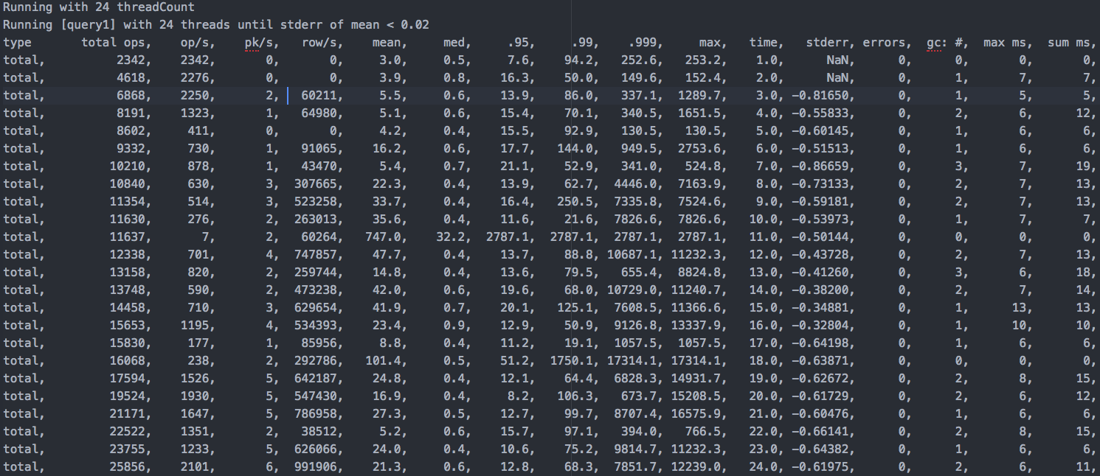
Cassandra-Stress
Cassandra-Stress results
Notes:
The results for both insert and query workloads will look very similar. Once each thread iteration is complete, it will display the progress in line with an increasing total operations count:
Figure 5.1: A report for query1 with a thread count of 24
As you can see in preceding screenshot, the operations report shows many aspects of the workload. The following is a quick summary and explanation for each column of data:
total ops: Total number of operations
op/s: Operations per second
pk/s: Primary keys processed per second
rows: Rows processed per second
mean: Mean latency of the operations
med: Median latency of the operations
.95: Latency for the 95th percentile of the operations (the worst 5%)
.99: Latency for the 99th percentile of the operations (the worst 1%)
.999: Latency for the 99.9th percentile of the operations (the worst 0.1%)
max: Maximum latency of the operations
time: Total time for the current thread count
stderr: Standard error of the mean latency
errors: Errors encountered
gc: #: Number of times garbage collection was triggered
max ms: Time of the longest garbage-collection pause
sum ms: Total time of all garbage-collection pauses for the current operations
sdv ms: Standard deviation of the garbage-collection times
mb: Total size of the garbage collected in megabytes
Note
All the preceding times are in milliseconds (ms).

Slide 285
Cassandra-Stress
Next, each iteration will also show a summary of the attempted operations.
This is a report from a query load run with a thread count of 24:
Refer to file 5_3.txt
Notes:
At the end of the run, a total summary will be given, which will be used to gain insight as to which parts of your data model may need improving.

Slide 286
Write performance
Given its log-based storage model and memtable/commitlog design, Apache Cassandra usually does very well when it comes to high-performance data-ingestion.
That being said, it is not uncommon to hear of application teams complaining about Cassandra nodes being saturated with load due to writes.
Notes:
Here is a short list of things to check when write performance suffers.

Slide 287
Write performance
Commitlog mount point
One piece of advice, going back to the early days of Apache Cassandra, was to ensure that the commitlog was on a different physical mount point than the data drives.
This is because disk I/O could become bottlenecked at the device level during periods of heavy writes.
Putting the commitlog and data directories on separate mount points can alleviate this contention.
Notes:
As solid state drive (SSD) technology evolved, it was discovered that this was less of an issue than it is with spinning disks. However, the era of cloud computing has significantly muddied the waters on this issue. For convenience and versatility, we have traded away specific knowledge of our backend. Even if you continue to separate them, it's still possible for your commitlog and data to end up on the same physical device. If disk I/O becomes an issue, you should speak to your cloud provider about appropriate storage types and provisioning strategies.
Scaling out
The obvious answer to solving write throughput issues is to scale horizontally by adding more nodes. Cassandra scales linearly. Assume that your application can write at 10,000 operations per second with 10 nodes without issue (assuming that the nodes are not becoming overwhelmed during periods of high-frequency writes). Therefore, if you want to be able to support writing at 20,000 operations per second, you could double the size of your cluster.

Slide 288
Write performance
Scaling out a data center
It is common for enterprises to have a cluster spread across multiple data centers and infrastructure providers.
A common pattern is for the application team to load data internally, and replicate it out to the cloud to be served by a customer-facing application.

Slide 289
Write performance
One solution, would be to create three logical data centers, as shown in the following table:
BigBoxCo Ecommerce cluster:
Data center name | RF | Nodes | Writes/ second | Reads/ second | CPUs | RAM (GB)
BBDC1 | 3 | 6 | 18,000 | 0 | 24 | 256
Cloud_East | 3 | 18 | 0 | 36,000 | 16 | 64
Cloud_West | 3 | 18 | 0 | 36,000 | 16 | 64
Notes:
Table : An example 42-node cluster for an e-commerce implementation
Given the cluster setup in Table , over time, writes per second may begin to increase. If we start to notice that the CPU usage becomes maxed out and the application team starts to report write timeouts during the loading phase, we have a few options:
Increase the number of nodes to accommodate the higher levels of write throughput.
Adjust the backpressure strategy settings.
Check the node(s) for issues with excessive resource consumption due to compaction or garbage collection.
Build a throttling mechanism on the loading application, and lower the level of write throughput. This can be accomplished by limiting the number of asynchronous threads in flight at any given time.
As the nodes in this example are experiencing a significant amount of increased writes per second (wps), adjusting the backpressure settings will have little effect. Improperly-built applications can also cause nodes in a cluster to experience issues. Often this can be solved by limiting the write throughput at the application. We will cover how to accomplish this in the lesson 8, Application Development.
Note
Be sure to check with your application team to ensure that they are not improperly using the BATCH functionality, as this has been known to cause similar problems.
In terms of scaling, the only viable option is the first. Given the data in Table 5.1, the BBDC1 data center (where the loading job runs) could previously support 18,000 wps with 6 nodes. This tells us that each node can handle 3,000 wps itself. If the cluster now has to support 30,000 wps, then adding another 4 nodes (for a total of 10) will allow the cluster to do this.
Note
While Apache Cassandra 3.0 and up has the ability to apply a backpressure strategy, this is only viable for small amounts of write backpressure. If a node is truly maxed out and trying to handle something in the realm of 2x normal throughput, no amount of backpressure configuration is going to help.

Slide 290
Read performance
If a cluster is exhibiting poor read performance, there are some obvious things to check on the application and data model (table definition) before adjusting any configuration settings.
As previously mentioned, tables in Cassandra must be designed based on the queries that they are required to serve.
Notes:
If application teams are complaining about operation slowness for multi-key queries or queries that contact multiple nodes, there is little that can be done to improve the situation. On the other hand, if you are confident about the table design and are not violating any known anti-patterns (see the Cassandra anti-patterns section, under Other performance considerations), then configuration in some of these areas may be helpful

Slide 291
Read performance
Compaction strategy selection
Apache Cassandra 3.0 ships with three compaction strategies, which offer some control over the frequency and methods for managing the underlying files.
These compaction strategy classes are SizeTieredCompactionStrategy (default), LeveledCompactionStrategy, and TimeWindowCompactionStrategy.
Notes:
As previously mentioned, if not specified at table-creation time, a table will be built with with SizeTieredCompactionStrategy. While the size-tiered strategy does make for a good default, there are situations where performance can be improved by using a different strategy. One of Apache Cassandra's early main goals was the optimization of write throughput. Likewise, the size-tiered strategy is not necessarily the best option for read-heavy use cases.

Slide 292
Read performance
Optimizing read throughput for time-series models
Since version 2.1, Apache Cassandra has delivered a compaction strategy that helps with optimizing file storage for time-series use cases.
Originally, DateTieredCompactionStrategy was delivered as a way to optimize data storage by time. With this strategy in place, SSTable files were sorted by relative time.
Notes:
This was efficient, as the idea with time-series models is that the application really only cares about specific date ranges of data. This allowed data for specific dates/times to be queried, while older, irrelevant data was ignored.
With Cassandra 3.10 came the advent of TimeWindowCompactionStrategy. This was an improvement over the date-tiered strategy in several areas (and was less buggy). But the general idea remains the same, where only data in a specific time window is queried. Again, data in different time windows does not interfere with requested data.
While only applicable to certain use cases, time-specific strategies are good at keeping data rows together, relative to the time they were written. This also results in a much lower possibility of a row having to be read from multiple SSTable files. As there are fewer (ideally one) SSTable files to have to look through, reads are faster.

Slide 293
Read performance
Optimizing tables for read-heavy models
Let's assume that I have a long-lived table that is updated on a semi-frequent basis, and that I want to query for a specific row:
SELECT * FROM users_by_dept
WHERE department='IT' AND username='tedk';
Notes:
The original size-tiered strategy should work fine for use cases where the read/write ratio is less than 50:50, and thus is slanted more toward the write-heavy side. But if a table’s use case calls for it to be read much more often than written to, LeveledCompactionStrategy should make for a good fit.
Using the leveled strategy helps read-heavy workloads perform better, as it significantly increases the chance of a row existing in a single SSTable file.

Slide 294
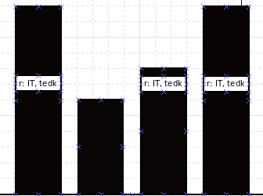
Read performance
A possible file layout for SSTable files behind the users_by_dept table is depicted here:
Notes:
As this row (r) gets updated every time an employee's information needs to be updated, it is likely that it will span multiple SSTables under size-tiered compaction.
Figure : An example showing four SSTable files of different sizes, with three of them containing part of the row for IT and tedk
As shown in the preceding figure, the tedk user from the IT dept spans three SSTable files. When the preceding query is executed, each of those files will have to be read, and then the results of each will have to be compared and merged. From a time perspective, a disk seek takes 10 ms (Dean, Norvig 2012), and (with the preceding example) that will have to be done three times.

Slide 295
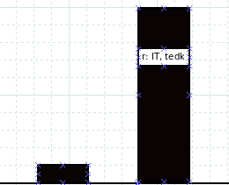
Read performance
But with leveled compaction, each additional level is 10 times the size of the previous.
Therefore, the mean chance (Hobbs 2012) that a row will be entirely contained within a single SSTable file is 90%:
Notes:
Figure : An example showing two levels of SSTable files, with one of them containing the row for IT and tedk
In this way, leveled compaction actually does a better job of mitigating issues that come from executing in-place updates (Hobbs 2012). Under these conditions, an Apache Cassandra node should only have to perform a single disk seek/read to return this row.
Note
Remember that leveled compaction does a better job of mitigating the effects of in-place updates. This does not make it a better compaction strategy for use cases with a higher ratio of writes to reads. This distinction is important to make.

Slide 296
Read performance
Cache settings
Apache Cassandra has two mechanisms that can be used to cache table data: the key cache, and the row cache.
As the name suggests, the key cache simply caches the location of the keys in RAM, providing a boost in efficiency to disk seeks for rows as well (Gilmore 2011).
Notes:
Similarly, enabling row-caching stores the entire row in cache. Hits on the row cache perform significantly better than reads from disk, as reads from RAM happen in a matter of nanoseconds (Dean, Norvig 2012).
Row-caching requires the size to be set in cassandra.yaml as well as the number of rows (per partition) to be set at the table level. Do note that row-caching is disabled by default, as its use is known to interfere with a node's ability to serve requests. However, key-caching helps in most use cases, so it is enabled by default (and also has a corresponding size setting in cassandra.yaml).
Note
Size settings for both row and key caches represent a single amount of memory that is shared by all tables.

Slide 297
Read performance
Appropriate uses for row-caching
As entire rows are stored in RAM with row-caching, it is important to note that some data models are intrinsically better for caching than others.
Tables modeled with slim or narrow rows (Gilmore 2011) per partition are very efficiently cached.
Notes:
However, partitions with wide rows or rows with lots of data in collections are best left in tables with row-caching disabled. Row-caching also works best when applied to datasets with access patterns that follow a gaussian (normal) distribution (Gilmore 2011).

Slide 298
Read performance
Compression
As discussed in prior lessons, table-level compression can also be specified.
Apache Cassandra ships with both the LZ4 and snappy compressor classes, and the LZ4 compressor is used by default.
Compression can also be disabled on a table, but this is not recommended.
Notes:
Compression of table data in Cassandra not only leads to a lighter disk footprint, but also to improved performance, due to a smaller amount of disk I/O at operation time.

Slide 299
Read performance
Chunk size
By default, Apache Cassandra implements LZ4 compression with a chunk_length_in_kb size of 64.
It's important to note that in read-heavy or mixed workloads, using a smaller chunk size can help to improve (reduce) our overall disk I/O usage.
Notes:
This is especially true if your data model is performing small, frequent reads. Jon Haddad of The Last Pickle put it best when he wrote the following:
Ultimately, we need to ensure we use a chunk length that allows us to minimize our I/O. Larger chunks can compress better, giving us a smaller disk footprint, but we end up needing more hardware, so the space savings becomes meaningless for certain workloads. There’s no perfect setting that we can apply to every workload. Frequently, the most reads you do, the smaller the chunk size (Haddad 2018).
When data is queried, it is read as chunks from an SSTable file. The chunks are of a fixed size, as we mentioned earlier, with a default value of chunk_length_in_kb=64. The problem though, is that Cassandra ends up having to read (and decompress) the entire 64 K chunk, instead of only the data that we actually need (Haddad 2018). By lowering the default size of the chunks, we can eliminate unnecessary disk I/O.
Note
In the article referenced in this section, Haddad lowers chunk_length_in_kb to 4, and sees improvements along the lines of 50% additional ops and a 2x reduction in p99 latency (2018).
However, lowering the default chunk size for a table does not come without its trade-offs. The compression metadata is stored off-heap, and the size used is directly proportional to the number of chunks. A smaller default chunk size equals more chunks, which equals more off-heap memory used. Lowering the chunk size to 16 K (from 64 K) may help ops and latency, but it increases that table's off-heap compression metadata size usage by 4x.
Also, Haddad notes that there isn't a one-size-fits-all value for this setting. Like many settings in Cassandra, changes should be made incrementally, and then monitored to verify their impact. Additionally, he adds warnings at the end of his article:
I highly recommend taking the time to understand your workload and analyze your system resources to understand where your bottleneck is, as there is no absolute correct setting to use for every workload.
He also cautions readers to consider the following:
When working with a memory constrained environment it may seem tempting to use 4 KB chunks everywhere, but it's important to understand that it'll use more memory.

Slide 300
Read performance
The bloom filter configuration
Another table setting that can help to tune performance is bloom_filter_fp_chance.
Remember from earlier lessons that the bloom filter is a probabilistic data structure.
Its job in the Cassandra read path is to provide guidance during query time.
Notes:
Specifically, the bloom filter is capable of indicating whether or not the requested data might be present in a particular SSTable file, or that it definitely is not. The false-positive (fp) chance is the main tunable property of the bloom filter. It defaults to a value of 0.01 (1%), unless the table is using Leveled compaction, and then it starts at 0.1 (10%).
Systems with SSDs can handle a higher value (of a false positive), as disk I/O is less of a bottleneck. Likewise, systems with slower (for example: spinning) disks will benefit from a smaller value. However, it is important to note that off-heap RAM usage increases dramatically with bloom filter accuracy. Setting a false-positive chance of 1% will use about 3x the memory that configuring a 10% chance will.

Slide 301
Read performance
Read performance issues
As previously indicated, reads can be slow for other reasons:
Too many tombstones
Result set is too large
Partitions are too large
Notes:
Please note that none of the configuration settings mentioned in this section can solve these issues. They must be dealt with at the data-model/usage level. lesson 3, Effective CQL, discusses strategies to help model around each of these performance issues.

Slide 302
Other performance considerations
In addition to the performance-tuning options mentioned in the preceding section, there are additional configuration settings that can be adjusted, depending on workload type.
Also, it is important to understand that there are use cases for which Apache Cassandra is just not a good fit, and is not likely to perform well regardless of performance tuning.
Notes:
Similarly, there are some parts of the overall platform architecture that may have a direct impact on Apache Cassandra's performance, and little can be done to remedy this.
JVM configuration
In lesson 4, Configuring a Cluster, configuration of the java virtual machine (specifically, garbage collection) was covered at length. While we won't waste time repeating the same information here, we'll add some quick guidelines that echo what was covered in lesson 4, Configuring a Cluster:
Be sure to monitor your nodes' garbage-collection logs. If your nodes are exhibiting long, stop the world (STW) pauses, there are adjustments that can be made to mitigate that.
It’s almost always a good idea to set the max heap size (-Xmx) and the initial heap size (-Xms) to be the same. This way, performance will not be impacted as the heap resizes itself.
If you're not experienced with JVM tuning, configure your nodes to use G1GC (garbage-first garbage collector). G1GC takes a lot of the guesswork out of tuning, and does a good job of efficiently collecting garbage on its own. Just remember not to set a new generation size (-Xmn) with G1GC, as this can prevent it from allocating new generation spaces efficiently.
With smaller instances (heap sizes of 8 GB or under) you may find more success using the CMS (concurrent mark and sweep) garbage collector. With CMS, you should specify the new generation size at 40-50% of the total JVM Heap. The idea here is that you want the young generation sized large enough that most objects are created, live, and die without being promoted. Intergenerational promotion often leads to performance issues.
Remember that increasing the size of the JVM heap does not necessarily help with performance. Compute resources permitting, care should be taken when increasing a CMS heap above 8 GB or a G1 heap above 30 GB.
The problem of smaller heaps in G1 is the reason that Apache Cassandra continues to default to the CMS collector, as laptop/dev environments would be negatively impacted.

Slide 303
Other performance considerations
Cassandra anti-patterns
With many distributed databases, there are known anti-patterns, or use cases, that they are just not good at.
Apache Cassandra definitely has its share of these. Identifying them is important, as you will want to avoid heading down these paths at all costs.
Notes:
Note
No amount of performance tuning can mitigate a bad use case or a known anti-pattern.

Slide 304
Other performance considerations
Building a queue
Well, what does a queue do? It does the following:
Data gets written to a queue.
Data gets updated while it's in the queue (example: status). Sometimes several times.
When the data is no longer required, it gets deleted.
Notes:
Using Apache Cassandra as a backend for a queue or queue-like structure is never going to end well. We have discussed at length that, due to Cassandra's log-based storage engine, inserts, updates, and deletes are all treated as writes.
Given what we have covered about how Cassandra handles things, such as in-place updates (obsoleted data) and deletes (tombstones), it should be obvious that this is not a good idea. Remember, a data model built to accommodate a small amount of in-place updates or deletes is fine. A data model that relies on in-place updates and deletes isn’t going to make anyone happy in the end.

Slide 305
Other performance considerations
Query flexibility
As with many distributed databases, the flexibility to work with dynamic query patterns is a key price to pay for not having all of your data in one place.
While Apache Cassandra does have the ability to apply secondary indexing, they exist for convenience and not for performance.
Notes:
Despite new features added with the goal of removing some of the pain of distributed indexing (such as materialized views and SASI indexes), tables in Cassandra must still be built to suit a specific query pattern.

Slide 306
Other performance considerations
Querying an entire table
Almost as bad as building a table with multiple secondary indexes are use cases that require multi-key or unbound queries.
Many developers just need to know exactly how many rows their 200 GB table contains, so they run an unbound query while selecting a count:
SELECT COUNT(*) FROM some_really_huge_table_that_will_timeout;
Notes:
Cassandra is simply not designed to scan its entire contents and return them in a nicely-formatted report. Queries such as this on large tables will likely result in a timeout.
Note
An application team may ask for the query request timeout to be relaxed to accommodate an occasional unbound query such as this. My advice, is to say NO. Writing queries within the constraints of the database is a responsibility that clearly falls to the developer! Do not put your entire cluster at risk for the sake of convenience.

Slide 307
Other performance considerations
Incorrect use of BATCH
As a Cassandra DBA, this is a common problem for which you will have to monitor your logs.
All developers have been taught that batching-up tens of thousands of writes together helps performance; in the RDBMS world, it does.
Inevitably, a developer will try this on one of your clusters, and could possibly cause the node to crash.
Notes:
Remember, BATCH in Apache Cassandra is a misnomer. It should probably have been named ATOMIC, because it ensures that all writes within a batch are applied atomically. The idea is that four or five query tables can be kept in sync using BATCH, so that a failure of one write will cause all of the others to be rolled back. It really was not designed to help with performance; in fact, you take about a 30% performance hit just by using BATCH. It definitely was not designed to apply 60,000 writes to the same table.

Slide 308
Other performance considerations
Network
The network is one of those aspects of platform architecture over which Cassandra administrators have little control.
Unfortunately, all theories of how distributed systems are supposed to work are premised on the fact that the network is an optimally-functioning constant.
Notes:
This could not be further from the truth, as real networks suffer from hardware and connection failures, brownouts (also know as flapping), noisy neighbors, bottlenecks, and poor connections between providers.
While not much can be done to maintain network connectivity, there are things (some proactive) that can be done to mitigate the effects of network failures:
Follow vendor/provider network recommendations. Often, your provider will have configuration settings that they recommend you apply to maintain a solid connection. You should follow those, and ensure that your network team is doing so.
Buy your network team a round of beers at the next company happy hour. When your on-premise nodes can't communicate with data centers in the cloud provider, you'll be glad that they know who you are.
Try to limit the number of logical data centers in your cluster. If your application team needs four, that's fine. Moving past six introduces that many more points of failure for maintaining your replication factor.
If your cluster is deployed across multiple providers, consider increasing phi_convict up to a value of 10 or 12. This will cause Cassandra to wait for a longer period of time before marking a node as down.

Slide 309
Summary
Here are some important takeaways from this lesson:
There is no amount of tuning that can mitigate a poorly-designed data model.
Cassandra-Stress is one of the most underrated, yet helpful, tools available for Apache Cassandra.
Notes:
In this lesson, we covered a lot in terms of Apache Cassandra and its performance-tuning options. We started with Cassandra-Stress to establish a performance baseline for a specific data model. Then, we began to evaluate factors that can influence write performance. We spent a bit of time covering read performance, and the different configuration properties that can help Apache Cassandra perform well during read-heavy and mixed workloads. Finally, we examined and discussed other factors that may influence or affect cluster performance.
Remember that Apache Cassandra was originally optimized for high-performance writes. If you plan on reading data (and most of us do), you'll want to look at some possible configuration changes to fit your use case.
Selecting an appropriate compaction strategy is more about the ratio of reads to writes than the actual table or model. Remember that leveled is better-suited for handling a read-heavy model. Otherwise, the default (size-tiered) should be fine.
When changing a configuration property, apply changes on a small and incremental basis.
Don't forget to monitor your cluster, and check both the system and gc logs for issues.
In the next lesson, we'll discuss cluster management and how to handle day-to-day operations with your Apache Cassandra clusters.

Slide 310
6. Managing a Cluster

Slide 311
Managing a Cluster
Topics discussed will include the following:
Adding and removing nodes
Working with logical data centers
Backups
Techniques for ensuring data consistency
Notes:
In this lesson, we will discuss several aspects related to maintaining and managing an Apache Cassandra cluster. First, we'll discuss the nodetool utility, and quickly move on to tasks associated with scaling your cluster up or down. From there, we'll talk a little about the backup functionality of Apache Cassandra. Finally, we'll present situations for maintenance on your cluster, and discuss routine tasks that can improve its ability to function properly.
At the conclusion of this lesson, you should have a thorough understanding of basic cluster operations. You will have discovered much of the functionality around nodetool, and will understand when to use certain of its functions. Additionally, you should understand how backups work with Apache Cassandra, as well as how to take a snapshot and how to restore from it. This lesson should serve as a good reference for future questions about operational tasks.

Slide 312
Revisiting nodetool
Before we get too far into discussing it, there are some important things to note about nodetool:
It uses port 7199 for JMX.
Remote JMX access must be explicitly enabled within each node's configuration.
Without remote JMX, you will need to SSH into the node to utilize it in nodetool.
Nodetool is separate from Apache Cassandra. Different versions of nodetool can communicate with different versions of Cassandra, so use it with caution.
Notes:
Much of this lesson will focus on using Apache Cassandra's nodetool utility. As mentioned previously, the nodetool utility installs with Cassandra, and is central to most aspects of cluster management.

Slide 313
Revisiting nodetool
A warning about using nodetool
As far as Apache Cassandra is concerned, nodetool is an admin-level management tool.
Make sure that you know what you are doing prior to invoking nodetool commands.
If care is not taken, serious damage can be done to a cluster with nodetool.
Notes:
If you're not sure how to put a command together, or what it will do, by all means look it up or ask someone! It's much better to be cautious now, rather than sorry later.

Slide 314
Scaling up
One common task for Apache Cassandra DBAs is to scale horizontally or scale up (that is, add more nodes to) a cluster.
Usually, this is because the cluster needs to store additional data, or provide additional operational throughput.
Notes:
Oftentimes, large e-commerce retailers will scale up their clusters just prior to the holiday season, as a way to ensure their ability to remain highly available during periods of heavy traffic.

Slide 315
Scaling up
Adding nodes to a cluster
The basic task behind scaling up a cluster is adding a new node.
To accomplish this, start with your newly provisioned instance.
If you follow good DevOps practices, and can install Apache Cassandra simply by executing your deployment pipeline, then this should be very easy for you.
Notes:
If you are installing Apache Cassandra manually, remember that all of the Cassandra configuration files should be mostly the same as they are on the other nodes.
There will, of course, be some differences in the files. Listen and RPC address values (as well as the broadcast addresses) should be specific to the node you are on. You will want to update those in your cassandra.yaml file, and your cassandra-env.sh script if you have it configured there, too. The cluster name, seed list, and everything else should stay pretty much the same.
Note
Don't be afraid to use a different seed list for a new node, if you need to. Remember, the seed list designation isn't anything special. All that list does is provide the node with a list of endpoints from which to start gossiping. Give it a node or two that are known to be currently running, and it should work just fine.
Note
When adding a new node to your cluster, be sure that its clock is synchronized with the first node's clock. If possible, configure your instances to use a Network Time Protocol (NTP) server to eliminate time drift.

Slide 316
Scaling up
This can be verified and altered by describing your keyspace using cqlsh to connect to the live node:
DESC KEYSPACE packt;
CREATE KEYSPACE packt WITH replication
= {'class': 'NetworkTopologyStrategy', 'ClockworkAngels': '1'};
...
ALTER KEYSPACE packt WITH replication
= {'class': 'NetworkTopologyStrategy', 'ClockworkAngels': '2'};
Notes:
If you are adding new nodes to a single-node cluster, you may want to increase the replication factor of your keyspace before adding the new node. This will ensure that it gets all of the data that it should.

Slide 317
Scaling up
Once configuration is complete, start the new node.
To accomplish this with service-based installations, run the following command:
sudo service cassandra start
Otherwise, you should have a script that runs the following command from the location where you installed Apache Cassandra:
bin/cassandra -p cassandra.pid

Slide 318
Scaling up
Depending on the size of your data, your new node may take a while to fully bootstrap.
You can monitor the bootstrap process with the following command:
nodetool netstats | grep Already
Already received 35 files, 5085120999 bytes total
Already received 7 files. 8325238 bytes total
Already received 18 files. 3105392851 bytes total
Notes:
While monitoring this process, you should see the bytes total numbers continuing to increase. If they appear to be stuck (that is, not moving), then you may need to stop Cassandra, wipe the data, and restart the process.
Some guidelines for adding a new node to a cluster are as follows:
The cassandra.yaml, cassandra-env.sh, jvm.options, and cassandra-rackdc.properties files of the new node should be largely identical to their counterparts on the existing nodes. The exception to this rule is obviously the IP addresses.
If you are adding a seed node, you will need to invoke either nodetool repair or nodetool rebuild afterward, as seed nodes do not bootstrap.
You can only bootstrap one node to the cluster at a time.
New nodes will fail to join if another node in the cluster is also currently joining.
No matter how fast the nodes come up after joining, allow the cluster to stabilize (watch system.log for activity) before attempting to join another node. It's usually a good idea to wait a couple of minutes before proceeding.
Allow the node to follow the bootstrap process, if possible. Bootstrapping, the node will have a status of UJ, meaning up and joining. This status prevents the node from being selected to handle requests.
If the bootstrap process is failing, you can disable it by adding the setting of auto_bootstrap: false to cassandra.yaml. In this case, you'll have to run nodetool repair or nodetool rebuild from another data center to stream data to the node, and chances are good that it may be asked to serve requests while streaming.

Slide 319
Scaling up
During this time, nodetool status queries will show that the new node is UJ, for up and joining.
In the example shown in the following snippet, 192.168.0.102 is shown joining the cluster:
nodetool status
Datacenter: ClockworkAngels
===========================
Status=Up/Down
|/ State=Normal/Leaving/Joining/Moving
-- Address Load Tokens Owns Host ID Rack
UN 192.168.0.101 114.26 GB 24 100.0% 0edb5efa... R40
UJ 192.168.0.102 901.62 MB 24 ? 38782ca0... R40

Slide 320
Scaling up
Cleaning up the original nodes
The original nodes will still have the data that they have streamed but are no longer responsible for.
In larger clusters, this data can be sizable.
To ensure that a node only contains data for which it is responsible, you can invoke the nodetool cleanup command:
nodetool cleanup
Notes:
It is important to remember that, once you have completed adding all of the new nodes, the data streamed to them still resides on other nodes. The reason for this is that, as new nodes get added, the number of tokens that each node is responsible for becomes smaller.

Slide 321
Scaling up
Adding a new data center
Sometimes, there are reasons to add a new data center to a cluster.
New data centers provide an easy means by which to migrate or expand your cluster to a new provider.
Typically, development teams ask for their Cassandra cluster to be built on the same provider, region, or data center as their application runs in.
Notes:
This is known as building for data locality. The goal is to provide the shortest possible network trip from the application to the database, and back again.

Slide 322
Scaling up
Adjusting the cassandra-rackdc.properties file
To add a new data center, all of the new nodes will have to share the same dc property.
An example from the cassandra-rackdc.properties file is shown as follows:
dc=ClockworkAngels
rack=R40
Notes:
The same steps must be taken as described in the preceding section. One addition to that list of steps is that an adjustment has to be made to the cassandra-rackdc.properites file. Recall how, in the first lesson, the file contained two important properties:dcandrack.
The rack property came about during the days when bare metal deployments were the norm. The idea was that the nodes in a cluster should be spread across multiple physical data centers, and mounted within each data center in multiple physical racks. When using a snitch designed to take advantage of multiple racks, the rack property will try to ensure that replicas are spread across the racks as evenly as possible. This way, if an entire rack should ever fail, the cluster should still have enough nodes and replicas available to still be able to serve requests.

Slide 323
Scaling up
For the new data center, I will specify the following for all nodes:
dc=VaporTrails
rack=R30
Notes:
Note
This configuration is what helps Apache Cassandra to be aware of both dc and rack. Remember that this configuration is a logical definition, which may or may not correspond to actual physical data centers and racks.
Each node in the new data center should be started one at a time. As mentioned in the previous section on adding new nodes, you should wait for 2 minutes before starting another node. This will allow the node to join and gossip to settle. At the point of joining the cluster, the nodes will be empty.

Slide 324
Scaling up
A warning about SimpleStrategy
To get data to the nodes in the new data center, we'll need to first modify the keyspace(s) to allow replication to them, as follows:
ALTER KEYSPACE packt WITH replication = {'class': 'NetworkTopologyStrategy', 'ClockworkAngels': '3', 'VaporTrails': '3'};
Notes:
Do note that, if existing keyspaces are defined using SimpleStrategy, queries running at LOCAL consistency levels (mainly LOCAL_QUORUM) could begin to fail. The Simple replication strategy is not data center-aware, so queries could be directed to the new nodes before they have data. This behavior is the main failing of SimpleStrategy.
Note
Remember, you will also need to adjust replication for the system_auth, system_distributed, and system_traces keyspaces as well.
At this point, applications or queries that do not define a local data center (discussed in a later lesson) could begin to exhibit failures. This is because incoming operations could query the new nodes (again) before they have data.

Slide 325
Scaling up
Streaming data
Streaming data to new nodes in a data center should be done with the nodetool rebuild command.
This command takes an existing data center as a parameter, which it uses as a source.
On each new node, run the following command:
nodetool rebuild -- ClockworkAngels
Notes:
This could take a while, depending on how much data needs to be streamed.
Note
Streaming data to new nodes can consume resources on the existing nodes. It is recommended to use notetool rebuild on one node at a time, so as not to overwhelm the source data center.

Slide 326
Scaling down
Needing to scale down a cluster isn't a terribly common task.
But sometimes a cluster uses more resources than it needs, due to application retirement or migration.
This is especially true in the case of deploying into a public cloud, where extra compute comes with a price tag.
Notes:
In this case, being fiscally responsible with your company's money often translates into trimming down your cluster's resources for efficiency.

Slide 327
Scaling down
Removing nodes from a cluster
The most obvious way to trim resources is to remove nodes from the cluster.
Sometimes, nodes may need to be removed after crashing on their own.
In a cloud environment built with efficient DevOps processes, it is often much faster to re-provision a troublesome node than it is to spend time resurrecting it.
Notes:
There are two nodetool commands used to remove nodes from a cluster: nodetool decommission and nodetool removenode. These will be discussed based on their use cases (live node versus dead node) in the following section.

Slide 328
Scaling down
Removing a live node
Scaling down by removing a live node (that is, a node which is still functioning) can be accomplished using the nodetool decommission command.
Decommissioning a live node begins by putting the node in a status of UL, for up and leaving.
This prevents the node from being included in serving queries by a coordinator.
Notes:
Additionally, the token range is adjusted for all nodes in the data center. Data on the node is then streamed to the nodes that will be responsible for the data.

Slide 329
Scaling down
The command begins the decommissioning process on the node specified by the host (-h) parameter, or runs on the current node if none is specified:
nodetool decommission -h 192.168.0.101
Or we can use as follows:
nodetool decommission
Notes:
Once the command is executed, the prompt waits while the decommission process begins. It runs in the background, so it is safe to break (using Ctrl + C) your way back to a Command Prompt.
Note
When decommissioning nodes, it is always a good idea to be careful. I have found it easier to SSH to the target node, and run nodetool decommission (without any parameters). This eliminates the possibility of mistyping an IP or hostname.

Slide 330
Scaling down
If I wanted to remove 192.168.0.102, I could do so with this command:
nodetool decommission -h 192.168.0.102
^C
nodetool status
Datacenter: ClockworkAngels
===========================
Status=Up/Down
|/ State=Normal/Leaving/Joining/Moving
-- Address Load Tokens Owns Host ID Rack
UN 192.168.0.101 114.26 GB 24 100.0% 0edb5efa... R40
UL 192.168.0.102 111.62 GB 24 100.0% 38782ca0... R40
UN 192.168.0.103 101.81 GB 24 100.0% e45b2ee0... R40
Notes:
When the process completes, note the following:
Any data owned by 192.168.0.102 will have been streamed to the nodes now responsible for its token ranges
The cassandra process will still be running on 192.168.0.102, but it will be out of the cluster
At this point, the process can be killed or the instance can safely be shut down

Slide 331
Scaling down
Removing a dead node
nodetool status
Datacenter: ClockworkAngels
===========================
Status=Up/Down
|/ State=Normal/Leaving/Joining/Moving
-- Address Load Tokens Owns Host ID Rack
UN 192.168.0.101 114.26 GB 24 100.0% 0edb5efa... R40
DN 192.168.0.102 111.62 GB 24 100.0% 38782ca0... R40
UN 192.168.0.103 101.81 GB 24 100.0% e45b2ee0... R40
Notes:
Sometimes, a node may be down and unable to be restarted. Common scenarios involve the host experiencing a hardware failure, or a cloud instance being prematurely destroyed. In the case of 192.168.0.102 being unrecoverable, a cluster status would look like this:

Slide 332
Scaling down
As data cannot be streamed from a down node, nodetool decommission will not work.
At this point, the best option for removing the node from the cluster will be to remove it.
The nodetool removenode command exists for this scenario, and works by identifying the node by host ID:
nodetool removenode 38782ca0-5dee-4576-b0f9-5c54ab6fef6b
Notes:
Similar to decommissioning, you can safely Ctrl + C back to a Command Prompt after invoking the removenode process. The process will continue to run in the background. During this time, data will be streamed to the new token ranges from other live replicas in the cluster. Once that completes, the node will be removed from gossip as well.

Slide 333
Scaling down
Other removenode options
Once you do that, you can query the current node for the status of the removal:
nodetool removenode status
RemovalStatus: Removing token (-7858886458974273909). Waiting for replication confirmation from [/192.168.0.103].
Notes:
Sometimes, the removal process may hang or become stuck. The chances of this happening have decreased with the newer and more stable versions of Apache Cassandra.

Slide 334
Scaling down
If this should happen, you can invoke force from the node responsible for the removal as follows:
nodetool removenode force
nodetool removenode status
RemovalStatus: No token removals in process.
Notes:
Note
The removal process requires a current, live node to coordinate another node's removal. That node is considered responsible for the removal process. Attempts to query the status of a removal from a node that is not responsible for that process will yield the No token removals in process message, regardless of whether or not a removal may actually be in process.
Forcing the removal of a node may have some unintended consequences. Firstly, the data has probably not been replicated to the nodes newly responsible for the removed node's token ranges. Secondly, removal from gossip is also probably not completed. Applications still running with open connections to the cluster may experience warnings or failures associated with the removed node for several hours afterward.
Note
It is a good idea to run a repair after forcing a node's removal.

Slide 335
Scaling down
When removenode doesn't work (nodetool assassinate)
Whatever the cause, sometimes a node may appear to be removed to some nodes, but not to others.
For edge cases like these, the nodetool assassinate command exists, and is used as follows:
nodetool assassinate 192.168.0.102
Notes:
Sometimes, despite our best efforts, even nodetool removenode fails to completely take a node out of the cluster. This can happen if the remove process hangs, or if another node crashes during this time
This command completely removes the node from the cluster, without streaming any data. It should only be used as a last resort, and only if either decommission or removenode fail to work.
Note
If a node is particularly stubborn about leaving gossip, you may need to run assassinate several times. For more information, refer to Casares J(2018) Assassinate - A Command of Last Resort within Apache Cassandra: The Last Pickle, available at http://thelastpickle.com/blog/2018/09/18/assassinate.html. The idea here is to create enough messages to all nodes to influence them to forget about the node in question.

Slide 336
Scaling down
Assassinating a node on an older version
The nodetool assassinate command is new to Apache Cassandra as of version 2.2.
Prior to Cassandra 2.2, this operation was still possible, but by invoking a command via JMX.
For this to work, you will first need to download the JMXTerm JAR file from http://wiki.cyclopsgroup.org/jmxterm/.
Then, run the JAR file from the command line, connect to your node, and assassinate the endpoint:
Refer to file 6_1.txt

Slide 337
Scaling down
Removing a data center
First of all, you should identify the name of the target data center and nodes to be removed.
Consider the following cluster:
Refer to file 6_2.txt
Notes:
A good way to safely and seamlessly phase in new changes to your cluster is by adding a new data center. For instance, migrating between cloud providers can be easily accomplished with Apache Cassandra, simply by creating nodes within a new, logical data center on the new provider. However, improperly disabling or shutting down nodes, still hosted on the old provider, can introduce problems with gossip (as described previously). Therefore, knowing how to properly remove an existing data center is an important part of any Cassandra DBA's repertoire.

Slide 338
Scaling down
In this scenario, we will remove the FlyByNight data center from our cluster.
Let's cqlsh into one of our nodes, and take a look at our keyspace:
desc keyspace packt_chapter6 ;
CREATE KEYSPACE packt_chapter6 WITH replication = {'class': 'NetworkTopologyStrategy', 'ClockworkAngels': '3', 'FlyByNight': '3'} AND durable_writes = true;

Slide 339
Scaling down
Let's start by changing our keyspace definition to no longer replicate to the FlyByNight data center.
We can accomplish this with the ALTER KEYSPACE command:
ALTER KEYSPACE packt_chapter6 WITH replication = {'class': 'NetworkTopologyStrategy', 'ClockworkAngels': '3'};
Notes:
Note
Be careful! Altering a keyspace to no longer replicate data does not actually remove the data, but it does prevent the nodes in that data center from serving requests for that data. Make sure that your application teams are no longer specifying the target data center as their local data center.
Run that command for any additional keyspaces that might be active in your cluster. This command also needs to be run for any system keyspaces that may share similar replication definitions. This includes thesystem_auth, system_distributed, andsystem_traceskeyspaces.
Note
Do not alter or change replication for the system or system_schema keyspaces, as those use a different, local replication strategy.

Slide 340
Scaling down
With the keyspace replication of those nodes disabled for the target data center, you can now SSH to them and run decommission on each of them:
aploetz@skywalker:~/local/apache-cassandra-3.11.2$ ssh aaron@192.168.17.91
...
aaron@192.168.17.91: ~$ nodetool decommission
aaron@192.168.17.91: ~$ exit
Connection to 192.168.17.91 closed.
Notes:
With each node no longer responsible for any token ranges, the nodetool decommission command should complete quickly. Repeat this exercise for all nodes within the target data center. Once complete on all nodes, the target data center will be effectively removed.

Slide 341
Backing up and restoring data
Apache Cassandra provides the ability to take a snapshot of all SSTable files on a node.
The resulting snapshot files are essentially hard links or pointers to these files.
Combining snapshots with the incremental backup feature helps to ensure that lost data can be restored in a quick and timely manner.
Notes:
For more information, refer to the Backing up and restoring data section of the Cassandra documentation, available at https://docs.datastax.com/en/cassandra/3.0/cassandra/operations/opsBackupRestore.html.

Slide 342
Backing up and restoring data
Taking snapshots
To take a snapshot for all tables in a specific keyspace, simply type the name of that keyspace on the end of the command:
nodetool snapshot packt_chapter3
Requested creating snapshot(s) for [packt_chapter3] with snapshot name [1538941504326] and options {skipFlush=false}
Snapshot directory: 1538941504326
Notes:
Snapshots can be taken system-wide, or focused on a single keyspace or table. Invoking a snapshot is done very easily with nodetool.

Slide 343
Backing up and restoring data
To take a snapshot for a specific table, use the --table option.
Follow that with the table and keyspace names:
nodetool snapshot --table security_logs_by_location packt_chapter3
Requested creating snapshot(s) for [packt_chapter3] with snapshot name [1538941525101] and options {skipFlush=false}
Snapshot directory: 1538941525101
Notes:
Note
It is advisable to move snapshot files to a location that is off the node, because they are usually required when the node is completely offline.

Slide 344
Backing up and restoring data
Enabling incremental backups
Incremental backups instruct Apache Cassandra to create links to newly flushed memtables since the last snapshot was taken.
This has the effect of keeping point-in-time snapshots up-to-date with the latest writes.
Incremental backups are disabled by default, but can be enabled by editing the following line in the cassandra.yaml file of each node:
incremental_backups: true
Notes:
Note
As with snapshot files, it is a good idea to move incremental backups to another instance for storage.

Slide 345
Backing up and restoring data
Recovering from snapshots
Run nodetool refresh. This will load the recently copied snapshot or backup files into the cluster.
A restart is not required.
An example of this process is as follows:
Refer to file 6_3.txt
Notes:
A table can be restored from snapshot files with these simple steps:
TRUNCATE the table. This is necessary in the case of an accidental delete operation. If the snapshot files are restored without the table having been truncated, then the timestamp on the prevailing tombstone will still be more recent than anything saved via the snapshot process. Truncating the table ensures that the restored data takes precedence.
Copy the files from the most recent snapshot and backups directories into the table's data directory. Snapshot files are no different from normal SSTable files. Simply copy them into the data directory for your table. If you move your snapshots to another storage location, make sure you copy over files that are applicable to the node that requires them. Snapshot files are specific to the node on which they were taken.

Slide 346
Maintenance
Let's say that 192.168.0.103 goes down, and I need to replace it.
I can re-instance a new node, say, 192.168.0.105.
To ensure that 105 gets the same token ranges as 103 had, I can add this one line to the end of the cassandra-env.sh file at 105:
JVM_OPTS="$JVM_OPTS -Dcassandra.replace_address=192.168.0.103"
Notes:
With most databases, there are a number of routine and ad hoc activities to be completed periodically. Apache Cassandra is no exception.
Replacing a node
Sometimes, instead of removing a bad node and adding a new one, you want to replace a node. In larger clusters, this becomes important, in that a new node can be designated as a replacement to a prior, down node. This means that, when the node starts up, it will contact the seed nodes and receive the same token ranges as the previous node.
Now, when 105 starts up, it will be assigned the same token ranges that 103 had.
Note
Remember to make sure that the new node has the same data center and rack names as the node being replaced.

Slide 347
Maintenance
Repair
Simply running this statement without any parameters will invoke a full repair on all keyspaces and tables in the cluster:
nodetool repair -full
As the system keyspaces shouldn't need to be repaired regularly, this command can be focused on repairing all tables in a particular keyspace:
nodetool repair -full packt_chapter3
Notes:
As Apache Cassandra is an eventually consistent database, it knowingly sacrifices consistency. Sometimes, network conditions, hardware/instance failures, or periods of extremely high load can cause issues with data replication. To remedy these possible scenarios, you should run weekly repairs on your cluster

Slide 348
Maintenance
Likewise, you can also specify a particular table to be repaired as follows:
nodetool repair -full packt_chapter3 security_logs_by_location
If you're in a multi-region cluster, you may want to restrict repairs to certain nodes.
This helps to avoid heavy cross-region streaming:
nodetool -h 192.168.0.101 repair -full packt_chapter3 -hosts 192.168.0.101 -hosts 192.168.0.102 -hosts 192.168.0.103
Notes:
Note
When specifying a list of hosts to limit a repair, be sure to include your current node, and to include all nodes necessary to cover all token ranges!

Slide 349
Maintenance
A warning about incremental repairs
The idea behind incremental repairs is pretty simple—mark certain data as repaired, and don't bother repairing it until it changes.
However, incremental repairs are still inherently broken, and there have been consistency issues reported with its use.
Notes:
They should be fixed with the release of Apache Cassandra 4.0, but the current warning with incremental repairs is to use them only at your own risk! When in doubt, use -full repairs.

Slide 350
Maintenance
Cassandra Reaper
Within the last year, an open source tool for managing Apache Cassandra repairs has emerged.
Its name is Cassandra Reaper, and it can be downloaded from http://cassandra-reaper.io/.
Notes:
Reaper takes all the guesswork out of running repairs with Apache Cassandra. In the past, repair had to be invoked manually, or via cron jobs that you hope complete on time. Reaper allows you to support many clusters with easily managed repair schedules.
Note
This tool is a life-saver! Hats-off to the Last Pickle team who adopted and worked on the project!

Slide 351
Maintenance
Forcing read repairs at consistency – ALL
One quick way to fix consistency on the system_auth tables is to set consistency to ALL, and run an unbound SELECT on every table, tickling each record:
use system_auth ;
consistency ALL;
consistency level set to ALL.
SELECT COUNT(*) FROM resource_role_permissons_index ;
SELECT COUNT(*) FROM role_permissions ;
SELECT COUNT(*) FROM role_members ;
SELECT COUNT(*) FROM roles;
Notes:
The type of repair isn't really part of the Apache Cassandra repair paradigm at all. When it was discovered that a read repair will trigger 100% of the time when a query is run at ALL consistency, this method of repair started to gain popularity in the community. In some cases, this method of forcing data consistency provided better results than normal, scheduled repairs.
Let's assume, for a second, that an application team is having a hard time logging into a node in a new data center. You try to cqlsh out to these nodes, and notice that you are also experiencing intermittent failures, leading you to suspect that the system_auth tables might be missing a replica or two. On one node you do manage to connect successfully using cqlsh
Note
This problem is often seen when logging in with the default cassandra user. Within cqlsh, there is code that forces the default cassandra user to connect by querying system_auth at QUORUM consistency. This can be problematic in larger clusters, and is another reason why you should never use the default cassandra user.
The original idea for this approach goes back to a Python script written by Apache Cassandra MVP Christos Kalantzis. His cassTickler code iterates through all rows in a table, tickling each one with the ALL consistency, and forcing a read repair. Christos' code can be found at https://github.com/ckalantzis/cassTickler.

Slide 352
Maintenance
Snapshots
Clearing snapshots is a simple matter, and can be done via nodetool:
nodetool clearsnapshot
Running clearsnapshot without any parameters instructs Apache Cassandra to remove all snapshot files on a node.
It can also be focused for a particular keyspace, like the following:
nodetool clearsnapshot -- packt_chapter3
Notes:
Clearing snapshots and incremental backups
While snapshots and incremental backups form a complete backup system, their use can increase overall disk usage. This is because the links, created to the SSTable files, prevent them from being cleaned up by the compaction process. Left unchecked, snapshots and incremental backups can fill a whole disk, causing node failure.

Slide 353
Maintenance
Additionally, clearsnapshot can be focused even further, by specifying a snapshot by name:
nodetool clearsnapshot -t 1538941504326
Notes:
Note
The nodetool clearsnapshot command is very helpful, and can be useful to quickly clear disk space in a pinch. However, many DBAs find it much more helpful to write a script to traverse the snapshot directories and purge old snapshot files instead, keeping only the latest two or three per table. Running a periodic script to keep those files in check can provide a viable, long-term solution for snapshot file management.
Incremental backups
Similar to snapshots, incremental backup files have the same problem. But presently, there exists no way to quickly clean them up through nodetool. The preceding tip for snapshots becomes the only really viable option. It is advised to manually monitor/delete the files, or to write a script to traverse the backup directories, to prevent incremental backup files from growing uncontrollably.
Compaction
As discussed in prior lessons, compaction is the process by which similarly sized underlying SSTables are joined together. This process reclaims space used by obsolete (overwritten) data, including tombstones. Although compaction can constrain system resources, it is generally something you want to run. After all, queries that require seeks/reads from multiple SSTable files are much slower than queries that only hit one file.
Why you should never invoke compaction manually
Remember that compaction works by finding multiple SSTable files that are similarly-sized. When you force compaction, you merge SSTable files together, regardless of their size, or whether or not there is a qualifying number of them. This often results in one large SSTable file. The likelihood of other SSTable files growing large enough to be compacted with that big file is very minimal. Essentially, running nodetool compact could cause compaction to pretty much never run again.
Note
As previously mentioned, the best advice is to let Cassandra figure out when it wants to run compaction. Don't get in its way!

Slide 354
Maintenance
Adjusting compaction throughput due to available resources
A common way to remedy this problem is to lower the compaction throughput, as follows:
nodetool getcompactionthroughput
Current compaction throughput: 256 MB/s
Notes:
As mentioned at the beginning of this section, compaction can consume a large amount of resources if left unchecked. A symptom of this would be an application experiencing query timeouts or consistency failures. When investigating the offending node, you may find that the CPU usage is maxed out, and several compactions (nodetool compactionstats) may be pending.

Slide 355
Maintenance
Woah! Allowing compaction to consume 256 Mbps (megabits per second) is a sure way to saturate your instance's resources.
Let's lower that, and monitor our node's progress:
nodetool setcompactionthroughput 8
nodetool getcompactionthroughput
Current compaction throughput: 8 MB/s
Notes:
Note
Remember, you want compaction to run. Setting the compaction throughput value too low will cause compactions to backup, and probably never complete. The idea is to find the right value that allows you to keep your files compacted, while still allowing nodes to serve requests.

Slide 356
Summary
This lesson covered a broad range of subjects related to the Apache Cassandra node tool utility.
The commands covered here will help you to scale your cluster horizontally, as well as to remove and replace failed nodes.
If you support a cluster that has nodes deployed in public or private cloud instances, you will find that it is often much faster to replace a failed node, than to try and resurrect it.
Notes:
To that end, you will find yourself using these tools and techniques often.
We discussed things such as taking snapshots, and incremental backups, as well as the maintenance associated with cleaning them up. It's important to remember that snapshots and backups taken are only valid for the data stored on a particular node. If the number of nodes exceeds your replication factor, you will likely have to maintain separate sets of off-cluster backup files for each node. This can be especially complex when a cluster gets big. It is often a good idea to do a sanity check with your application team. Remind them that Apache Cassandra isn't a consistent data store in the first place, and then ask if they are loading their data from an upstream source, which may lend itself to taking backups more easily than Apache Cassandra does.
Finally, we discussed some maintenance tasks and issues that you may face on your cluster. Remember to run your repairs weekly, especially if your application team is using deletes. And sometimes, quick and simple repairs can be made by tickling a record. Be sure to investigate Cassandra Reaper as a means to take some of the grunt work out of repair scheduling. Keep an eye on your compactions, take a set-and-monitor approach to finding the ideal compaction throughput, and don't let your pending compaction count get too high.
In the next lesson, we'll discuss tips and tools for monitoring your cluster. Combined with this lesson, you should have plenty of good information as a reference for managing and troubleshooting your production Apache Cassandra cluster.

Slide 357
7. Monitoring

Slide 358
Monitoring
Specifically, this lesson will cover the following topics:
The Java Management Extension (JMX) interface: JConsole, JMXTerm
Nodetool
Metrics: JMXTrans, Telegraf, InfluxDB, Grafana, Alerting
Logging: Filebeat, Kibana
Troubleshooting
Notes:
This lesson will cover monitoring, logging, and administration. With large-scale datasets on distributed architectures comes the problem of providing a reliable service, which makes it more complex to keep an eye on all servers. As DataStax OpsCenter is no longer an option for use with Apache Cassandra,this lesson concentrates only on the open source toolset.
By the end of this lesson, you will understand different monitoring and logging tools, and how they providemore insight for problem solving on your cluster. You will be able to make decisions using reliable out-of-the-box applications from the open source community, including installing, configuring, analyzing, and setting up alerting.

Slide 359
JMX interface
JMX is a Java technology that provides tools for managing and monitoring applications, services, components, devices, and settings.
These settings are represented as Java objects, known as Managed Beans (MBeans).
As Apache Cassandra is written in Java, all the required classes have exposed MBeans, through which we can manage/monitor them accordingly.
Notes:
Cassandra defaults its JMX port to 7199, hence it should be opened through firewalls and security groups to allow access over it.
MBean packages exposed by Cassandra
The following are the MBean packages exposed by Cassandra:
org.apache.cassandra.db: Key Cassandra architectural metrics and management operations, you can get a compaction summary and perform a compaction operation for an entire node or restrict it to a table in a keyspace
org.apache.cassandra.hints: Only operations related to the hints service, such as pause/resume, dispatch, and delete all hints or for an endpoint
org.apache.cassandra.internal: Unlike the previous package, this contains metrics related to internal actions of Cassandra, such as the number of core and maximum threads used for flushing memtables, clearing the cache, dispatching hints, and so on
org.apache.cassandra.metrics: All statistical metrics and operations, such as row/key cache, client read/write request count/latency, cross-node latency for all requests, or narrow it down to a table
org.apache.cassandra.net: Stats on internal communication network metrics and operations for Cassandra cluster-management, such as number of down/up end points, streams, dropped messages, and assassinating nodes.
org.apache.cassandra.request: As in the internal package, this gives the core and maximum threads being used for the read repair stage
org.apache.cassandra.service: Similar to the request package, it provides statistical reset metrics related to the GC inspector

Slide 360
JMX interface
JConsole (GUI)
JConsole is a built-in utility for the JDK, which gives a graphical view of resource utilization for a Java process.
It also provides an interface to view metrics and perform operations to manage applications.
Refer to the JConsole docs for further informationat
Notes:
Oracle Java SE Documentation:Using JConsole: https://docs.oracle.com/javase/7/docs/technotes/guides/management/jconsole.html.

Slide 361
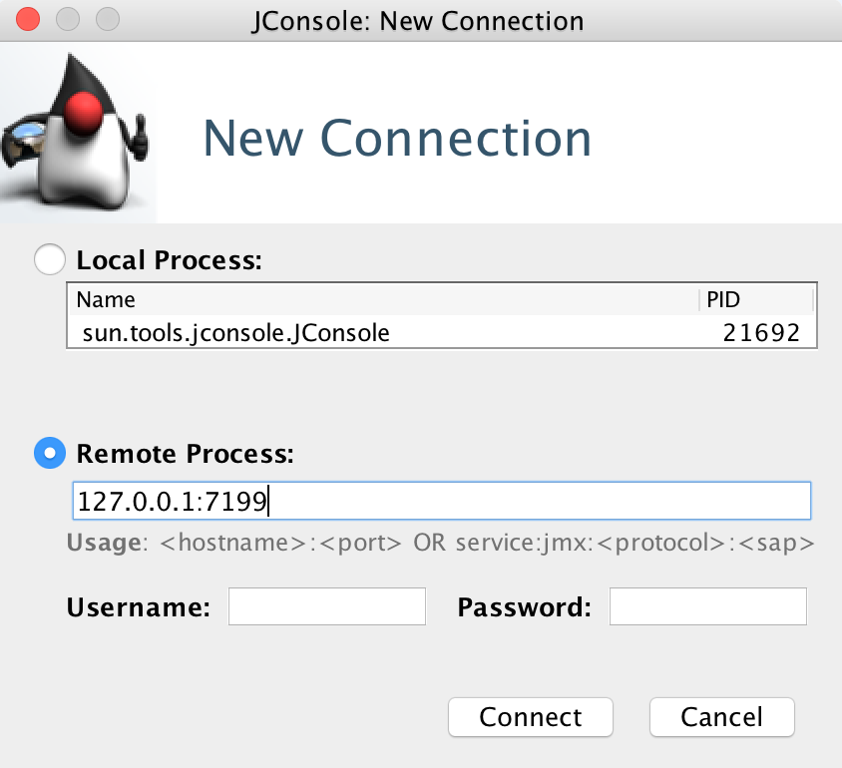
JMX interface
Connection and overview
Figure: JConsole connection
Notes:
nvoking a JConsole connection is pretty simple. You can connect to a local or remote Java process. For local, just select the corresponding Process Identifier (PID). To connect to a remote process, you can either use the hostname/IP and port combination, or the JMX service that runs Cassandra without JMX authentication and SSL:

Slide 362
JMX interface
In certain implementations, a node would have both internal and external IPs.
These would be set in the Cassandra.yaml config, with the listen_address and rpc_address parameters set to internal IPs, and the broadcast_address and broadcast_rpc_address parameters set to external IPs.
Additionally, some additional parameters need to be updated in Cassandra-env.sh as follows:
Refer to file 7_1.txt

Slide 363
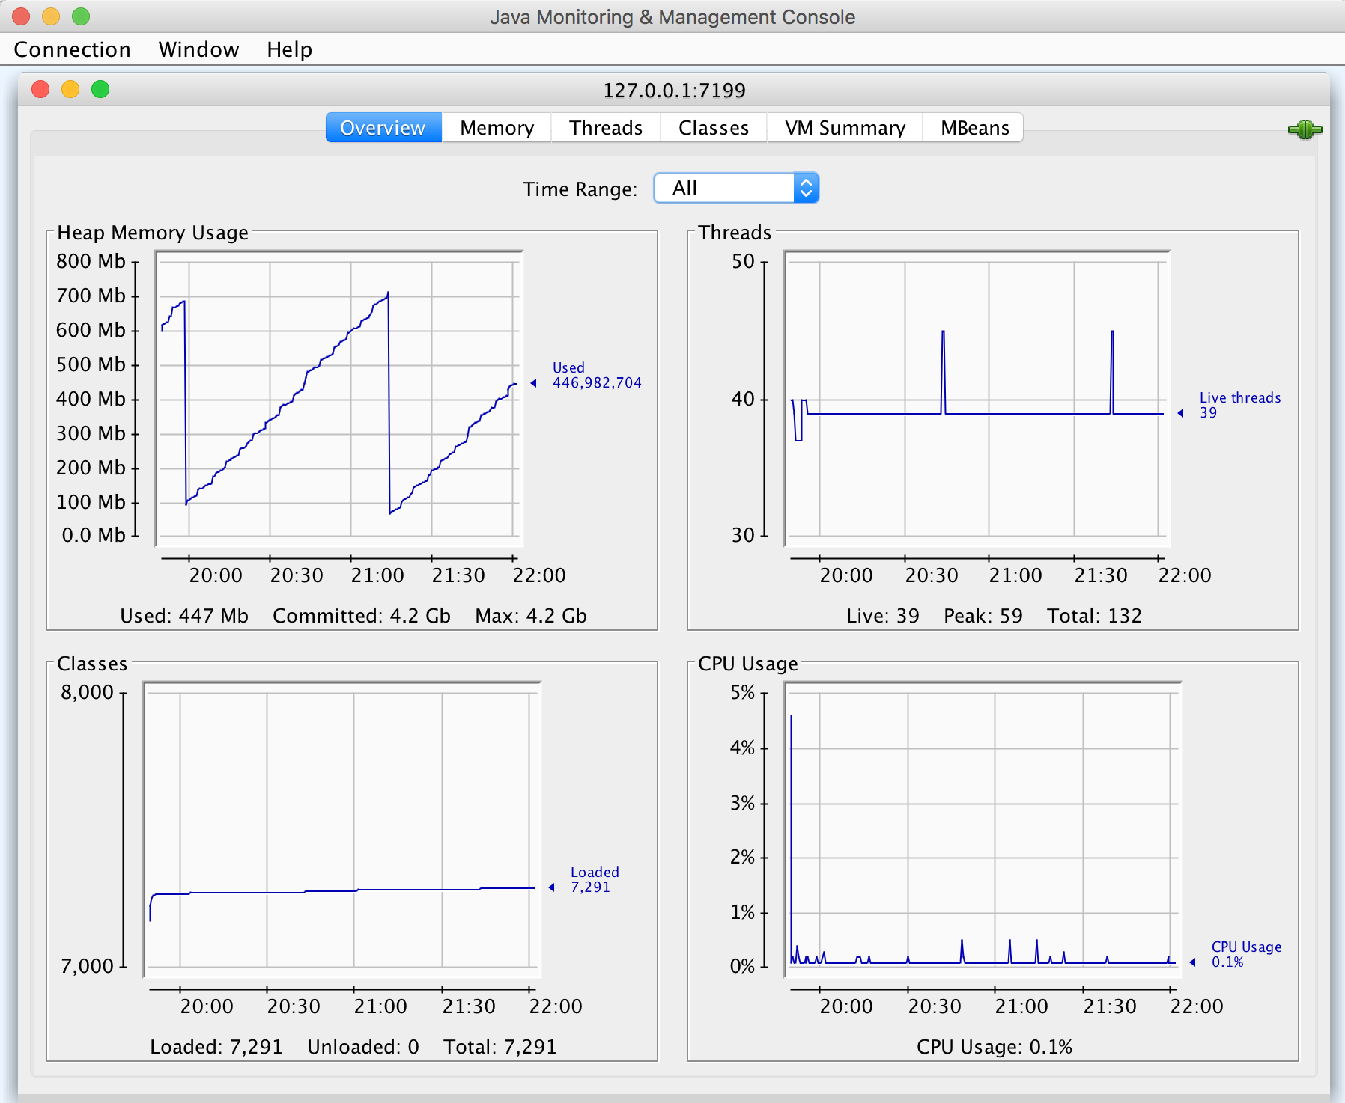
JMX interface
The following shows an of JConsole:
Notes:
Figure : JConsole overview
Once a connection is successfully established, the Overview tab will be the homepage. It contains a view of key metrics for resources being utilized by the Java process, with more details under each tab for each corresponding metric.

Slide 364
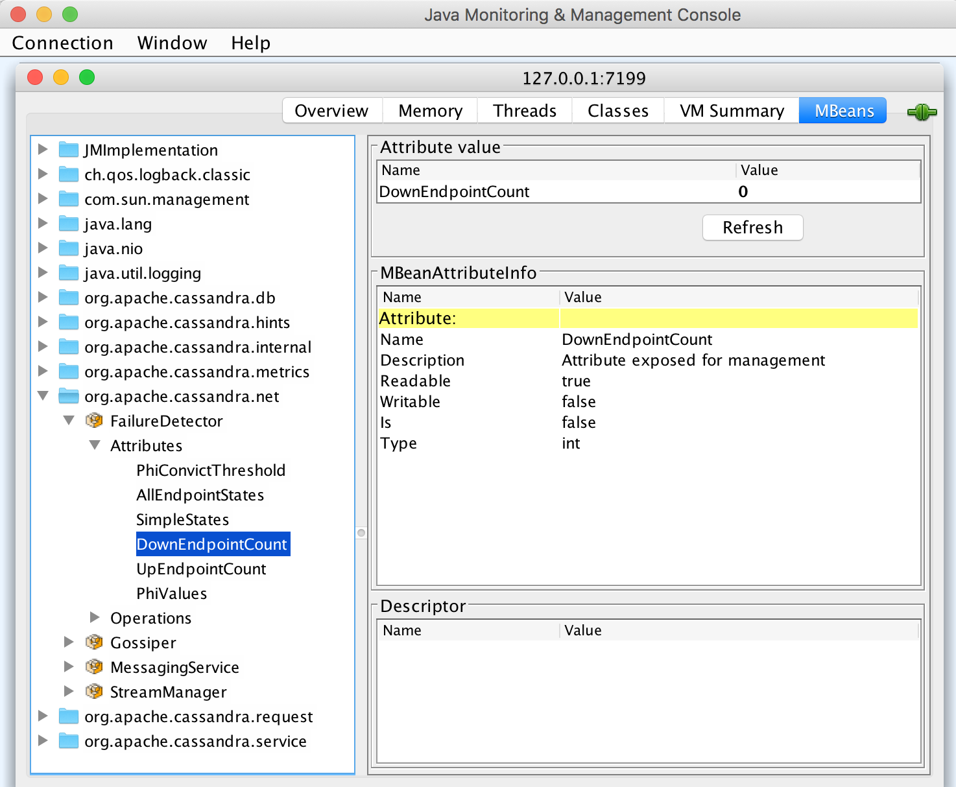
JMX interface
Viewing metrics
Notes:
The MBeans tab contains all the packages exposed by Cassandra, along with some Java-related packages exposed by default for any Java process. You can navigate to any of the nested methods to get a value of an attribute. In the following screenshot, theDownEndpoint metric can be viewed through org.apache.Cassandra.net | FailureDetector | Attributes | DownEndpointCount, which gives a count of the number of nodes that are down. Which is your favorite metric in Cassandra?

Slide 365
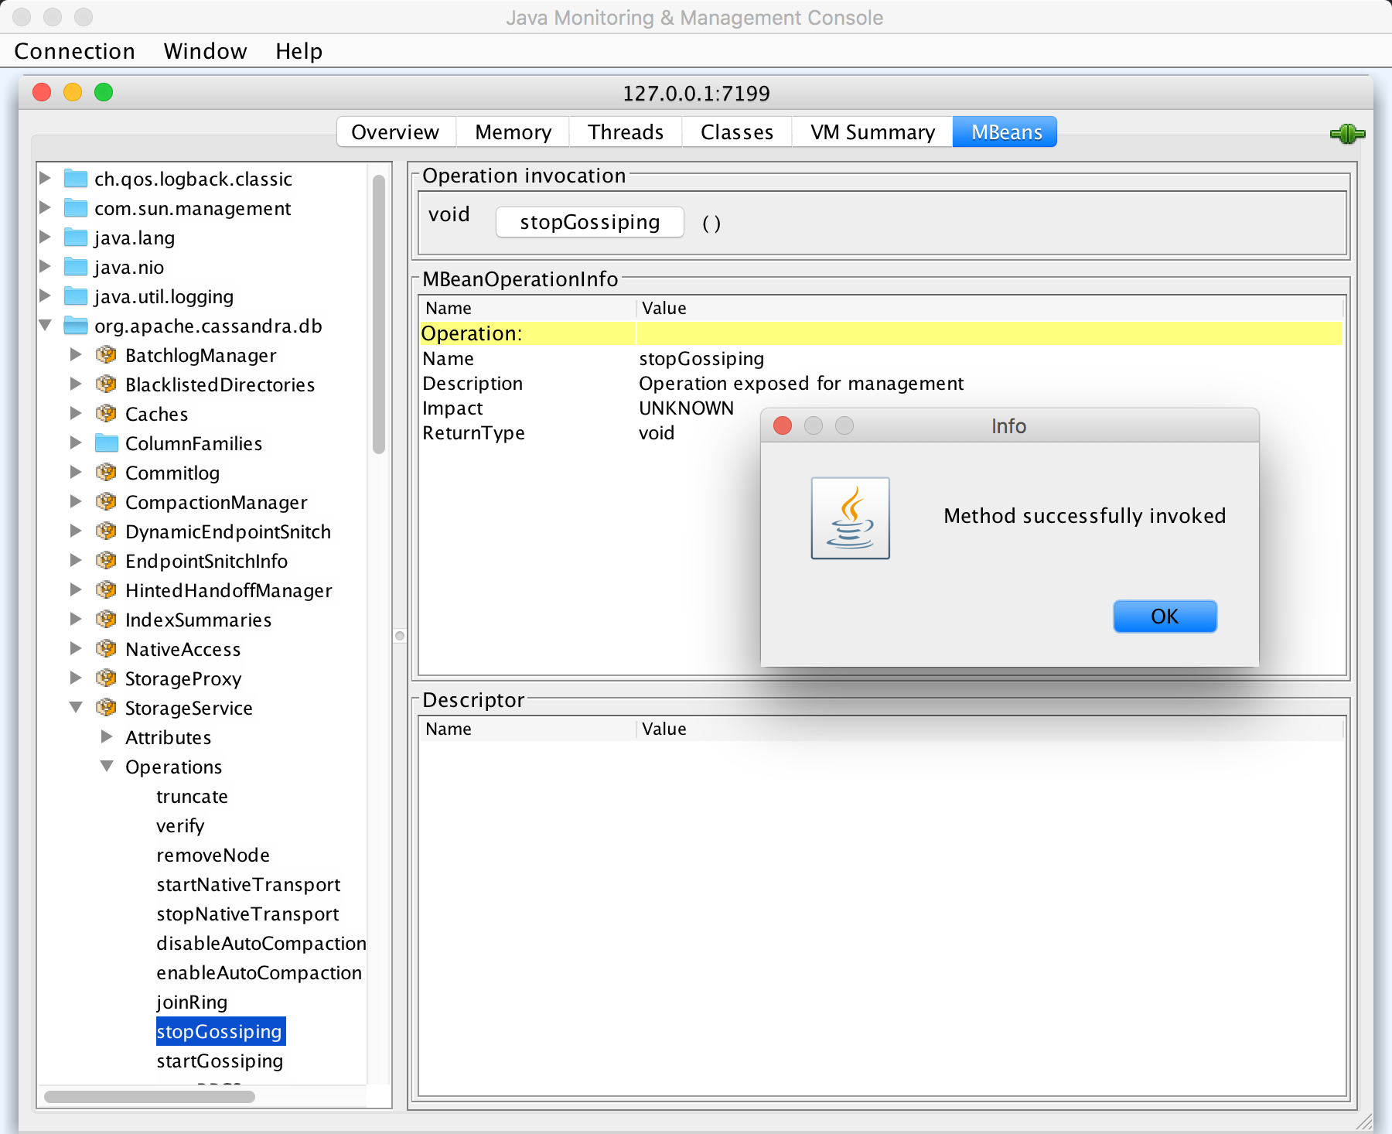
JMX interface
Which is your most-used operation for Cassandra?
Notes:
Performing an operation
Instead of just getting a value for an attribute, you can perform an operation even without logging in to the server. This is the reason why we would recommend using JMX authentication/SSL, as the JMX port will be wide open. For example, you can invoke the stopGossiping operation from org.apache.Cassandra.db | StorageService | Operations | stopGossiping, which stops gossiping to other nodes.

Slide 366
JMX interface
Connection and domains
Download the JMXTerm jar from http://wiki.cyclopsgroup.org/jmxterm/download.html, then invoke JMXTerm from the CLI.
Once you run the following command, Java just provides an interface to interact through JMX.
This allows youto create a connection to the desired IP and port
Notes:
JMXTerm (CLI)
Unlike JConsole, JMXTerm is a command-line utility for any Java process with the JMX interface to view metrics and perform operations to manage applications. It's just a command-line tool, similar to JConsole, with an exception of graphical user interface. Refer to the JMXTerm docs for further information atApache-Confluence: JMXTerm Quick start: https://cwiki.apache.org/confluence/display/KAFKA/jmxterm+quickstart.

Slide 367
JMX interface
If Cassandra is running on my local, 127.0.0.1:7199 can be used where JMX authentication and SSL are disabled on Cassandra:
java -jar <absolutePath>/jmxterm-1.0.0-uber.jar
open <IP>:7199

Slide 368
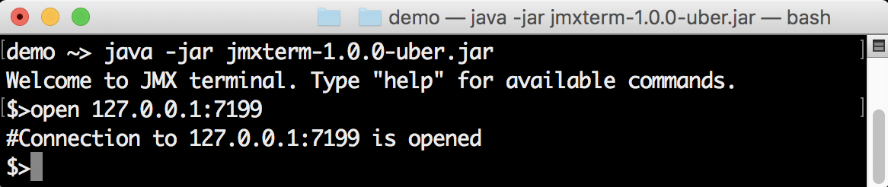
JMX interface
The preceding command will give the following output:

Slide 369
JMX interface
The domains command gives all the MBean packages exposed by Cassandra, along with any Java-related packages exposed by default for any Java process:
domains

Slide 370
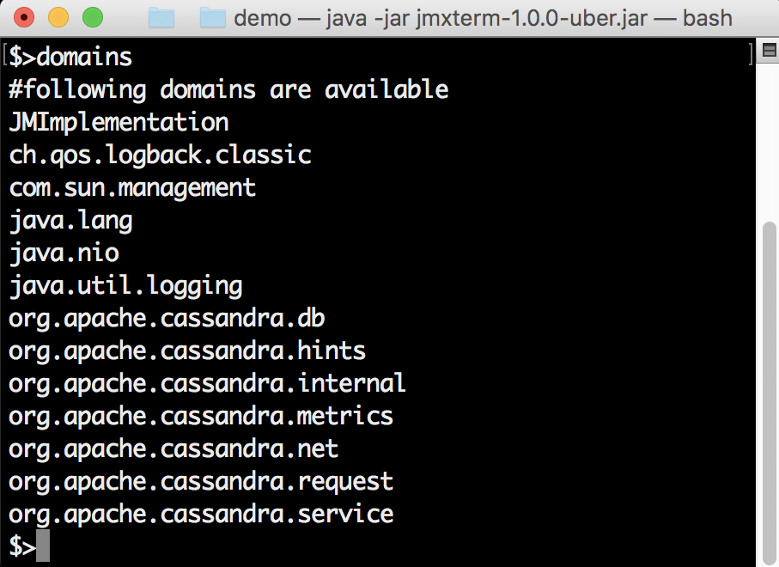
JMX interface
The output of the domains command is as follows:

Slide 371
JMX interface
Getting a metric
Which is your most-used metric in Cassandra?
get -b org.apache.cassandra.net:type=FailureDetector DownEndpointCount
Notes:
To get a metric, such asDownEnpointCount in the org.apache.Cassandra.net package, the get command can be used as follows. This gives a count of nodes that are down via the CLI, which in turn can be used for alerting through a cron job.

Slide 372
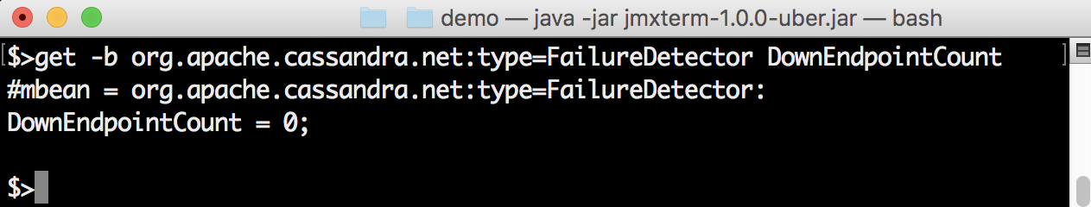
JMX interface
The output of the preceding command is as follows:

Slide 373
JMX interface
Performing an operation
Performing an operation is also possible through JMXTerm.
For example, you can invoke thestopGossiping operation under the org.apache.Cassandra.db package using the following run command.
This stops gossiping to other nodes. Which is your favorite operation on Cassandra?
run -b org.apache.cassandra.db:type=StorageService stopGossiping

Slide 374
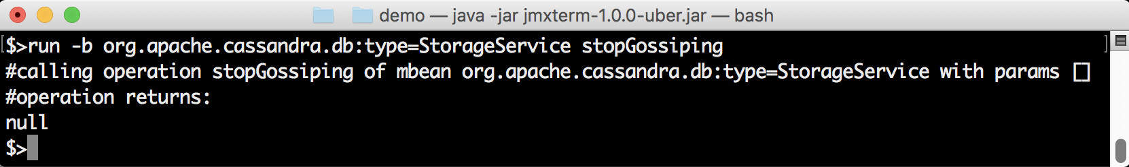
JMX interface
The output of the preceding command is as follows:

Slide 375
JMX interface
Instead of the interactive CLI, you can run a list of commands using a file, as follows:
echo-e"open <IP>:7199\nrun -b org.apache.cassandra.db:type=StorageService forceTerminateAllRepairSessions\nclose">jmxcommands
java -jar<absolutePath>/jmxterm-1.0.0.-uber.jar -v silent -n < jmxcommands
Notes:
Stopping a running repair process is similar on any production node. But invoking the preceding kind of operation would gracefully stop the repair process without restarting Cassandra. This can be used at the start of business hours to reduce the impact of a repair process.

Slide 376
The nodetool utility
Running a nodetool command remotely is very helpful as it wouldn't require SSH.
But at the same time, it would be more prone to a security risk if endpoints are wide open to the public.
The remote command can be triggered with the -h parameter through nodetool:
$CASSANDRA_HOME/bin/nodetool -h <ipAddress of host> ring
Notes:
Nodetool is an inbuilt CLI utility tool by Apache Cassandra for monitoring and managing Cassandra clusters. It even includes the ability to trigger commands on a remote node, as long as remote JMX has been enabled along with the required firewalls.
Based on the kind of installation, nodetool can be found in corresponding bin directories. Refer to the nodetool docs for further informationat Apache-Cassandra: Nodetool Usage: http://Cassandra.apache.org/doc/4.0/tools/nodetool/nodetool.html.

Slide 377
The nodetool utility
Monitoring using nodetool
Monitoring Apache Cassandra clusters using nodetool has multiple parameters that can be passed based on the use case through the CLI.
This is very good for checking on a single node, but when there are more nodes, it's hard to keep track of this setup across all nodes, as it is a tedious process.
Notes:
The following are the most popular nodetool commands.

Slide 378
The nodetool utility
describecluster
As name suggests, it gives details about name of the cluster, the snitching type, the partitioner type, schema version, and the dynamic endpoint snitch flag.
The schema version will display all the nodes along with nodes that have any schema version mismatches between nodes, resulting in an easier way of identifying faulty nodes:
$CASSANDRA_HOME/bin/nodetool describecluster

Slide 379
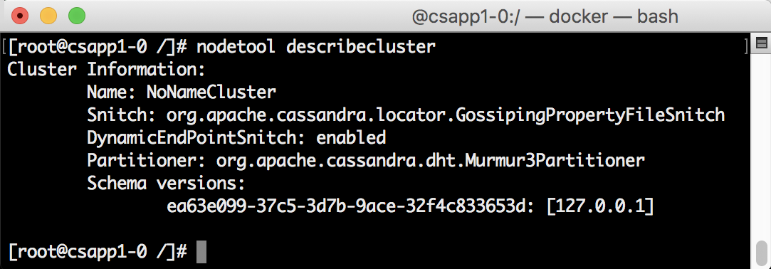
The nodetool utility
The output of the preceding command is as follows:

Slide 380
The nodetool utility
Gcstats
This displays key garbage-collection statistics for the Apache Cassandra JVM and those stats are related to garbage collection, which have run since the last time thenodetool gcstatscommand was executed:
$CASSANDRA_HOME/bin/nodetool gcstats

Slide 381
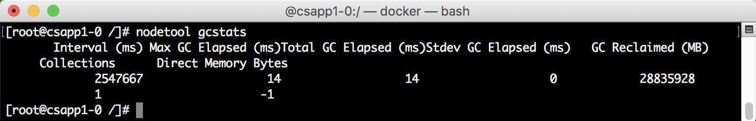
The nodetool utility
The output of the preceding command is as follows:

Slide 382
The nodetool utility
getcompactionthreshold
This provides minimum and maximum thresholds for compaction on a table in a keyspace.
This can be configured, but would require a restart of Cassandra for that config to be reflected.
This can also be increased using setcompactionthreshold, but it would be reset when Cassandra is restarted.
But it can be used as a quick fix during issues with nodes or while bootstrapping a node:
$CASSANDRA_HOME/bin/nodetool getcompactionthreshold <keyspaceName> <tableName>

Slide 383
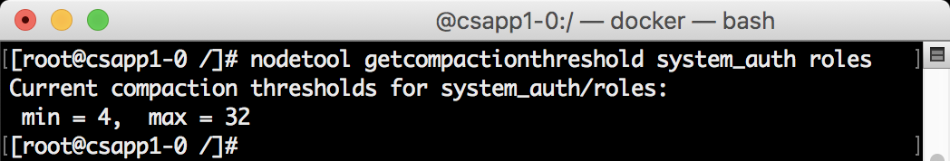
The nodetool utility
The output is as follows:

Slide 384
The nodetool utility
getcompactionthroughput
This provides the current throughput for all compactions, irrespective of the table and keyspace.
This can be configured but would require a restart of Cassandra for that config to be reflected.
This can also be increased usingsetcompactionthroughput, but it would be reset when Cassandra is restarted, so it can be used as a quick fix during issues with nodes or while bootstrapping a node:
$CASSANDRA_HOME/bin/nodetool getcompactionthroughput

Slide 385
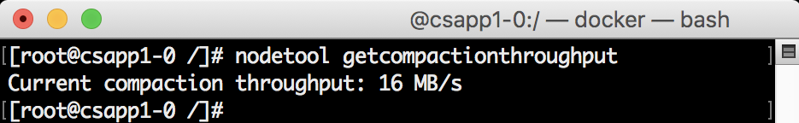
The nodetool utility
The output is as follows:

Slide 386
The nodetool utility
Getconcurrentcompactors
This provides the number of possible concurrent compactions for Cassandra.
This can be configured, but would require a restart of Cassandra for that config to be reflected.
This can also be increased usingsetconcurrentcompactors, but it will also be reset when Cassandra is restarted.
It can be used as a quick fix during issues with nodes or while bootstrapping a node:
$CASSANDRA_HOME/bin/nodetool getconcurrentcompactors

Slide 387
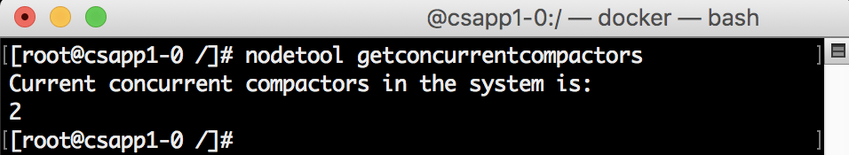
The nodetool utility
The output of the preceding command is as follows:

Slide 388
The nodetool utility
Getendpoints
This provides all the endpoints owned by a partition key for a table in a keyspace across the Cassandra cluster.
During inconsistencies across a Cassandra cluster, it provides an easier way to find a faulty node for random partitions by checking theLOCAL_ONEconsistency on all those replicas, and resolve the issue by running a repair only on that node or datacenter:
$CASSANDRA_HOME/bin/nodetool getendpoints <keyspaceName> <tableName> <partitionKey>

Slide 389
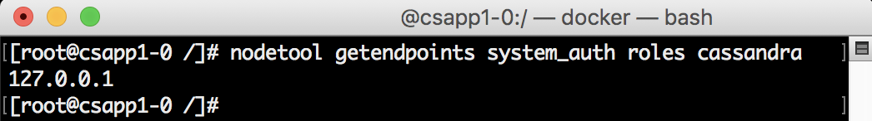
The nodetool utility
The output of the preceding command is as follows:

Slide 390
The nodetool utility
getlogginglevels
This provides all the logging levels set for the current Cassandra node.
This can be configured, but would require a restart of Cassandra for that config to be reflected.
It can also be increased usingsetlogginglevel, but it would be reset when Cassandra is restarted, so it can be used as a quick fix during issues with nodes or while troubleshooting a node:
$CASSANDRA_HOME/bin/nodetool getlogginglevels

Slide 391
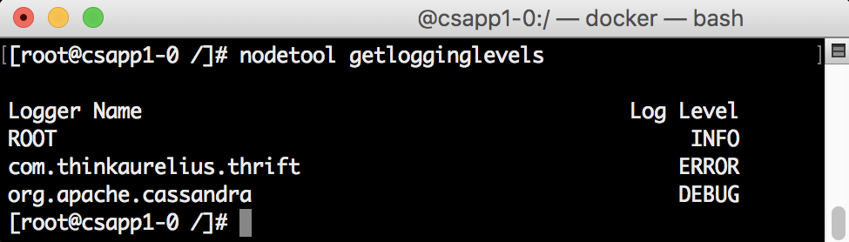
The nodetool utility
The output of the preceding code is as follows:

Slide 392
The nodetool utility
getstreamthroughput
This provides the Mbps (megabits per second) limit for any streaming on the current Cassandra node.
This can be configured, but would require a restart of Cassandra for that config to be reflected.
It can also be increased usingsetsteamthroughput, but it would be reset when Cassandra is restarted, so it can be used as a quick fix during issues with node or while bootstrapping a node:
$CASSANDRA_HOME/bin/nodetool getstreamthroughput

Slide 393
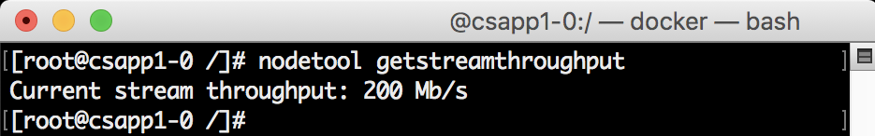
The nodetool utility
The output of the preceding command is as follows:

Slide 394
The nodetool utility
gettimeout
This provides the timeout in milliseconds for read, range, write, counterwrite, cascontention, truncate, steamingsocket, and rpc on the current Cassandra node.
This can be configured, but would require a restart of Cassandra for that config to be reflected.
This can also be increased usingsettimeout, but it would be reset when Cassandra is restarted.
However, it can be used as a quick fix during issues with nodes or while bootstrapping a node:
$CASSANDRA_HOME/bin/nodetool gettimeout <timeoutType>

Slide 395
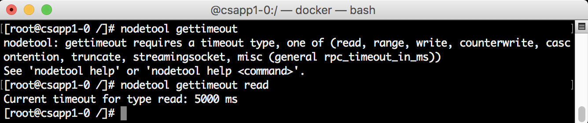
The nodetool utility
The output of the preceding code is as follows:

Slide 396

The nodetool utility
Gossipinfo
This provides all the gossip information for a Cassandra node, and contains the status, load, schema version, dc, rack, Cassandra version, listen, and RPC addresses:
$CASSANDRA_HOME/bin/nodetool gossipinfo

Slide 397
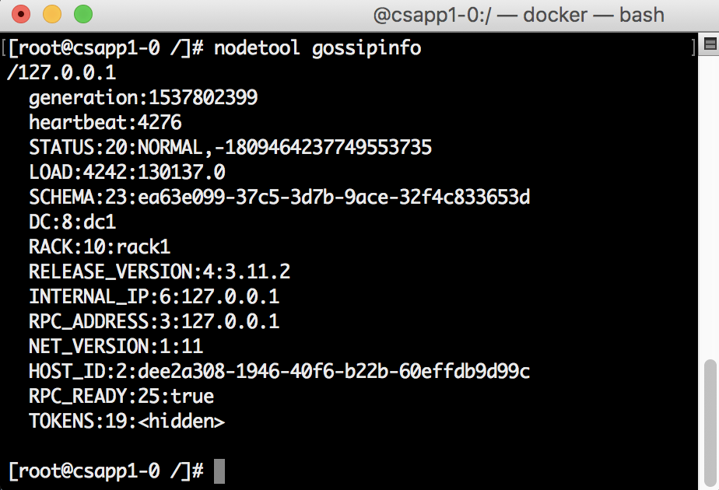
The nodetool utility
The output of the preceding code is as follows:

Slide 398
The nodetool utility
Info
This provides all the internal information of a Cassandra node, and contains ID, gossip, thrift, native transport, and other statuses, along with key and row-cache details:
$CASSANDRA_HOME/bin/nodetool info

Slide 399
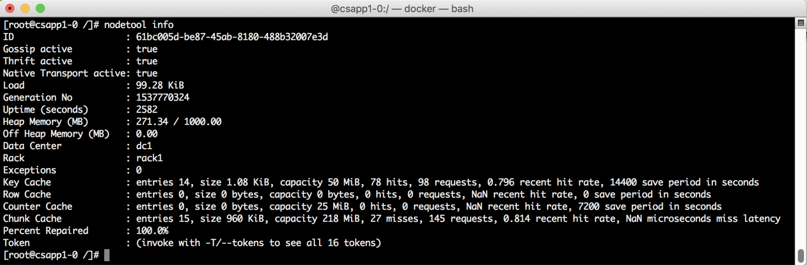
The nodetool utility
The output of the preceding code is as follows:

Slide 400
The nodetool utility
Netstats
This provides all network information for a Cassandra node, and contains Mode, Large messages, Small messages, Gossip messages that are Active, Pending, Completed, and Dropped:
$CASSANDRA_HOME/bin/nodetool netstats

Slide 401
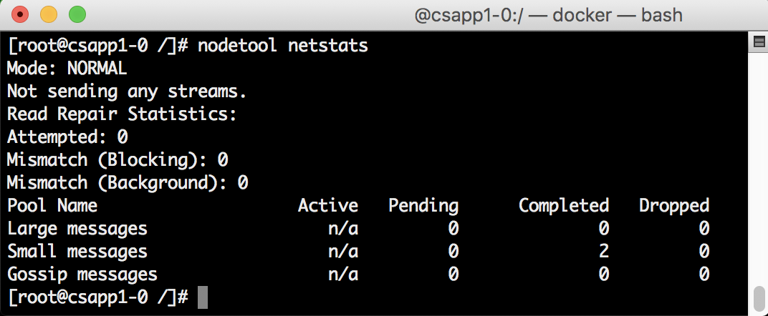
The nodetool utility
The output is as follows:

